Slide 1
Trustworthy Autonomy Lecture 9
Bineet Ghosh
bineet@ua.edu
Notes:
Posted grades
Project – as a paper
Learning Dynamics, using RL. Then bettering the model using few online logs.
Misclassification using Statistical Methods.
Encourage you to think about topics too.
You two wanna do it together?
The Masters student
We all can do it together, as one submission.

Slide 2
Complexity of these algorithms?
If there are $n$ variables, then the time taken is $O\left(2^{n}\right)$
Can we do better in theory? Is it so in practice?
In Theory: unlikely because checking satisfiability of Boolean formulas SAT is NP–Complete. If you can prove P = NP (or otherwise) then you will become rich and famous.
In practice: Yes, SAT is in many practical instances solved very quickly by many modern day SAT solvers.
Formulas with 1000s of variables are solved in seconds.
Key idea: Apply heuristics, mainly DPLL algorithm

Slide 3
Other ways?
Natural Deduction – Apply a set of rules to come to a logical conclusion

Slide 4
What Is Truth (in prop. logic)
One of the rules: Natural deduction. (A proof system for propositional logic)
An inference has two things: premise and conclusions.
Inference rules tells us what can be inferred from a given set of premises.
A proof is a sequence of application of inference rules that leads us from the premise to conclusion
Notes:
Truth: Given a premise, apply rules to natural deduction to come to conclusion. That is what is truth.
Given \phi_i’s, what can I infer. Say we have rules, \phi_i, \phi_j, \phi_k.
MP, A->B, A => B

Slide 5
Natural Deduction
One set of proof rules for propositional logic.
Notes:
* These are some rules, that will help us to arrive at new (true) formulas, from a set of given formulas (i.e., premise)

Slide 6
Natural Deduction
One set of proof rules for propositional logic.

Slide 7
Natural Deduction
One set of proof rules for propositional logic.

Slide 8
Natural Deduction (contd.)
More rules

Slide 9
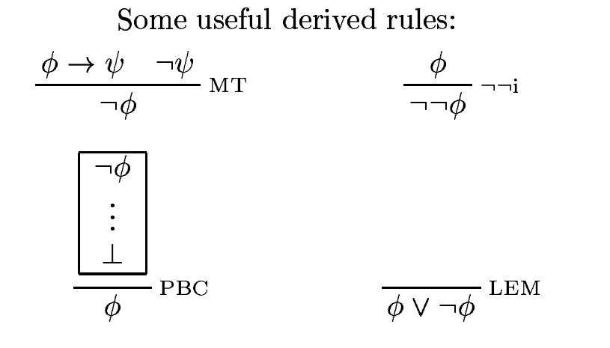
Natural Deduction
Even more rules
Notes:
PBC: Proof by contradiction
LEM: Law of excluded middle
The earliest known formulation is in Aristotle's discussion of the principle of non-contradiction, first proposed in On Interpretation,^{[4]} where he says that of two contradictory propositions (i.e. where one proposition is the negation of the other) one must be true, and the other false.

Slide 10
Revisit
If you are given premises $p$ and $q$, using the $∧$ introduction, you can infer $p∧q$, using $∨$ introduction you can infer $p∨q$.
Seems obvious, but on careful inspection, it isn’t.
If $ψ$ can be inferred from $φ_{1}, φ_{2},…, φ_{n}$ then we write $φ_{1}, φ_{2}, …, φ_{n}⊢ψ$

Slide 11
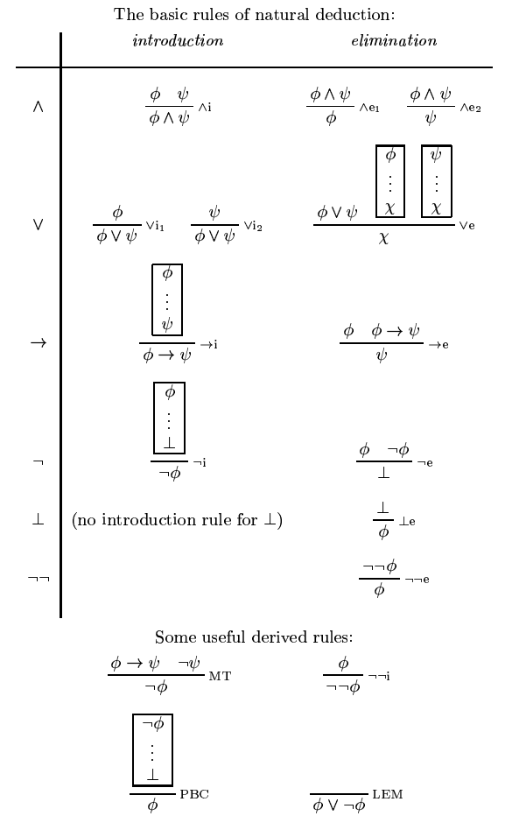
All of natural deduction

Slide 12
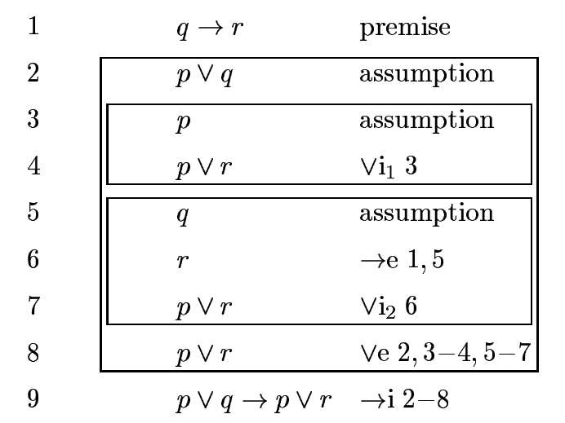
Examples
$q→r⊢p∨q→p∨r$
Notes:
If (p \lor q) is F, it’s trivially true.
What about (p \lor q) is T?

Slide 13
Examples
$\left(p∨q\right)∨r⊢p∨(q∨r)$ Obvious! Isn’t it?

Slide 14
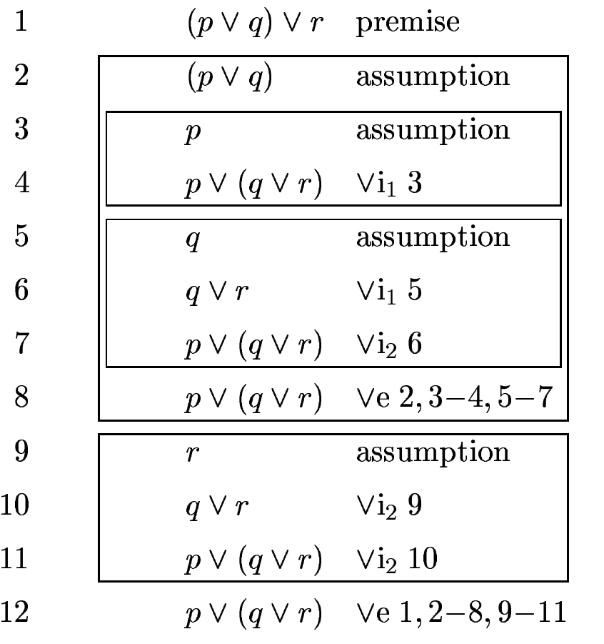
Examples
$\left(p∨q\right)∨r⊢p∨(q∨r)$ Not so much!

Slide 15
One More Example
$p∧\left(q∨r\right)⊢\left(p∧q\right)∨(p∧r)$

Slide 16
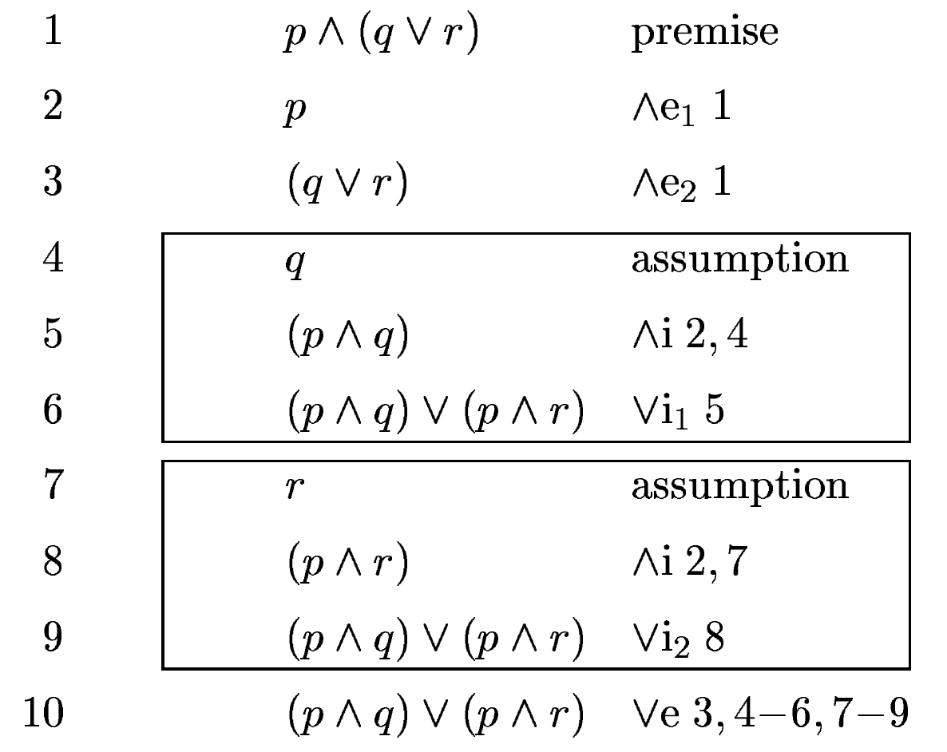
One More Example
$p∧\left(q∨r\right)⊢\left(p∧q\right)∨(p∧r)$

Slide 17
Other Proof Systems
Are there other proof systems other than natural deduction?
Yes, the first proof system is called Frege’s proof system by Gottlob Frege in 1879.

Slide 18
Inference and Tautologies
A formula $ψ$ is called a tautology if $∅⊢ψ$. That is, you don’t need any premise to prove a tautology.

Slide 19
Connection between inference and semantic entailment.
What happened to all the truth tables. Tautologies, contradictions, semantic entailment.
The proof system is equivalent to all the truth tables.
Difference between
$φ_{1}, φ_{2}, …, φ_{n}⊨ψ$ and $φ_{1}, φ_{2}, …, φ_{n}⊢ψ$
Natural deduction is sound, i.e., whatever you infer from natural deduction can be proved using truth tables.
Natural deduction is complete, i.e., whatever can be proved using truth tables, can be proved using proof rules.

Slide 20
Soundness and completeness
Natural deduction is sound, i.e., whatever you infer from natural deduction can be proved using truth tables.
Natural deduction is complete, i.e., whatever can be proved using truth tables, can be proved using proof rules.
Notes:
Soundness: A⊢B⇒A⊨B
Completeness: A⊨B⇒A⊢B

