Slide 1
Trustworthy Autonomy Lecture 8
Bineet Ghosh
bineet@ua.edu

Slide 2
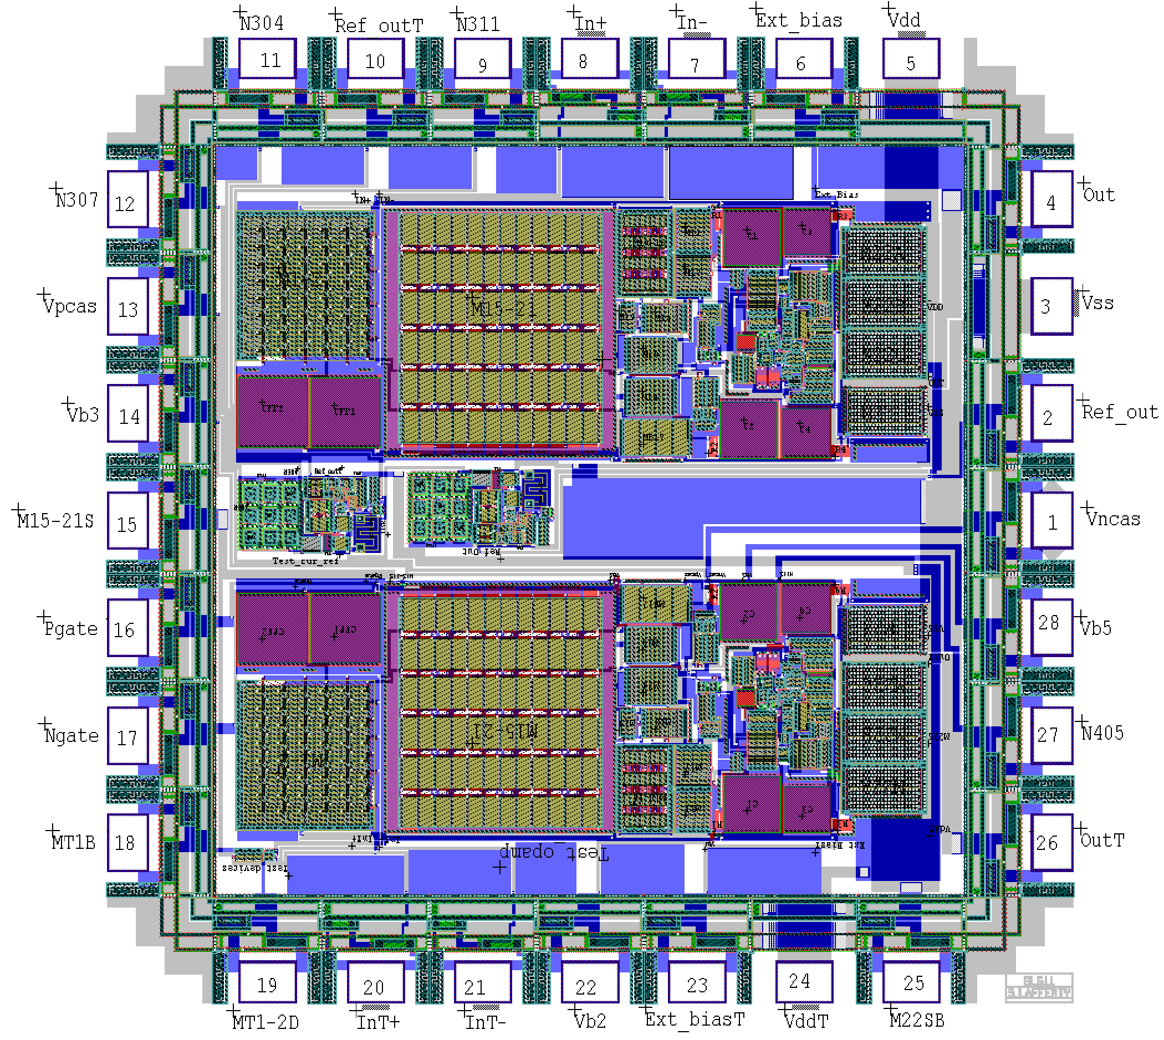
Example 2: Reachability Verification
Hardware chip designed using some complex logic.
Computation: Sequence of inputs, Sequence of Outputs
Proving that the computation is “correct”.

Slide 3
Example 2: Reachability Verification
What do you mean correct? One of the outputs should not be set to true for 5 steps starting from an initial input.
Lets formalize this
$\overline{i}$ is for inputs
$\overline{x}$ is for internal variables
$\overline{o}$ is for outputs
Circuit – transition relation from $\overline{x}$ to $\overline{x}′$ for given input $\overline{i}$ leads to input $\overline{o}$ given as $C(\overline{i},\overline{x},{\overline{x}}^{′},\overline{o})$
Input sequence ${\overline{i}}_{1},{\overline{i}}_{2},{\overline{i}}_{3},{\overline{i}}_{4},{\overline{i}}_{5}$, similarly with computational sequence and output sequence
Notes:
l_1,x_1 ->

Slide 4
Safety Of Circuits
Initial input and state $φ\left({\overline{i}}_{1}\right), χ({\overline{x}}_{1})$.
Safety of output $ψ({\overline{o}}_{i})$
Encoding safety as SAT solving:
$φ\left({\overline{i}}_{1}\right)∧χ\left({\overline{x}}_{1}\right)∧C\left({\overline{i}}_{1},{\overline{x}}_{1},{\overline{x}}_{2},{\overline{o}}_{1}\right)∧C\left({\overline{i}}_{2},{\overline{x}}_{2},{\overline{x}}_{3},{\overline{o}}_{2}\right)∧…⇒$
$ψ\left({\overline{o}}_{2}\right)∧ψ\left({\overline{o}}_{2}\right)∧ψ\left({\overline{o}}_{3}\right)∧ψ\left({\overline{o}}_{4}\right)∧ψ\left({\overline{o}}_{5}\right)$
Science behind most hardware verification tools like Synopsis, Cadence, and others. Of course, there is a lot of engineering.
Can be applied for discrete systems as well.

Slide 5
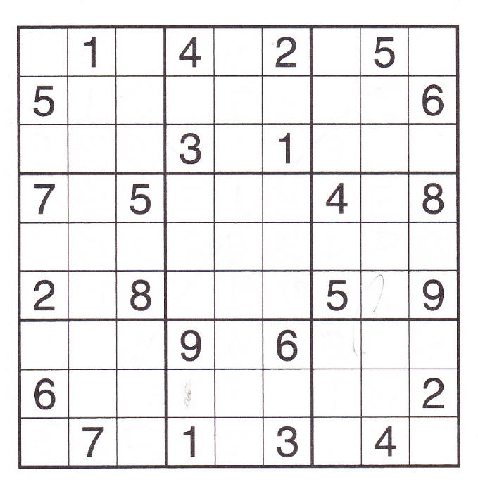
Propositional Logic And Sudoku
Solving Sudoku using SAT solvers?
Rules:
Every row has 1–9.
Every column has 1–9.
Every marked 3x3 square has 1–9.
No number is repeated in row, column, or square.
How to solve?

Slide 6
4 Coloring using SAT
a
Four colors R, B, G, Y
For each vertex create 4 variables
$a_{00}=⊤$ iff a is colored R
$a_{01}=⊤$ iff a is colored B
$a_{10}=⊤$ iff a is colored G
$a_{11}=⊤$ iff a is colored Y
Encode graph constraints
$\left[a_{00}→\left(¬a_{01}∧¬a_{10}∧¬a_{11}\right)\right]∧…$ Unique color to each vertex
${[a}_{00}→¬b_{00}∧¬d_{00}∧¬c_{00}]∧…$ Adj. vertices have diff. colors
b
d
c
e
f
g
Notes:
Can you have multiple colors on a vetex (stupid question? Not when doing logic)
If a is RED – it cannot have any other colors.
Repeat the same
for other colors,
and other vertices
Adjacent vertices have different colors
Repeat the same
for other colors,
and other vertices

Slide 7
Propositional Logic And Sudoku
Solving Sudoku using SAT solvers?
Rules:
Every row has 1–9.
Every column has 1–9.
Every marked 3x3 square has 1–9.
No number is repeated in row, column, or square.
How to solve?
Notes:
a_i,j,v = T, iff a_ij has value v
\forall_and_i \forall_and_j \forall_or_v aijv

Slide 8
Algorithms for: Tautology, Contradiction, and Satisfiability
Given a formula $φ$ how to check if it is a tautology?
Compute the truth table for the formula and see if all the rows evaluate to True.
How to check if it is a contradiction?
See if all the rows in truth table evaluates to false.
How to check it is satisfiable?
Same thing.

Slide 9
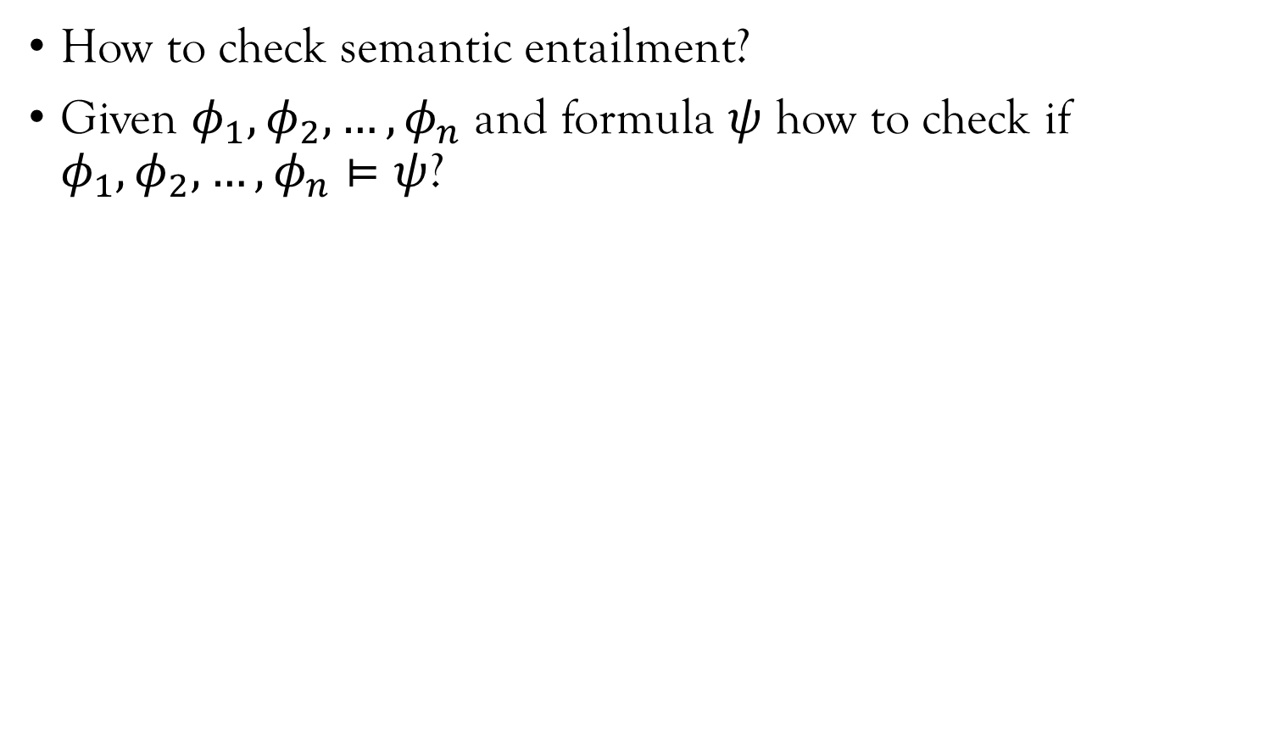
Algorithms for: Semantic Entailment
How to check semantic entailment?
Given $φ_{1}, φ_{2}, …, φ_{n}$ and formula $ψ$ how to check if $φ_{1}, φ_{2}, …, φ_{n}⊨ψ$?

Slide 10
Algorithms for: Semantic Entailment
How to check semantic entailment?
Given $φ_{1}, φ_{2}, …, φ_{n}$ and formula $ψ$ how to check if $φ_{1}, φ_{2}, …, φ_{n}⊨ψ$?
Same thing as before?
Compute truth tables of $φ_{i}$ and $ψ$.
Collect all rows of truth tables when all the $φ_{i}$s are true.
Check that $ψ$ is true for these rows.

Slide 11
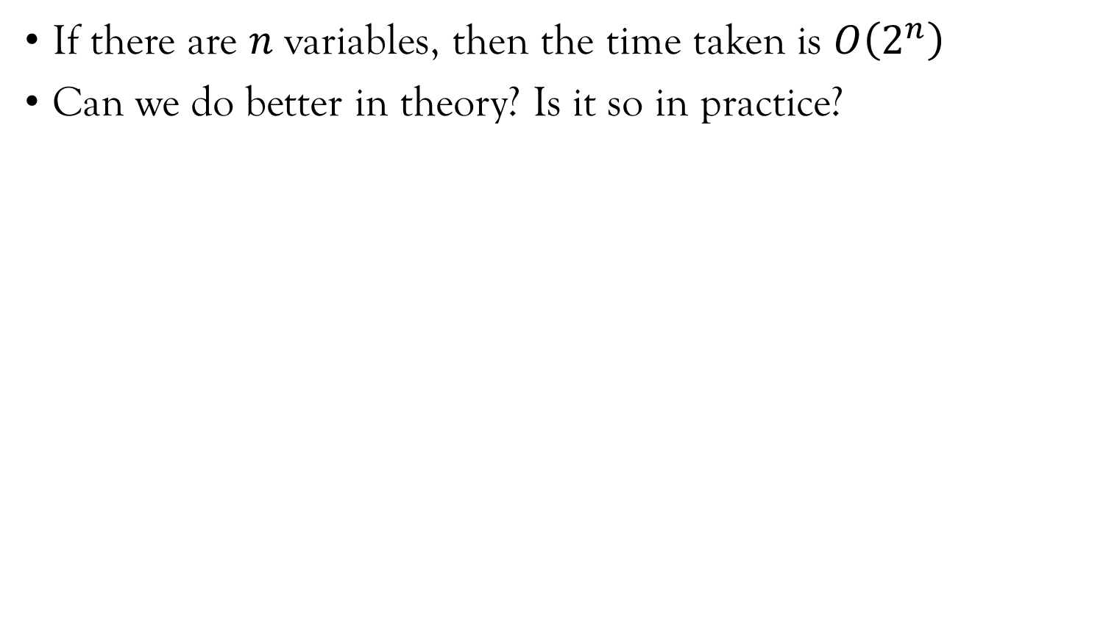
Complexity of these algorithms?
If there are $n$ variables, then the time taken is $O\left(2^{n}\right)$
Can we do better in theory? Is it so in practice?

Slide 12
Complexity of these algorithms?
If there are $n$ variables, then the time taken is $O\left(2^{n}\right)$
Can we do better in theory? Is it so in practice?
In Theory: unlikely because checking satisfiability of Boolean formulas SAT is NP–Complete. If you can prove P = NP (or otherwise) then you will become rich and famous.

Slide 13
Complexity of these algorithms?
If there are $n$ variables, then the time taken is $O\left(2^{n}\right)$
Can we do better in theory? Is it so in practice?
In Theory: unlikely because checking satisfiability of Boolean formulas SAT is NP–Complete. If you can prove P = NP (or otherwise) then you will become rich and famous.
In practice: Yes, SAT is in many practical instances solved very quickly by many modern day SAT solvers.
Formulas with 1000s of variables are solved in seconds.
Key idea: Apply heuristics, mainly DPLL algorithm (will be discussed later in this course)

Slide 14
Other ways?
Natural Deduction – Apply a set of rules to come to a logical conclusion

Slide 15
What Is Truth (in prop. logic)
One of the rules: Natural deduction. (A proof system for propositional logic)
An inference has two things: premise and conclusions.
Inference rules tells us what can be inferred from a given set of premises.
A proof is a sequence of application of inference rules that leads us from the premise to conclusion
Notes:
Truth: Given a premise, apply rules to natural deduction to come to conclusion. That is what is truth.
Given \phi_i’s, what can I infer. Say we have rules, \phi_i, \phi_j, \phi_k.
MP, A->B, A => B

Slide 16
Natural Deduction
One set of proof rules for propositional logic.

Slide 17
Natural Deduction
One set of proof rules for propositional logic.

Slide 18
Natural Deduction
One set of proof rules for propositional logic.

