Slide 1
Trustworthy Autonomy Lecture 7
Bineet Ghosh
bineet@ua.edu

Slide 2
Propositional Logic
Propositions: variables/statements that can be assigned either true or false.
Which of the following are propositions:
Today is Tuesday.
Look out!
Drilling for oil caused the dinosaurs to become extinct.
How far is the next town?
$x+2=2x$
The space obeys Euclidian geometry.
This sentence if false.

Slide 3
Operations and Inference on propositions
Propositional variables: are assigned either T or F.
Operations: $∧$ (and), $∨$ (or), $¬$ (not), $⇒$ (implies), etc.
Well founded formulas and Truth tables
Notes:
Basic operations in truth table.
AND and OR

Slide 4
Implication
A bit different from “causally” used implication.
If the earth is flat, then the space is made up of 12 dimensional geodesics.
Notes:
Just remember, if A is F, we don’t care about B, and the formula is always T.
See the equivalent formula

Slide 5
Logical Inference
Given a set of well founded formulas that are true, what are the other statements that can be inferred to be true.
Modus Ponens WFFs: If there is smoke, then there should be fire. WFFs: There is smoke. Inference: There is fire.
Modus Tonens WFFs: If there is smoke, then there should be fire. WFFs: There is no fire. Inference: There is no smoke.
Notes:
Revisit the Truth Table of A->B.
And explain A->B

Slide 6
Certificate
Developing verification tools requires some basic mathematical understanding of logic.
The simplest logic is propositional logic.
Logic used extensively in verification.
Model
Continuous
+
Discrete variables
(ODEs + Software)
Verification Tool
Counterexample
Property
(Breaks should be deployed within 3ms)

Slide 7
Propositional Logic
Propositions: Statements/variables that can be assigned True or False.
Well founded formulas: propositional variables, operations $∧, ∨, ¬, →, ↔$.
Syntax: $φ∷= p \left|¬φ | φ∨φ \right| φ∨φ \left| φ→φ \right| φ↔φ$
Association: $¬ > ∧ > ∨ > →$. Also $→$ is right-associative.
Examples:
$p∨(q∧¬r)$
$p→p→p$ is it $p→(p→p)$ or $\left(p→p\right)→p$? Does it matter?
$\left(p→q\right)∧¬(r∨p→q)$
…

Slide 8
Tautologies, Contradictions, and Satisfiable formulas.
Tautology: A formula that always evaluates to True for all values of the propositional variables.
$p∨¬p$
$\left(p→p→p\right)→(p→p→p)$.
$\left(\left(p→q\right)→p\right)→p$
Contradiction: A formula that always evaluates to False for all values of propositional variables.
$p∧¬p$
Satisfiable formulas: At least one valuation is true.
$p∧(r→p)$
…

Slide 9
Homework 1 is due at 11:59pm today!

Slide 10
Equivalent formulas
Two formulas that evaluate to True for the same valuation of propositional variables.
$p∧q≡q∧p$
$p→q≡¬p∨q$
…
Given formulas $φ_{1}, φ_{2}, …, φ_{n}$ we say that $ψ$ semantically entails from the formulas, i.e., $φ_{1}, φ_{2}, …, φ_{n}⊨ψ$ if and only if $ψ$ is true whenever all $φ_{i}$s are true.
Examples
$p→q, p⊨q$
$p→q, ¬q⊨q$
$¬p , ¬q⊨¬(p∨q)$
Notes:
Demonstrate using a Truth Table.
Ask question about two formulas \phi_1(a,b) and \phi_2(a,b)
Give the example of A->B and A’ or B
Show semantic entailment using TT
Exercise

Slide 11
Algorithms for : Tautology, Contradiction, and Satisfiability
Given a formula $φ$ how to check if it is a tautology?

Slide 12
Algorithms for : Tautology, Contradiction, and Satisfiability
Given a formula $φ$ how to check if it is a tautology?
Compute the truth table for the formula and see if all the rows evaluate to True.
How to check if it is a contradiction?

Slide 13
Algorithms for : Tautology, Contradiction, and Satisfiability
Given a formula $φ$ how to check if it is a tautology?
Compute the truth table for the formula and see if all the rows evaluate to True.
How to check if it is a contradiction?
See if all the rows in truth table evaluates to false.
How to check it is satisfiable?
Same thing.

Slide 14
Algorithms for: Semantic Entailment
How to check semantic entailment?
Given $φ_{1}, φ_{2}, …, φ_{n}$ and formula $ψ$ how to check if $φ_{1}, φ_{2}, …, φ_{n}⊨ψ$?

Slide 15
Algorithms for: Semantic Entailment
How to check semantic entailment?
Given $φ_{1}, φ_{2}, …, φ_{n}$ and formula $ψ$ how to check if $φ_{1}, φ_{2}, …, φ_{n}⊨ψ$?
Same thing as before?
Compute truth tables of $φ_{i}$ and $ψ$.
Collect all rows of truth tables when all the $φ_{i}$s are true.
Check that $ψ$ is true for these rows.

Slide 16
Complexity of these algorithms?
If there are $n$ variables, then the time taken is $O\left(2^{n}\right)$
Can we do better in theory? Is it so in practice?

Slide 17
Complexity of these algorithms?
If there are $n$ variables, then the time taken is $O\left(2^{n}\right)$
Can we do better in theory? Is it so in practice?
In Theory: unlikely because checking satisfiability of Boolean formulas SAT is NP–Complete. If you can prove P = NP (or otherwise) then you will become rich and famous.

Slide 18
Complexity of these algorithms?
If there are $n$ variables, then the time taken is $O\left(2^{n}\right)$
Can we do better in theory? Is it so in practice?
In Theory: unlikely because checking satisfiability of Boolean formulas SAT is NP–Complete. If you can prove P = NP (or otherwise) then you will become rich and famous.
In practice: Yes, SAT is in many practical instances solved very quickly by many modern day SAT solvers.
Formulas with 1000s of variables are solved in seconds.
Key idea: Apply heuristics, mainly DPLL algorithm

Slide 19
Where is the core of propositional logic?
Whenever we think of logic, we first think of inference, proofs, and contradictions, not formulas and tautologies.

Slide 20
Why Propositional Logic Is Useful In Formal Methods?
Logic
Certificate
Model
Continuous
+
Discrete variables
(ODEs + Software)
Verification Tool
Counterexample
Property
(Breaks should be deployed within 3ms)

Slide 21
Example: 4 Color Theorem
Given a graph, can it be colored using 4 colors?
Logic
Certificate
Graph
Verification Tool
Counterexample
Property
Whether it is 4 colorable?

Slide 22
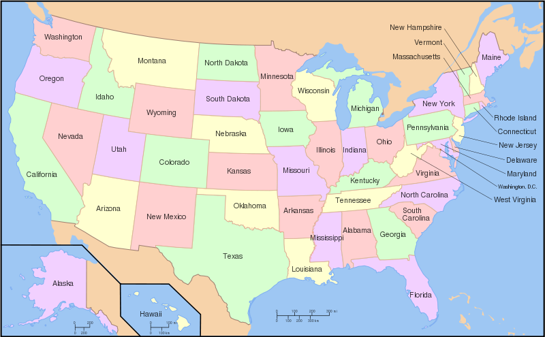
4 Color Theorem: All Planar Graphs Are 4 Colorable.
Proposed in 1852 by Francis Guthrie to De Morgan
“Proved” in 1976 at UIUC by Kenneth Appel and Wolfgang Haken
Proof reduced all the maps to 1936 configurations and each of these configurations is 4 colorable is proved using a computer (took > 1000 hrs).

Slide 23
Is this a planar graph?
Examples of planar graph
Notes:
Can you 4-color it?

Slide 24
Is this 4 colorable?
Examples of planar graph (complete graph)
Notes:
Can you 4-color it?

Slide 25
Is this 4 colorable?
Examples of planar graph

Slide 26
4 Coloring using SAT
a
Four colors R, B, G, Y
For each vertex create 4 variables
$a_{00}=⊤$ iff a is colored R
$a_{01}=⊤$ iff a is colored B
$a_{10}=⊤$ iff a is colored G
$a_{11}=⊤$ iff a is colored Y
Encode graph constraints
$\left[a_{00}→\left(¬a_{01}∧¬a_{10}∧¬a_{11}\right)\right]∧…$ Unique color to each vertex
${[a}_{00}→¬b_{00}∧¬d_{00}∧¬c_{00}]∧…$ Adj. vertices have diff. colors
b
d
c
e
f
g
Notes:
Can you have multiple colors on a vetex (stupid question? Not when doing logic)
If a is RED – it cannot have any other colors.
Repeat the same
for other colors,
and other vertices
Adjacent vertices have different colors
Repeat the same
for other colors,
and other vertices

Slide 27
4 Coloring using SAT
a
Four colors R, B, G, Y
For each vertex create 4 variables
$a_{00}=⊤$ iff a is colored R
$a_{01}=⊤$ iff a is colored B
$a_{10}=⊤$ iff a is colored G
$a_{11}=⊤$ iff a is colored Y
Encode graph constraints
$\left[a_{00}→\left(¬a_{01}∧¬a_{10}∧¬a_{11}\right)\right]∧…$ Unique color to each vertex
${[a}_{00}→¬b_{00}∧¬d_{00}∧¬c_{00}]∧…$ Adj. vertices have diff. colors
What is the size of SAT Formula?
b
d
c
e
f
g
Notes:
How many variables? 6*4

Slide 28
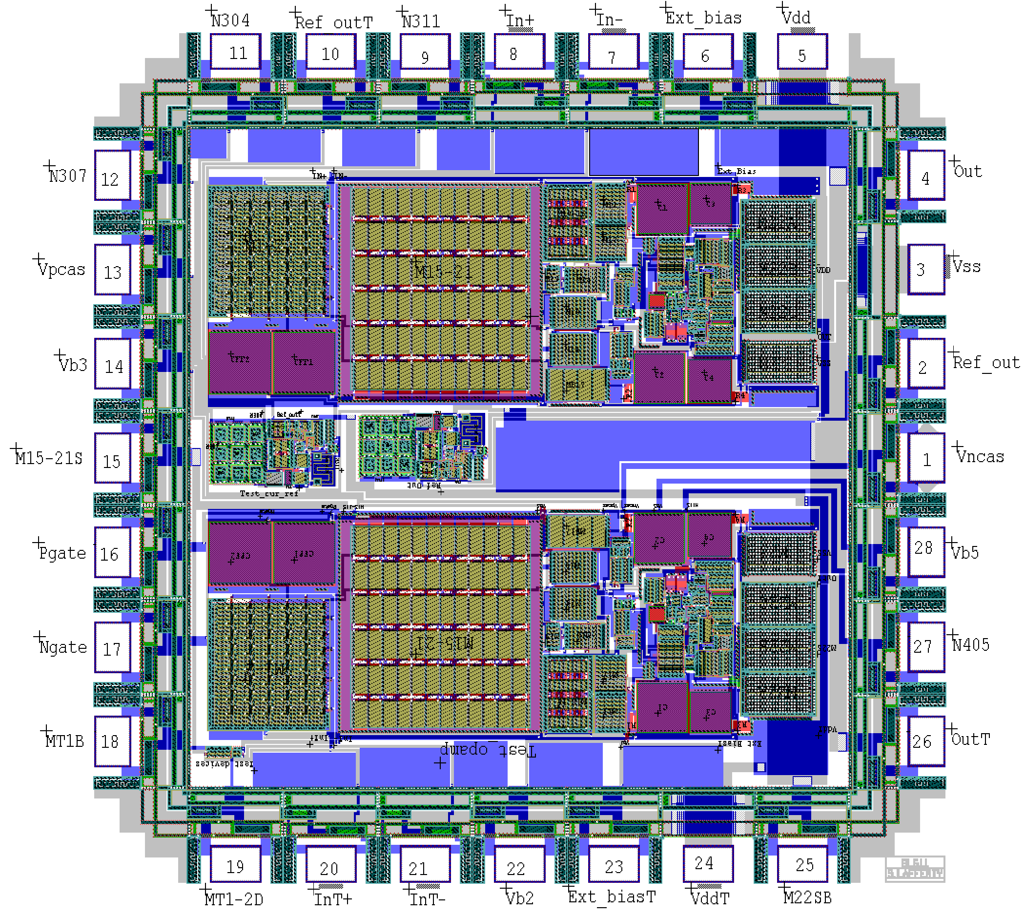
Example 2: Reachability Verification
Hardware chip designed using some complex logic.
Computation: Sequence of inputs, Sequence of Outputs
Proving that the computation is “correct”.

Slide 29
Example 2: Reachability Verification
What do you mean correct? One of the outputs should not be set to true for 5 steps starting from an initial input.
Lets formalize this
$\overline{i}$ is for inputs
$\overline{x}$ is for internal variables
$\overline{o}$ is for outputs
Circuit – transition relation from $\overline{x}$ to $\overline{x}′$ for given input $\overline{i}$ leads to input $\overline{o}$ given as $C(\overline{i},\overline{x},{\overline{x}}^{′},\overline{o})$
Input sequence ${\overline{i}}_{1},{\overline{i}}_{2},{\overline{i}}_{3},{\overline{i}}_{4},{\overline{i}}_{5}$, similarly with computational sequence and output sequence

