Slide 1
Trustworthy Autonomy Lecture 6
Bineet Ghosh
bineet@ua.edu

Slide 2
Interval Arithmetic: Subtraction
$$\left[a,b\right]−\left[c,d\right]=[a−d,b−c]$$

Slide 3
$$t=2$$
$$z\left[t\right]=A⋅z[t−1]$$
$$y$$
$$t=1$$
An interesting property of this system
Compute trajectories from the vertices of the boxes
$$t=0$$
Gives you the set at each time step, without using interval matrices
$$x$$
Notes:
Superposition principle
Number of vertices in a box?
What if the initial set is a circle?

Slide 4
Formal Methods
Formal techniques to ensure safety in systems
Notes:
Formal techniques? Is C/Python Code?
Systems?

Slide 5
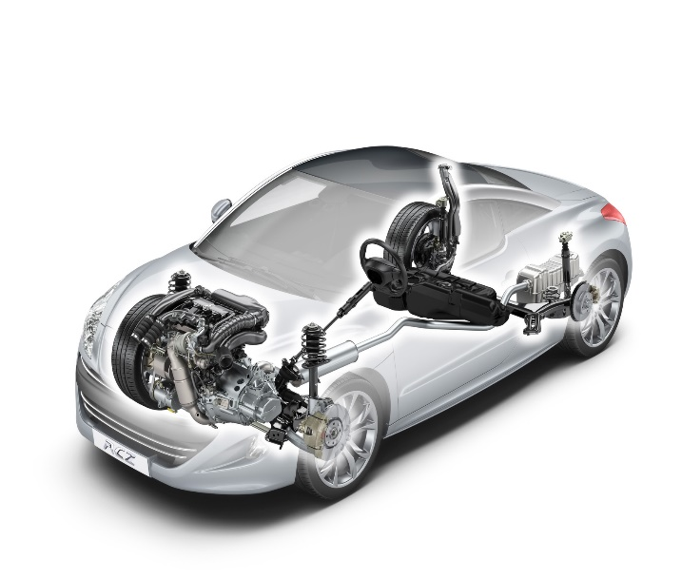
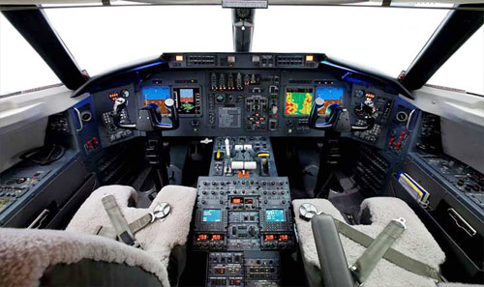
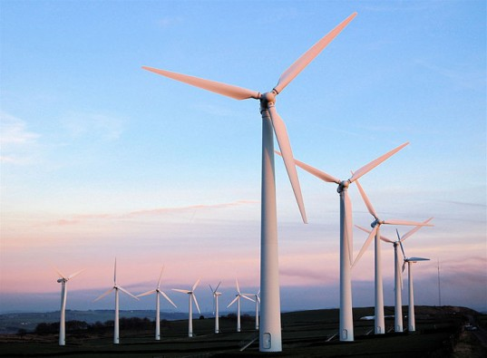
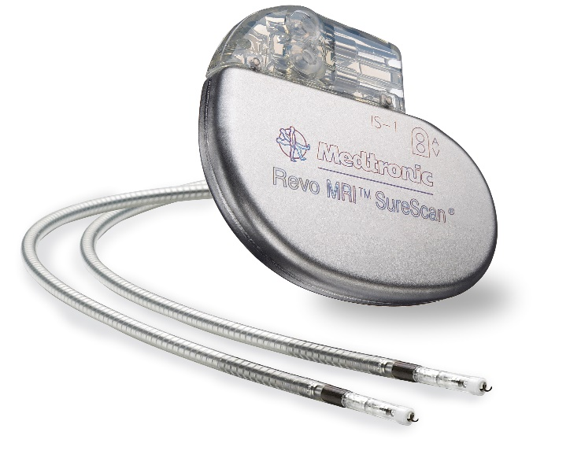
Formal Methods
Autonomous Systems (Cyber-physical Systems): Physical part + Software
Problems in CPS
Toyota recalled 1.9 Million Prius cars (total cars recalled in 2013 – 20M)
FDA report: Software failure is responsible for 24% of recalls in medical devices (of 2M)
Northeast blackout of 2003 caused due to a race condition
Software testing did not reveal all “bugs” in the system.
Need for verification: consider all possible behaviors of the system.
Notes:
How do you solve these problems? Any ideas?
How do you test your code?
Race condition

Slide 6
Formal Methods
Understand the fundamental concepts and principles of formal methods.
Gain insights into the techniques used for verifying the safety and correctness of programs and autonomous systems.
Explore the theoretical foundations of formal methods and their practical applications.
Notes:
Tools
Use those tools to verify
Some theoretical concepts and applications

Slide 7
What is Formal Verification?
Certificate
Model
Continuous
+
Discrete variables
(ODEs + Software)
Verification Tool
Counterexample
Property
(Breaks should be deployed within 3ms)

Slide 8
Different components in verification.
Model: Choosing a modeling framework which accurately captures the details of the system. Represent the real world system in a mathematical domain
Property: Choose a mathematical domain to express the properties you expect the system to satisfy. In software terms: specification.
Verification: Develop techniques for checking if the model satisfies the properties.
Certificate: “Proof” that the model satisfies the property.
Counterexample: The execution of the model that violates the property.

Slide 9
Verification 101
Model: Finite state machine (represents say the user interface of touch–screen phone).
Property: Specification of interface (you should be able to hang up the ongoing call).
Verification technique: Model checking.
Model: Software (Say auto-pilot software).
Property: No division by zero errors and no buffer overflows.
Verification technique: Software model checking.

Slide 10
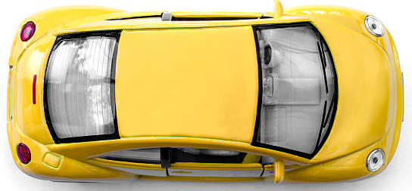
$x\left[t\right]=$ $x\left[t−1\right]$ + $y\left[t−1\right]$
$$y\left[t\right]=x\left[t−1\right] \text{+} y\left[t−1\right]$$
$$(0.8,0.8)$$
What is the model?
What is the property?
What if there is an obstacle at $\left(3.2, 3.2\right)$?
Verification result?
$$y$$
Will it be safe?
NO!
Verification tool?
$$(0.4,0.4)$$
At what time step does it become unsafe?
$$t=5$$
$$(0.2,0.2)$$
$$(0.1,0.1)$$
$$x$$

Slide 11
Why is verification hard?
In general: Undecidable problem.
Notes:
General verification problem?

Slide 12
Initial state: State of the system at time step $t=0$
Will this computed trajectory be still valid?
$$(0.8,0.8)$$
What if the initial state of the system is noisy?
How will it ‘look’?
$$y$$
$$0.1$$
$$z\left[0\right]=$$
+ noise
$$(0.4,0.4)$$
$$0.1$$
$$[0.1,0.2]$$
$$(0.2,0.2)$$
$$[0.1,0.2]$$
$$(0.1,0.1)$$
$$x$$

Slide 13
Initial state: State of the system at time step $t=0$
Will this computed trajectory be still valid?
$$(0.8,0.8)$$
What if the initial state of the system is noisy?
How will it ‘look’?
$$y$$
$$0.1$$
$$z\left[0\right]=$$
+ noise
$$(0.4,0.4)$$
$$0.1$$
$$[0.1,0.2]$$
$$(0.2,0.2)$$
$$[0.1,0.2]$$
$$(0.1,0.1)$$
$$x$$

Slide 14
Initial state: State of the system at time step $t=0$
Will this computed trajectory be still valid?
$$(0.8,0.8)$$
What if the initial state of the system is noisy?
How will it ‘look’?
$$y$$
$$0.1$$
$$z\left[0\right]=$$
+ noise
$$(0.4,0.4)$$
$$0.1$$
$$[0.1,0.2]$$
$$(0.2,0.2)$$
$$[0.1,0.2]$$
$$x$$

Slide 15
$$t=2$$
Initial state: State of the system at time step $t=0$
Will this computed trajectory be still valid?
What if the initial state of the system is noisy?
How will it ‘look’?
$$y$$
$$t=1$$
$$0.1$$
$$z\left[0\right]=$$
+ noise
$$0.1$$
$$[0.1,0.2]$$
$$t=0$$
$$[0.1,0.2]$$
$$x$$

Slide 16
$$t=2$$
Initial state: State of the system at time step $t=0$
Will this computed trajectory be still valid?
$$(0.8,0.8)$$
What if the initial state of the system is noisy?
How will it ‘look’?
$$y$$
$$t=1$$
$$0.1$$
$$z\left[0\right]=$$
+ noise
$$(0.4,0.4)$$
$$0.1$$
How many trajectories do you have to compute?
$$[0.1,0.2]$$
$$t=0$$
$$(0.2,0.2)$$
How do you compute the trajectories then?
$$[0.1,0.2]$$
$$x$$
Notes:
verify: f(x,t). Property: \forall_t \ge 0 f(x,t)>=0, x \in \theta

Slide 17
Why is verification hard?
In general: Undecidable problem.
Why? Let’s see a specific example.
Model: Software.
Property: Given code terminates on an input.
Equivalent to: Halting problem.
Halting problem: Whether a given Turing machine $M$ halts on a given input $w$. Is an undecidable problem.
Notes:
While (true) {C;C ; if (x SAT prop. P) {break;}} – Halting problem.

Slide 18
If there is no generic algorithm, why do it?
Because it is important. REALLY important.
PPT crashed 3 times while I was preparing these slides.
If my flight control software crashes that many times?
Verification is important in Safety Critical Systems.
Failure of these systems have catastrophic consequences.

Slide 19
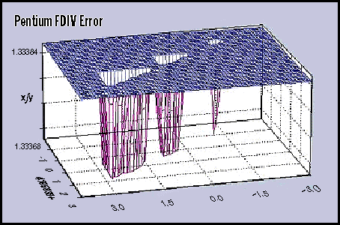
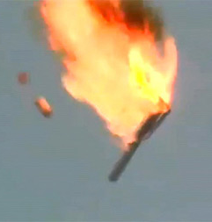
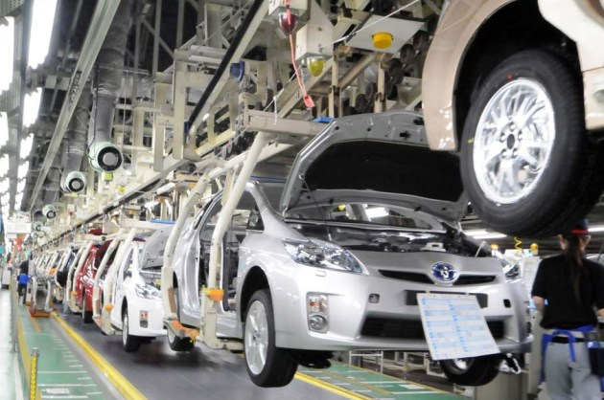
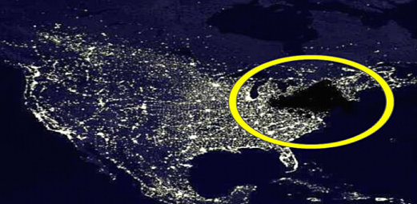
Disaster Scenarios!
Bad software caused some serious damage!
Intel Pentium bug
caused loss of
reputation
and money.
Ariane 5 crashed
within a few
minutes after
launch
Software race condition caused
northeast blackout of 2003
Software bug
caused Toyota to
recall 1.2M
Prius cars

Slide 20
How Could They Have Been Averted?
The software bug for Ariane 5 is due to floating point imprecision that could not be detected during extensive testing.
Static analysis could catch the bug during the analysis
Intel now uses Synopsys/Cadence tools for formal verification.
NASA review of Toyota’s code mentions using Formal verification tools.

Slide 21
Propositional Logic
Propositions: variables/statements that can be assigned either true or false.
Which of the following are propositions:
Today is Tuesday.
Look out!
Drilling for oil caused the dinosaurs to become extinct.
How far is the next town?
$x+2=2x$
The space obeys Euclidian geometry.
This sentence if false.

Slide 22
Operations and Inference on propositions
Propositional variables: are assigned either T or F.
Operations: $∧$ (and), $∨$ (or), $¬$ (not), $⇒$ (implies), etc.
Well founded formulas and Truth tables
Notes:
* Basic operations in truth table?

Slide 23
Implication
A bit different from “causally” used implication.
If the earth is flat, then the space is made up of 12 dimensional geodesics.

Slide 24
Logical Inference
Given a set of well founded formulas that are true, what are the other statements that can be inferred to be true.
Modus Ponens WFFs: If there is smoke, then there should be fire. WFFs: There is smoke. Inference: There is fire.
Modus Tonens WFFs: If there is smoke, then there should be fire. WFFs: There is no fire. Inference: There is no smoke.

Slide 25
Certificate
Developing verification tools requires some basic mathematical understanding of logic.
The simplest logic is propositional logic.
Logic used extensively in verification.
Model
Continuous
+
Discrete variables
(ODEs + Software)
Verification Tool
Counterexample
Property
(Breaks should be deployed within 3ms)

Slide 26
Propositional Logic
Propositions: Statements/variables that can be assigned True or False.
Well founded formulas: propositional variables, operations $∧, ∨, ¬, →, ↔$.
Syntax: $φ∷= p \left|¬φ | φ∨φ \right| φ∨φ \left| φ→φ \right| φ↔φ$
Association: $¬ > ∧ > ∨ > →$. Also $→$ is right-associative.
Examples:
$p∨(q∧¬r)$
$p→p→p$ is it $p→(p→p)$ or $\left(p→p\right)→p$? Does it matter?
$\left(p→q\right)∧¬(r∨p→q)$
…

Slide 27
Tautologies, Contradictions, and Satisfiable formulas.
Tautology: A formula that always evaluates to True for all values of the propositional variables.
$p∨¬p$
$\left(p→p→p\right)→(p→p→p)$.
$\left(\left(p→q\right)→p\right)→p$
Contradiction: A formula that always evaluates to False for all values of propositional variables.
$p∧¬p$
Satisfiable formulas: At least one valuation is true.
$p∧(r→p)$
…

