Slide 1
Trustworthy Autonomy Lecture 4
Bineet Ghosh
bineet@ua.edu

Slide 2
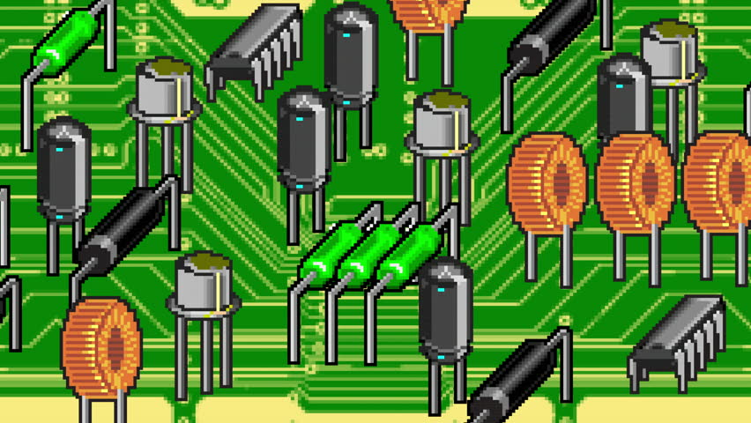
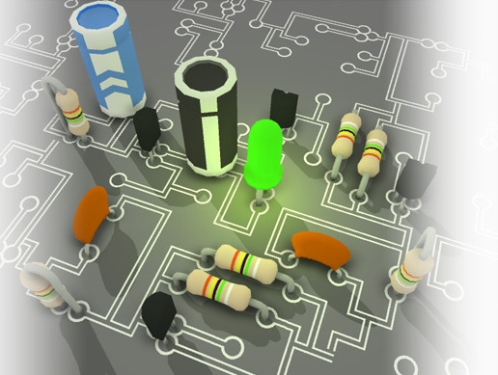
Introduction: Model Selection Problem
Always available
Local: Fast, and less accurate
Cloud: Slow, but highly accurate
A robot needs to perform a task based on its perception, such as autonomous driving
Invoke the cloud or not?
Model Selection Problem

Slide 3
Optimality: Problem Statement Illustration
All Local: Local, Local, . . ., Local
Loss
Local, Local, . . ., Local, Cloud
. . .
Local, Cloud, . . ., Cloud, Local
All Cloud: Cloud, Cloud, . . ., Cloud
. . .
Cloud, Cloud, . . ., Cloud, Cloud
Cost
Compute a sequence – without exploring all sequences – that belongs to this region
Notes:
Here, I propose a strategy, among all possible sequences of invoking the cloud/local model, that has low cost and low loss.
These are the possible sequences of invoking the cloud/local model.

Slide 4
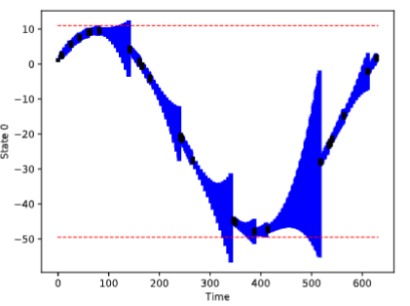
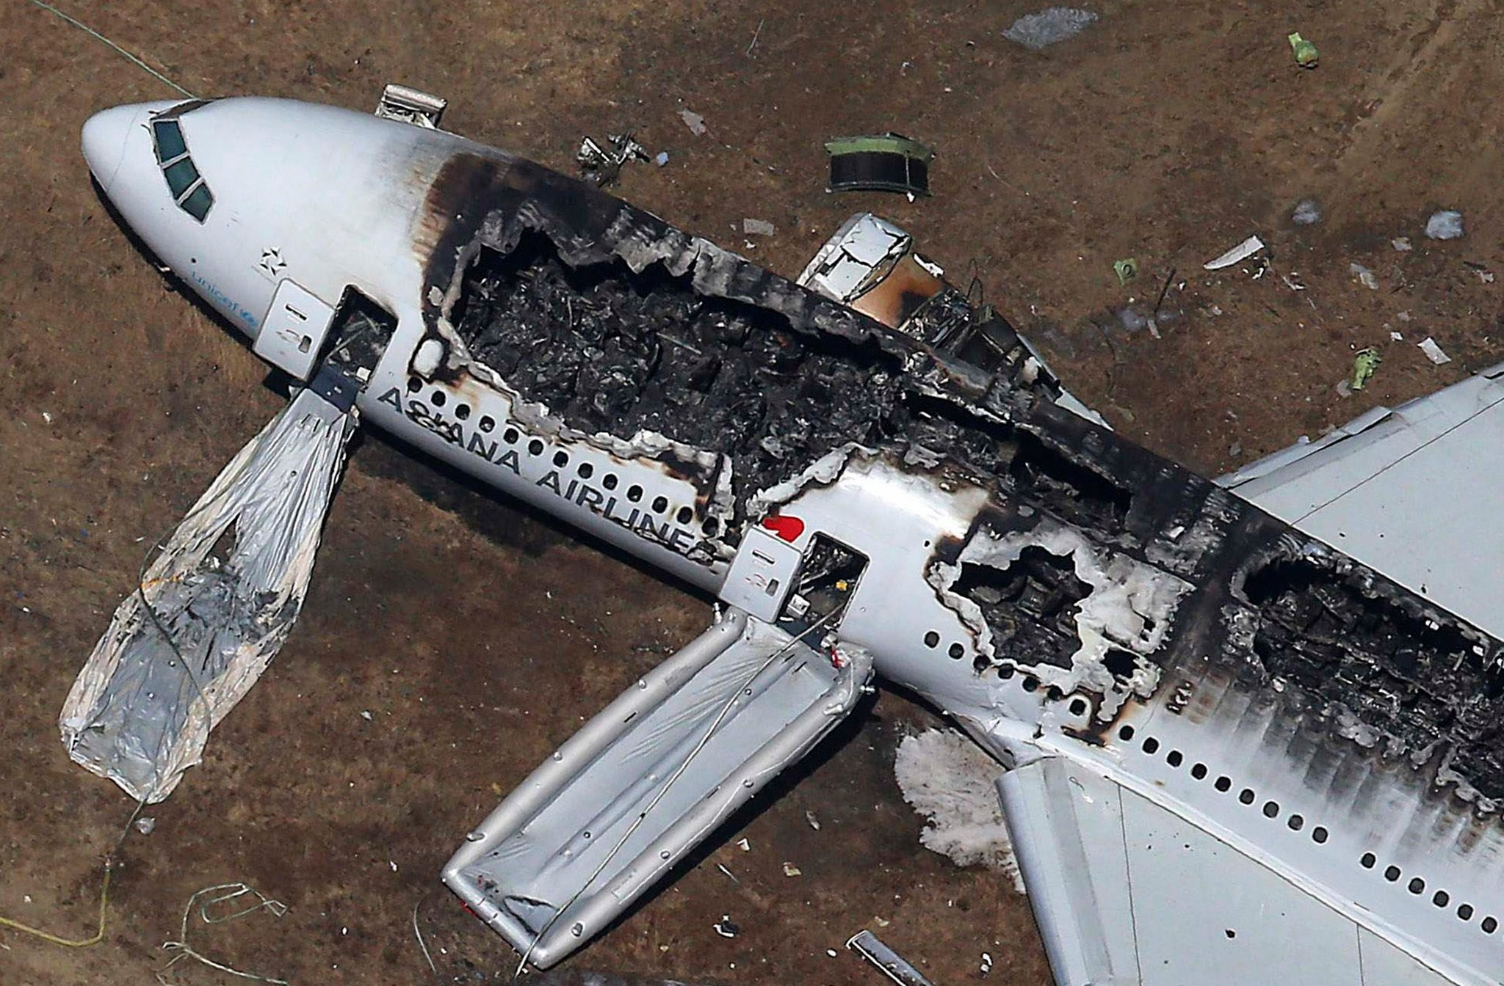
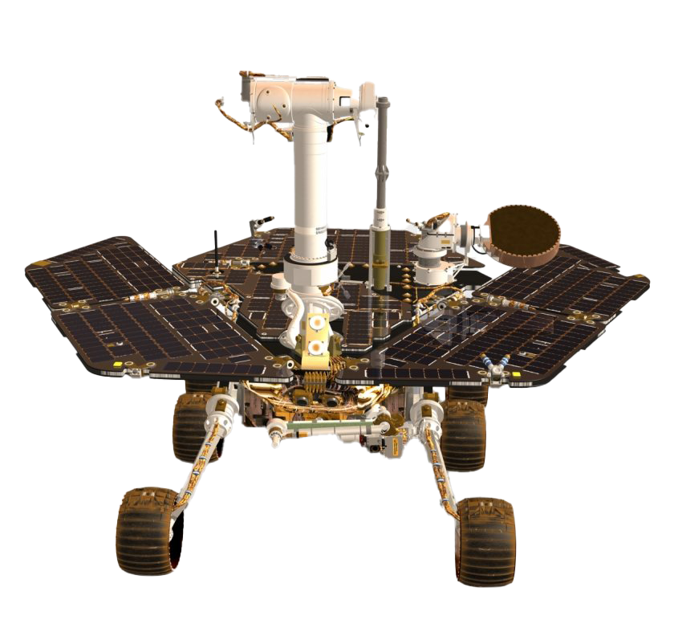
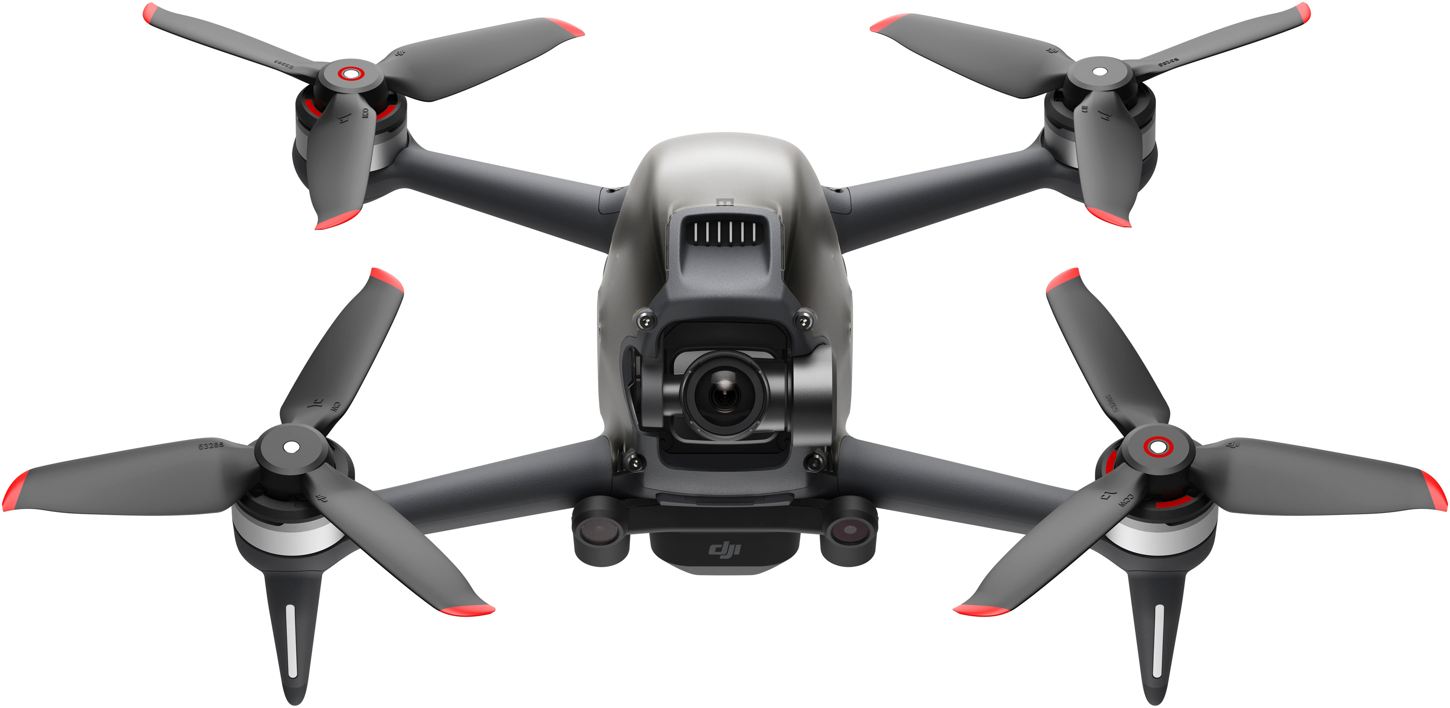
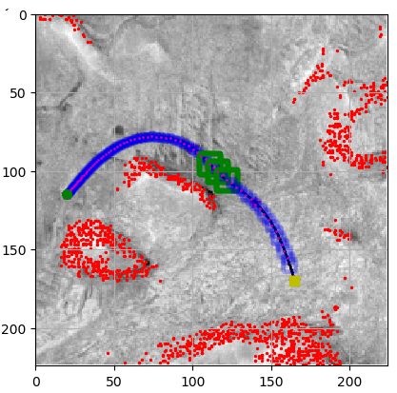
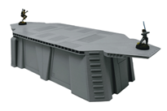
Workload balancing
Crash Detection/Prevention
Smartly processes the jobs s.t. the vehicle is safe
Logged behavior
Lane Departure
Recreated behavior to detect crash
Perception
Unsafety
Heat Control
Formal Methods
Low bandwidth processor installed on a vehicle
Trustworthy Autonomy
Real-Time & Embedded Sys.
Control Theory
Safe, performance optimal maneuvers
Mars rover safe navigation

Slide 5
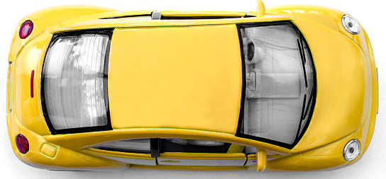
Toy Car Example: Modeling Autonomous Systems
Moves in a 2-D space
Model the movement of the toy car in $x,y$ direction
$$y$$
$$x$$

Slide 6
Toy Example: Modeling Autonomous Systems
$x\left[t\right]:$ The position of the car in $x$ axis, at time $t$
$y\left[t\right]:$ The position of the car in $y$ axis, at time $t$
$t:$ Time is discrete, $0, 1, 2, ⋯, T$
$$y$$
Position of the vehicle: $\left(x\left[0\right],y\left[0\right]\right),\left(x\left[1\right],y\left[1\right]\right), ⋯,\left(x\left[T\right],y\left[T\right]\right)$
$$x$$

Slide 7
$x\left[t\right]=$ Dependent on both $x\left[t−1\right]$ & $y\left[t−1\right]$
$$y\left[t\right]=\text{Dependent} \text{on} \text{both} x\left[t−1\right] \text{\&} y\left[t−1\right]$$
?
$$y$$
$$(0.1,0.1)$$
$$x$$

Slide 8
$x\left[t\right]=$ $x\left[t−1\right]$ + $y\left[t−1\right]$
$$y\left[t\right]=x\left[t−1\right] \text{+} y\left[t−1\right]$$
$$x\left[0\right], y\left[0\right]=(0.1,0.1)$$
$$x\left[1\right]=0.2 \\ y\left[1\right]=0.2$$
$$(0.8,0.8)$$
$$x\left[2\right]=0.4 \\ y\left[2\right]=0.4$$
$$y$$
$$x\left[3\right]=0.8 \\ y\left[3\right]=0.8$$
$$(0.4,0.4)$$
$$(0.2,0.2)$$
$$(0.1,0.1)$$
$$x$$
Notes:
* Acceleration is baked in the dynamics

Slide 9
$x\left[t\right]=$ $x\left[t−1\right]$ + $y\left[t−1\right]$
$$y\left[t\right]=x\left[t−1\right] \text{+} y\left[t−1\right]$$
$$x\left[0\right], y\left[0\right]=(0.1,0.1)$$
Can we represent this ‘compactly’?
System of linear equations – matrix form?
$$y$$
$$x[t]$$
$$?$$
$$?$$
$$x[t−1]$$
=
$$y[t]$$
$$?$$
$$?$$
$$y[t−1]$$
$$x$$
Notes:
* Take a few mins and think how can you compactly represent these equations

Slide 10
$x\left[t\right]=$ $x\left[t−1\right]$ + $y\left[t−1\right]$
$$y\left[t\right]=x\left[t−1\right] \text{+} y\left[t−1\right]$$
$$x\left[0\right], y\left[0\right]=(0.1,0.1)$$
Can we represent this ‘compactly’?
System of linear equations – matrix form?
$$y$$
State Space
Is this correct?
$$x[t]$$
$$1$$
$$1$$
$$x[t−1]$$
Let’s check!
=
$$y[t]$$
$$1$$
$$1$$
$$y[t−1]$$
$$z[t]$$
$$A$$
$$z[t−1]$$
$$z\left[t\right]=A⋅z[t−1]$$
$$x$$

Slide 11
$x\left[t\right]=$ $x\left[t−1\right]$ + $y\left[t−1\right]$
$$y\left[t\right]=x\left[t−1\right] \text{+} y\left[t−1\right]$$
$$x\left[0\right], y\left[0\right]=(0.1,0.1)$$
$$x\left[1\right]=0.2 \\ y\left[1\right]=0.2$$
$$(0.8,0.8)$$
$$x\left[2\right]=0.4 \\ y\left[2\right]=0.4$$
$$y$$
$$x\left[3\right]=0.8 \\ y\left[3\right]=0.8$$
$$(0.4,0.4)$$
$$(0.2,0.2)$$
$$(0.1,0.1)$$
$$x$$

Slide 12
$z\left[t\right]=$ $A$ $⋅$ $z\left[t−1\right]$
$$x\left[0\right], y\left[0\right]=(0.1,0.1)$$
$z\left[0\right]=$ $(0.1,0.1)$
$$x[t]$$
$$1$$
$$1$$
$$x[t−1]$$
$$x\left[1\right]=0.2 \\ y\left[1\right]=0.2$$
$z\left[1\right]=$ $A⋅z[0]$
=
$$y[t]$$
$$1$$
$$1$$
$$y[t−1]$$
$$x\left[2\right]=0.4 \\ y\left[2\right]=0.4$$
$z\left[2\right]=$ $A⋅z[1]$
$$z[t]$$
$$A$$
$$z[t−1]$$
$z\left[3\right]=$ $A⋅z[2]$
$$x\left[3\right]=0.8 \\ y\left[3\right]=0.8$$
$$y$$
Trajectories of the system
$z\left[t\right]=$ $A⋅z[t−1]$
State of the system reached at time $t$
Can we compute the state of the system at time $t$ directly, from the state of the system at time $t=0$?
$$x$$

Slide 13
$z\left[0\right]=$ $(0.1,0.1)$
Can we compute the state of the system at time $t$ directly, from the state of the system at time $t=0$?
$z\left[1\right]=$ $A⋅z[0]$
What is the objective?
$z\left[2\right]=$ $A⋅z[1]$
$$z\left[t\right]= ? ⋅z[0]$$
Board work
$z\left[3\right]=$ $A⋅z[2]$
$$y$$
$z\left[t\right]=$ $A⋅z[t−1]$
$z\left[t\right]=$ $A$ $⋅$ $z\left[t−1\right]$
$$x[t]$$
$$1$$
$$1$$
$$x[t−1]$$
=
$$y[t]$$
$$1$$
$$1$$
$$y[t−1]$$
$$x$$
Notes:
* Board work with co-eff in the dynamics

Slide 14
$z\left[0\right]=$ $(0.1,0.1)$
$z\left[1\right]=$ $A⋅z[0]$
$z\left[2\right]=$ $A⋅z[1]$
$z\left[3\right]=$ $A⋅z[2]$
$$y$$
$z\left[t\right]=$ $A⋅z[t−1]$
$z\left[t\right]=$ $A$ $⋅$ $z\left[t−1\right]$
$$x[t]$$
$$1$$
$$1$$
$$x[t−1]$$
=
$$y[t]$$
$$1$$
$$1$$
$$y[t−1]$$
$$x$$

Slide 15
$z\left[t\right]=$ $A$ $⋅$ $z\left[t−1\right]$
$$x[t]$$
$$1$$
$$1$$
$$x[t−1]$$
=
$$y[t]$$
$$1$$
$$1$$
$$y[t−1]$$
$$x\left[0\right]=0.1$$
$$z\left[0\right]=$$
$$y$$
$$y\left[0\right]=0.1$$
$$(0.1,0.1)$$
$$x$$

Slide 16
$z\left[t\right]=$ $A$ $⋅$ $z\left[t−1\right]$
$$x[t]$$
$$1$$
$$1$$
$$x[t−1]$$
=
$$y[t]$$
$$1$$
$$1$$
$$y[t−1]$$
$$z\left[1\right]= ?$$
$$y$$
$$(0.2,0.2)$$
$$0.1$$
$$z\left[0\right]=$$
$$(0.1,0.1)$$
$$0.1$$
$$x$$

Slide 17
$z\left[t\right]=$ $A$ $⋅$ $z\left[t−1\right]$
$$x[t]$$
$$1$$
$$1$$
$$x[t−1]$$
=
$$y[t]$$
$$1$$
$$1$$
$$y[t−1]$$
$$z\left[2\right]= ?$$
$$y$$
$$(0.4,0.4)$$
$$(0.2,0.2)$$
$$0.1$$
$$z\left[0\right]=$$
$$(0.1,0.1)$$
$$0.1$$
$$x$$

Slide 18
$z\left[t\right]=$ $A$ $⋅$ $z\left[t−1\right]$
$$x[t]$$
$$1$$
$$1$$
$$x[t−1]$$
=
$$y[t]$$
$$1$$
$$1$$
$$y[t−1]$$
$$(0.8,0.8)$$
$$z\left[3\right]= ?$$
$$y$$
$$(0.4,0.4)$$
$$(0.2,0.2)$$
$$0.1$$
$$z\left[0\right]=$$
$$(0.1,0.1)$$
$$0.1$$
$$x$$

Slide 19
Initial state: State of the system at time step $t=0$
Will this computed trajectory be still valid?
$$(0.8,0.8)$$
What if the initial state of the system is noisy?
How will it ‘look’?
$$y$$
$$0.1$$
$$z\left[0\right]=$$
+ noise
$$(0.4,0.4)$$
$$0.1$$
$$[0.1,0.2]$$
$$(0.2,0.2)$$
$$[0.1,0.2]$$
$$(0.1,0.1)$$
$$x$$

