Slide 1
Trustworthy Autonomy Lecture 3
Bineet Ghosh
bineet@ua.edu

Slide 2
Uncertainties with an Example: Anesthesia
$$C_{p}$$
Initial concentration level of $c_{p}$ ($[2.1,2.2]$)
$$C_{1}$$
Initial concentration level of $c_{1}$ ($[2.1,2.15]$)
$$C_{2}$$
Initial concentration level of $c_{2}$
$$C_{e}$$
Initial concentration level of $c_{p}$
$$u$$
Injected drug $u$
https://cps-vo.org/node/12111
Notes:
As an illustration, let us consider the following initial concentration levels.

Slide 3
Uncertainties with an Example: Anesthesia
Using the dynamics, compute the concentration levels after time $t$
Initial Set
$$C_{p}$$
After time $t$
$$C_{p}$$
$$C_{1}$$
$$C_{1}$$
$$C_{2}$$
$$C_{2}$$
$$C_{e}$$
Reachable Set at time $t$
$$C_{e}$$
$$u$$
$$u$$

Slide 4
Uncertainties with an Example: Anesthesia
Reachable sets are a tool for safety verification
Check if concentration levels are safe
$$C_{p}$$
$$C_{1}$$
$$C_{2}$$
$$C_{e}$$
$$u$$
Notes:
Now the question is, why do we care about computing reachable sets?
We care about computing reachable sets is because, it is a handy tool to perform safety verification, among many
Now that we know possible concentration levels after time t apriori, we can check if those concentration levels are indeed withing the safe limits or not. That is, not too high, or not too low.

Slide 5
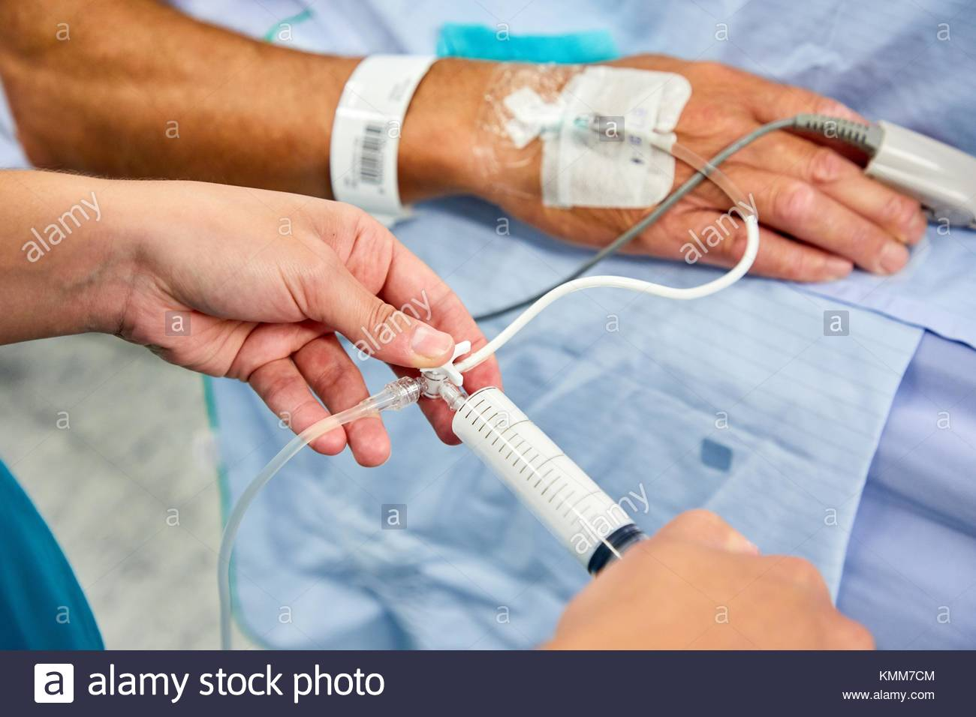
Uncertainties with an Example: Anesthesia
A safety critical event that occurs before (almost) all surgeries.
Determining its safety:
Understanding of how it is metabolized.
Its effect on the depth of hypnosis.
Safety Analysis Using Reachable Sets
UNC Chapel Hill
Notes:
Now, let’s recall the anesthesia model again.
And we would want to perform safety verification of the model using reachable sets.

Slide 6
Uncertainties with an Example: Anesthesia
Perform analysis on this model
Safe
Provide certificate
Unsafe
This technique assumes the model is accurate!
I.e., all the parameter values are accurate
Dynamics
Dictated
Parameters: $θ_{1},θ_{2},θ_{3}$
Notes:
Now that we have the dynamics, which is dictated by some parameters \theta_i.
We perform safety analysis on this model, and provide a safety certificate. Which is, safe or unsafe.
However, this techniques assumes that the model is accurate.
That is, the chosen values of the thetas are accurate.

Slide 7
Uncertainties with an Example: Anesthesia
Dynamics
Dictated
Parameters: $θ_{1},θ_{2},θ_{3}$
Analysis
Safe
(Say)
UNC Chapel Hill
Notes:
Now with this assumption, let’s say we perform our analysis and see that the system is safe.

Slide 8
Uncertainties with an Example: Anesthesia
Dynamics
Dictated
Parameters: $θ_{1},θ_{2},θ_{3}$
Analysis
Modeling Error!
?
Safe
(Say)
Why modeling error?
Would it still be safe?
UNC Chapel Hill
Notes:
Now, what if we discover a modeling error.
I.e., the values that we chose for \thetas are not accurate.
Would it still be safe? We don’t know!
Now the question is, why would there be a modeling error?

Slide 9
Uncertainties with an Example: Anesthesia
Dynamics
Dictated
Parameters: $θ_{1},θ_{2},θ_{3}$
Determined empirically – come with errors
Dependent on weight, alveolar volumes etc. –patient specific
Modeling Error!
Why modeling error?
UNC Chapel Hill
Notes:
Recall that these parameters we determined empirically. Therefore, they come with errors associated with them.
Also, these parameters are dependent on patient specific factors such as weight, lung capacity etc..
So choosing the same fixed set of values, of the parameters, for all patients might not be an accurate way of modeling.

Slide 10
Verification of Autonomous Systems
Monitoring systems for safety
Safe-workload balancing
Designing of Autonomous Systems
Safe and performance optimal autonomous system
Notes:
Two aspects of this course, using 3 examples.

Slide 11
Verification of Autonomous Systems
Monitoring systems for safety
Safe-workload balancing
Designing of Autonomous Systems
Safe and performance optimal autonomous system

Slide 12
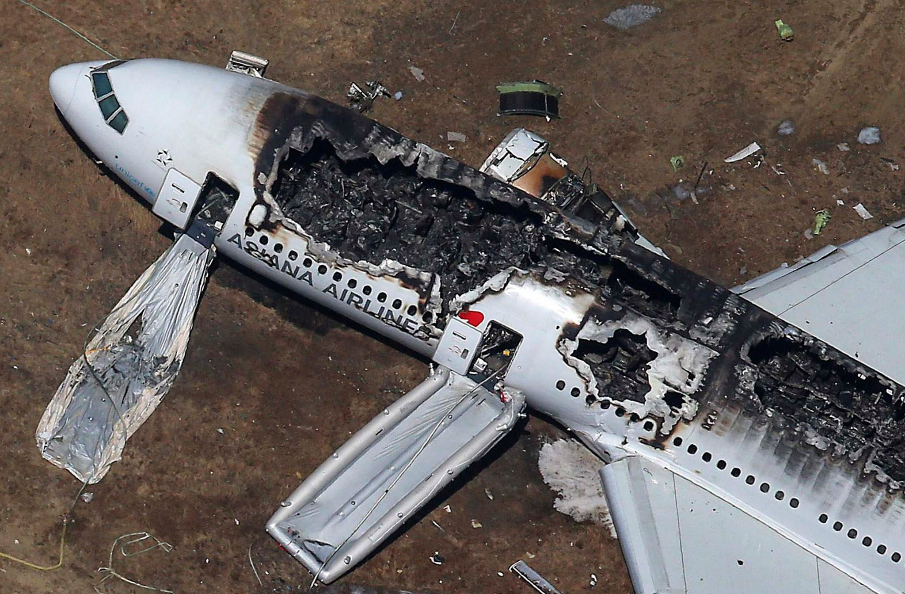
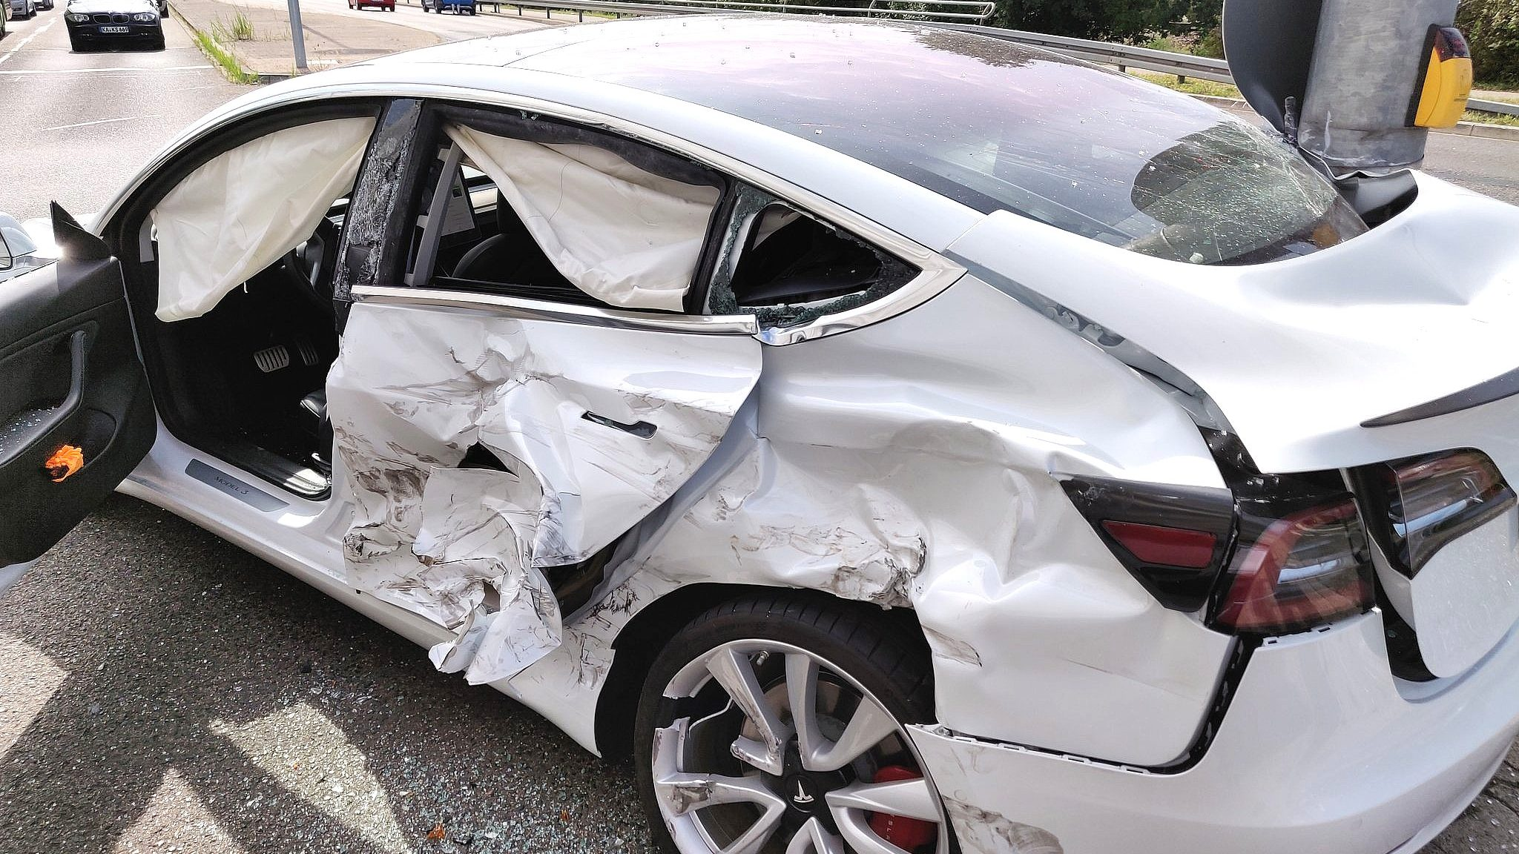
In the Event of a Crash!
Cause of the crash?
Who was at fault?

Slide 13
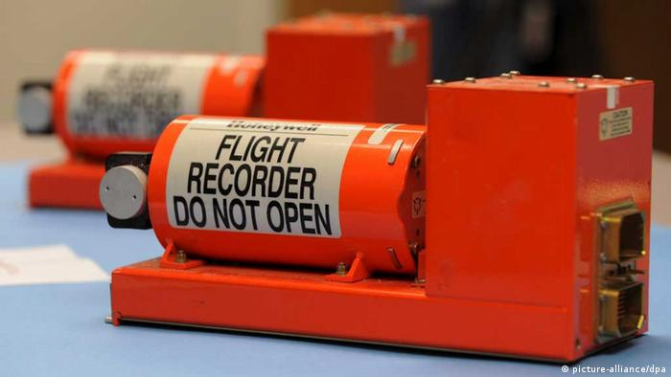
Investigating the Crash
Stores information of the vehicle/plane until the time of crash.
Flight Black Box
Detecting safety violation from the stored information.

Slide 14
Investigating the Crash: Logging is Expensive!
Logging accurately at all time steps is hard!
Sensors are uncertain, on budget systems
Logs sent over unreliable networks
Energy consumption – a concern on intermittently powered devices
Flight Black Box

Slide 15
Monitoring: Proposed Strategy
Scattered & Noisy Logs
Reconstruct missing logs using reachable sets
Safe or Unsafe?
Bounding Model: Dynamics with Uncertainties

Slide 16
Verification of Autonomous Systems
Monitoring systems for safety
Safe-workload balancing
Designing of Autonomous Systems
Safe and performance optimal autonomous system

Slide 17
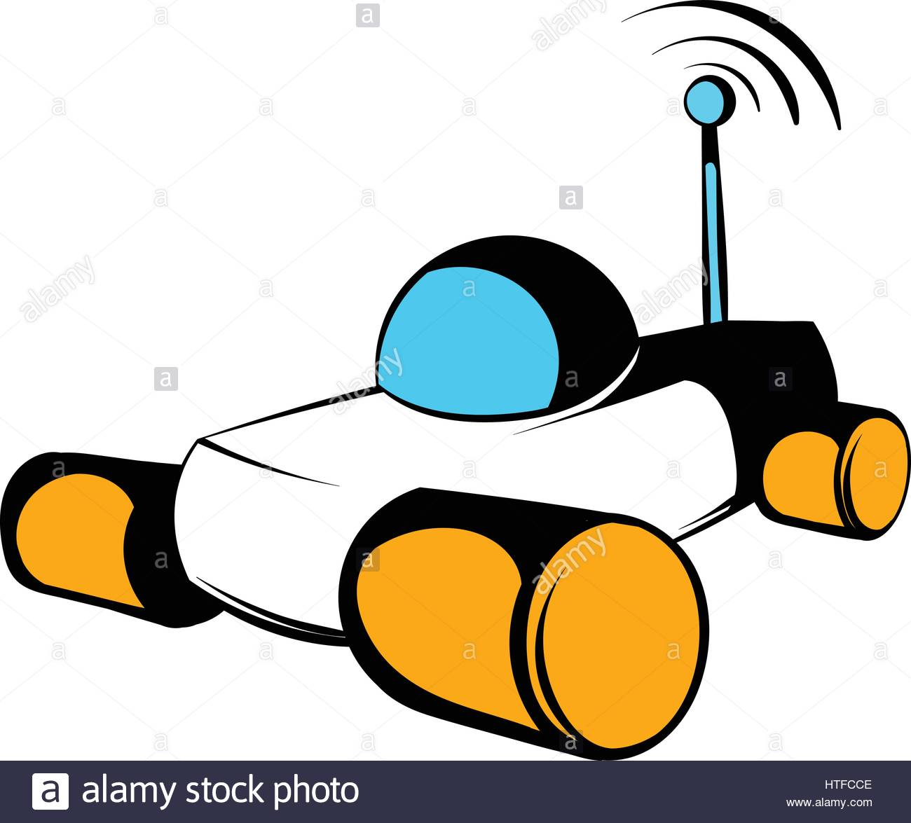
Robot Maneuvers
Robot trying to reach its destination, avoiding obstacles.
Obstacles
Nominal Trajectory: Planned Path
Notes:
Consider this notion of quantitative safety.

Slide 18
Robot Maneuvers
But: The robot is running multiple jobs on its processor!
Path Follower
Responsible for moving the robot along the planned trajectory.
Multiple Jobs
Perception
All jobs cannot always be scheduled—deadline misses!
Heat Control
What if the path follower misses its deadline?

Slide 19
Robot Maneuvers
What if the path follower misses some deadlines?
The trajectory can deviate from the nominal trajectory!

Slide 20
Robot Maneuvers
Trajectory under deadline misses
What if the path follower misses some deadlines?
The trajectory can deviate from the nominal trajectory!

Slide 21
Robot Maneuvers
What if the path follower misses deadlines very frequently?
The trajectory can deviate more from the nominal trajectory!

Slide 22
Robot Maneuvers
What if the path follower misses deadlines very frequently?
The trajectory can deviate more from the nominal trajectory!
And becomes unsafe!

Slide 23
Robot Maneuvers
In Conclusion: Not all patterns of deadline misses are safe!
Goal: Detect if a given pattern of deadline misses is safe!

Slide 24
Verification of Autonomous Systems
Monitoring systems for safety
Safe-workload balancing
Designing of Autonomous Systems
Safe and performance optimal autonomous system

Slide 25
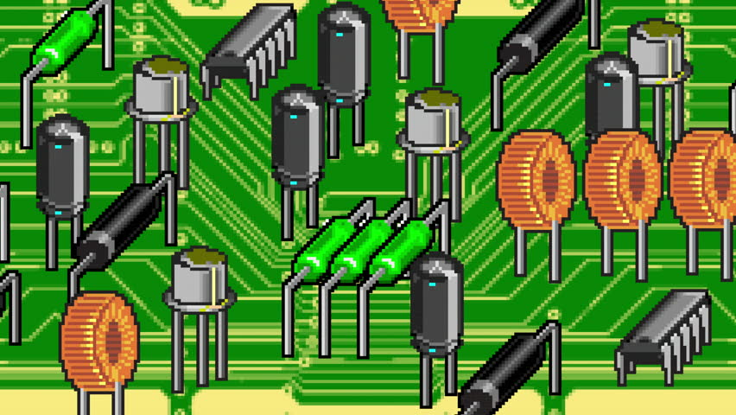
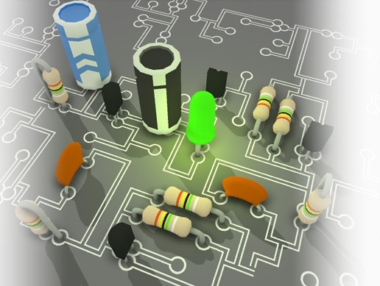
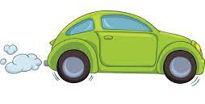
Introduction: Model Selection Problem
Always available
Local: Fast, and less accurate
Cloud: Slow, but highly accurate
A robot needs to perform a task based on its perception, such as autonomous driving
Invoke the cloud or not?
Model Selection Problem

Slide 26
Optimality: Problem Statement Illustration
All Local: Local, Local, . . ., Local
Loss
Local, Local, . . ., Local, Cloud
. . .
Local, Cloud, . . ., Cloud, Local
All Cloud: Cloud, Cloud, . . ., Cloud
. . .
Cloud, Cloud, . . ., Cloud, Cloud
Cost
Compute a sequence – without exploring all sequences – that belongs to this region
Notes:
Here, I propose a strategy, among all possible sequences of invoking the cloud/local model, that has low cost and low loss.
These are the possible sequences of invoking the cloud/local model.

Slide 27
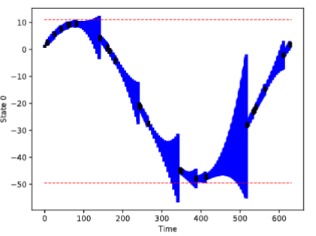
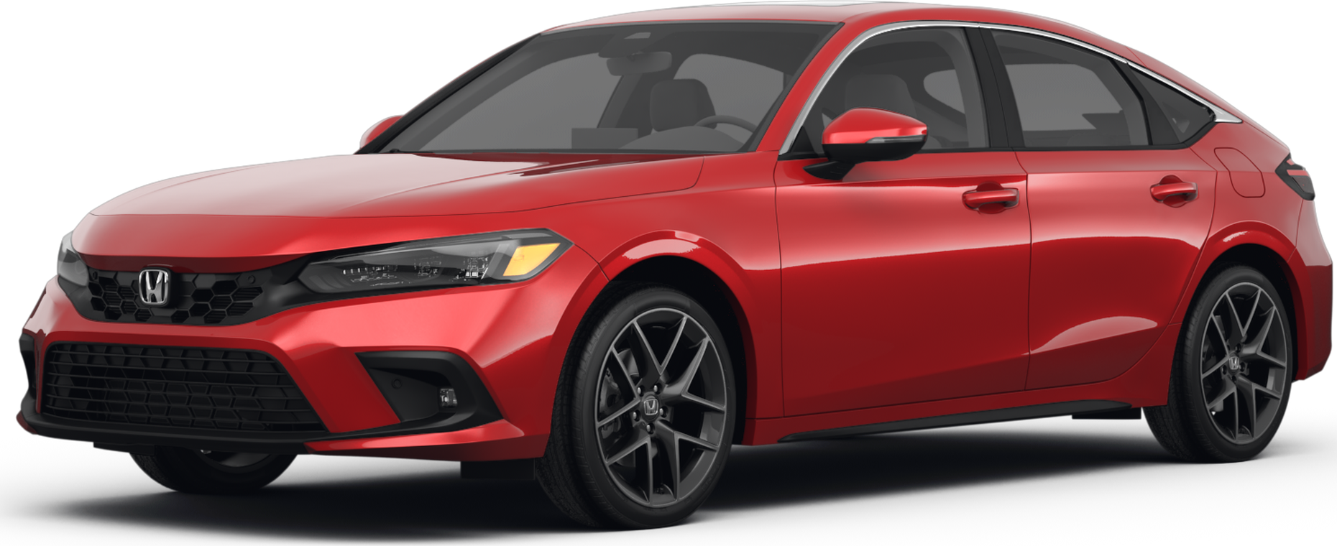
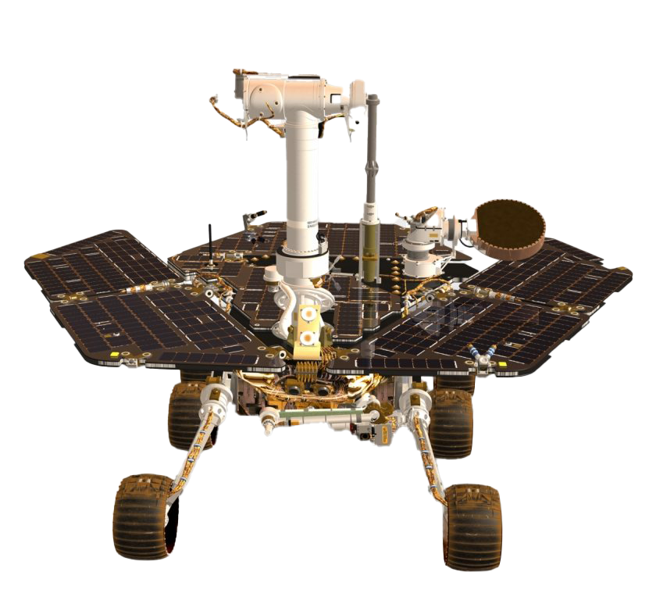
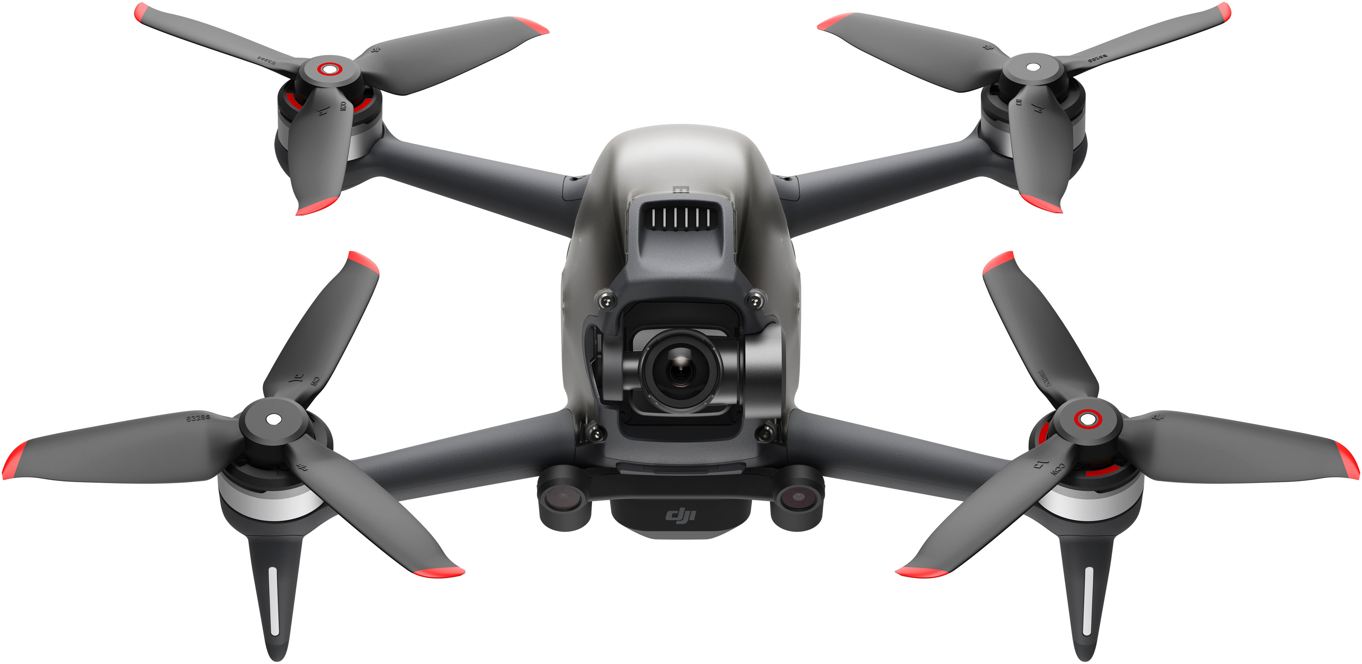
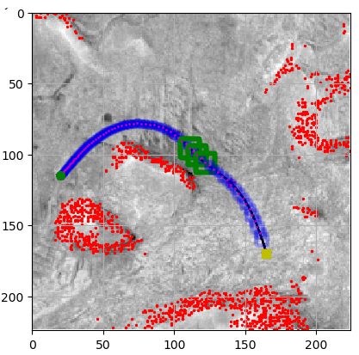
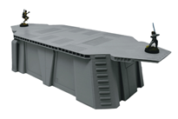
Workload balancing
Crash Detection/Prevention
Smartly processes the jobs s.t. the vehicle is safe
Logged behavior
Lane Departure
Recreated behavior to detect crash
Perception
Unsafety
Heat Control
Formal Methods
Low bandwidth processor installed on a vehicle
Trustworthy Autonomy
Real-Time & Embedded Sys.
Control Theory
Safe, performance optimal maneuvers
Mars rover safe navigation

