Slide 1
Trustworthy Autonomy
Lecture 20
Bineet Ghosh
bineet@ua.edu

Slide 2
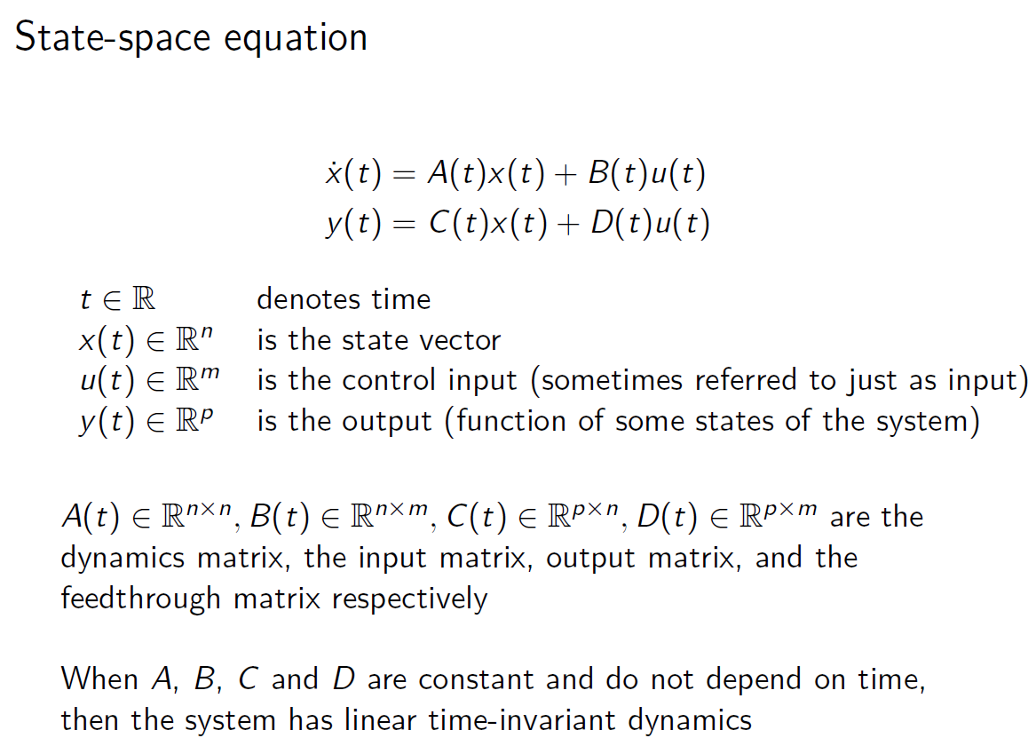
Notes:
m= # control inputs
N= dimension (no of states)

Slide 3
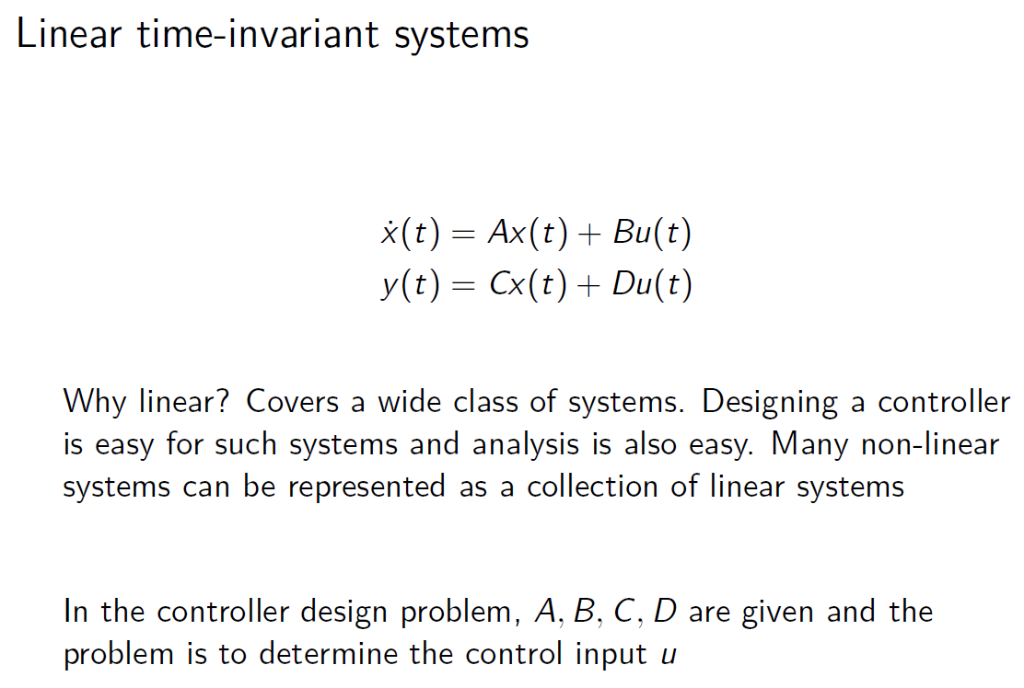

Slide 4
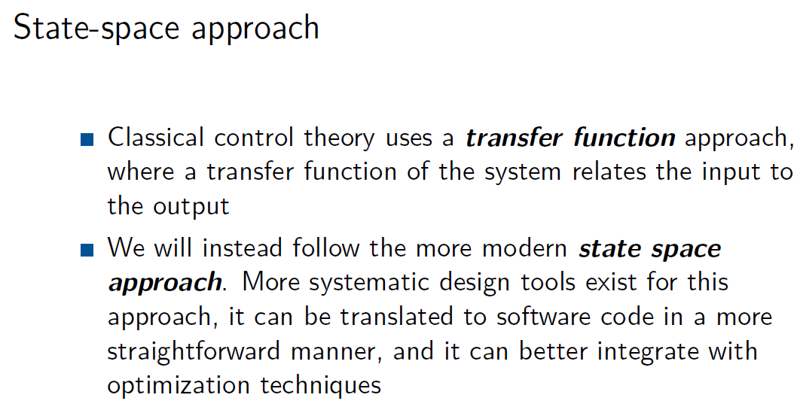
Notes:
Transfer function & State Space Approach are equivalent

Slide 5
Handouts
Will be due after Homework 3 (as Homework 4)
Group work, but individual submissions required detailing their contributions
Integrates/Segway from homework to the project
Will be posted in Blackboard soon.

Slide 6
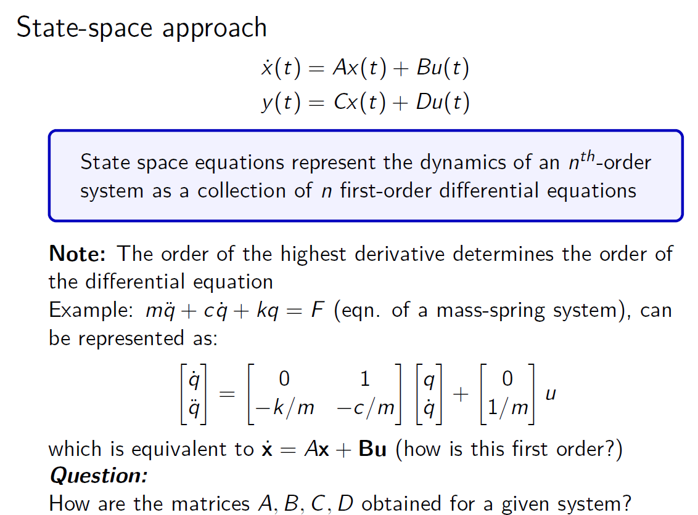
Notes:
q=x
c=\rho

Slide 7
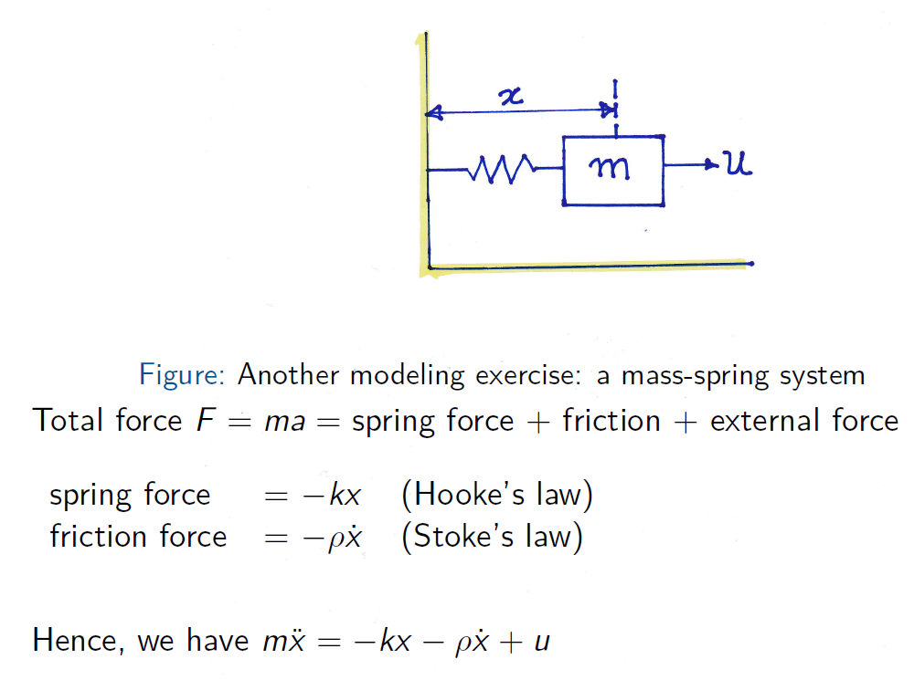

Slide 8
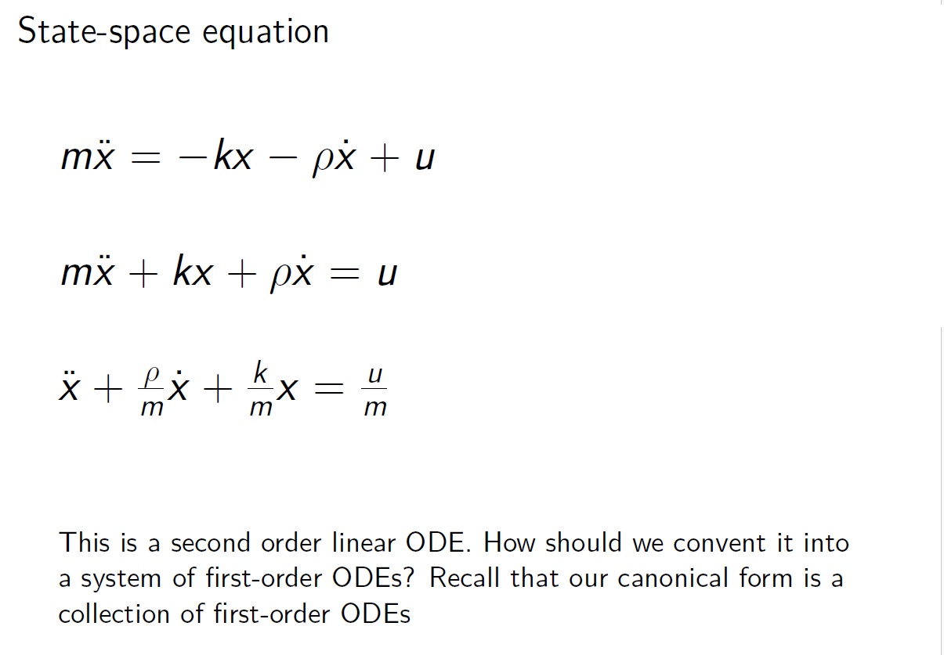
Notes:
q=x
c=\rho

Slide 9
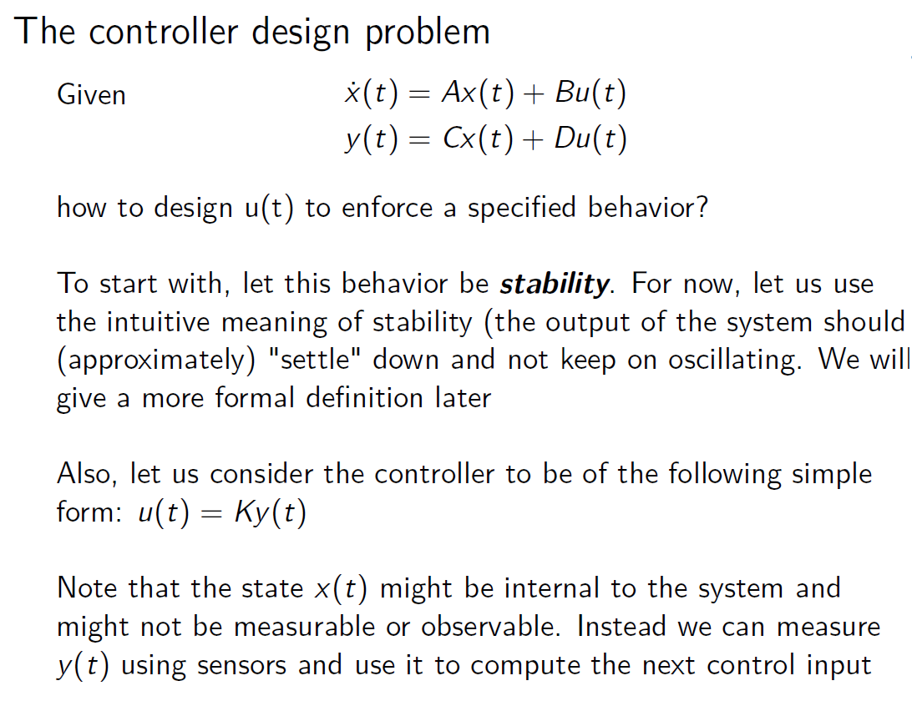

Slide 10
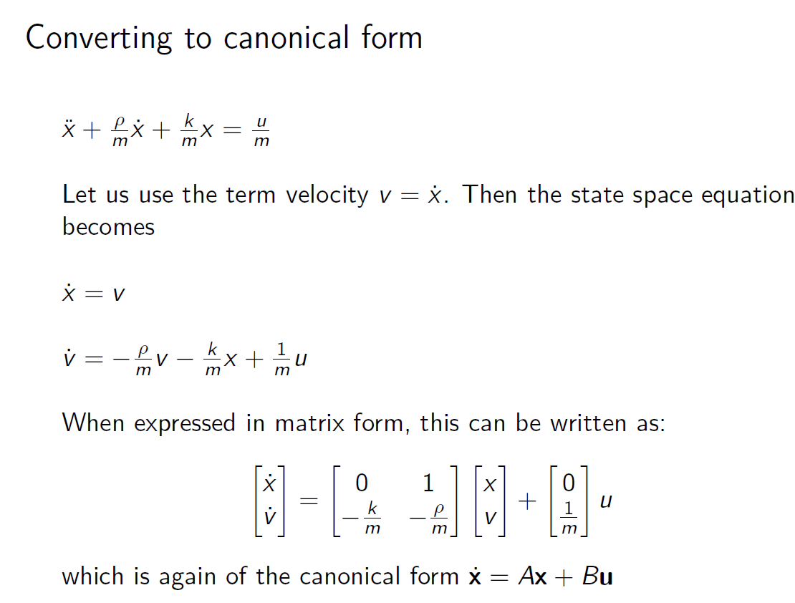

Slide 11
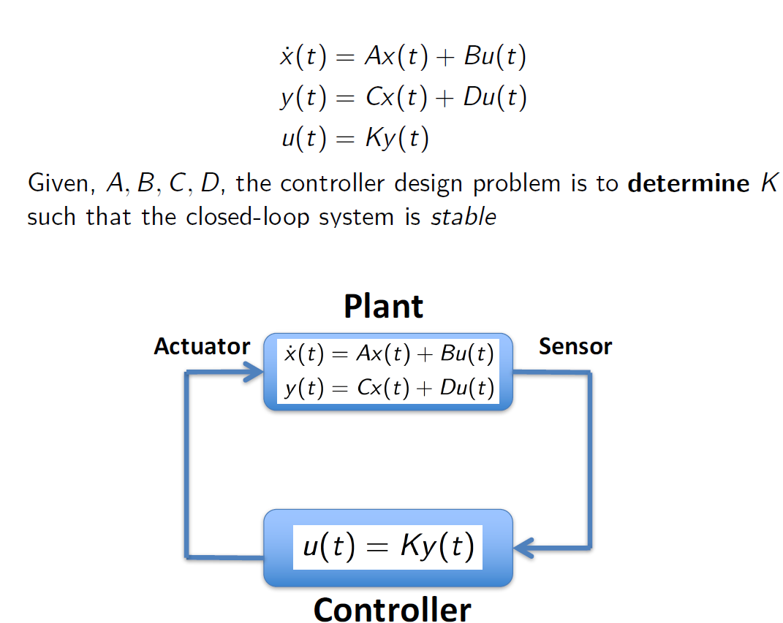

Slide 12
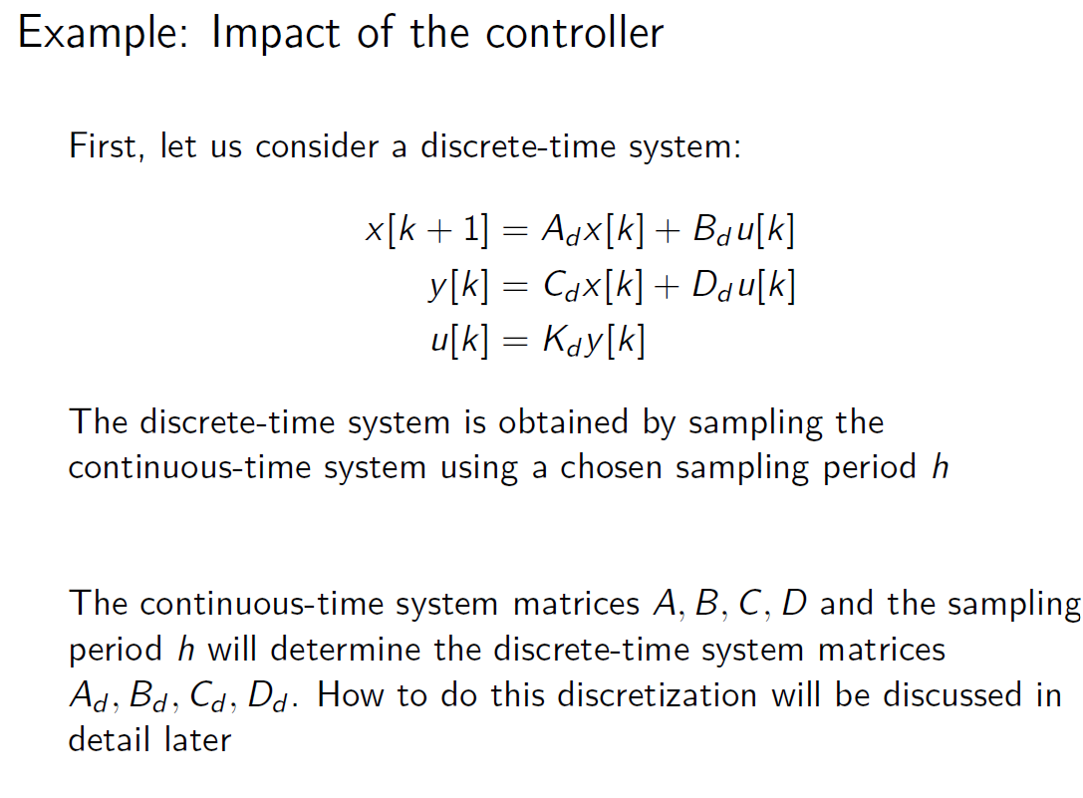

Slide 13
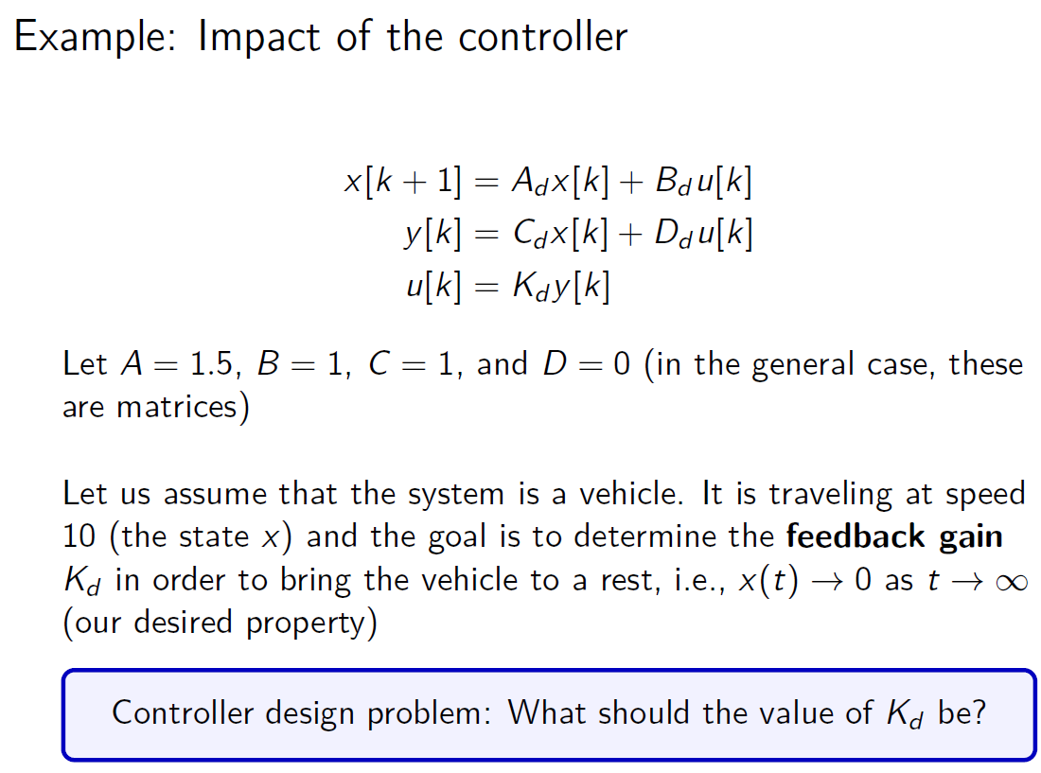

Slide 14
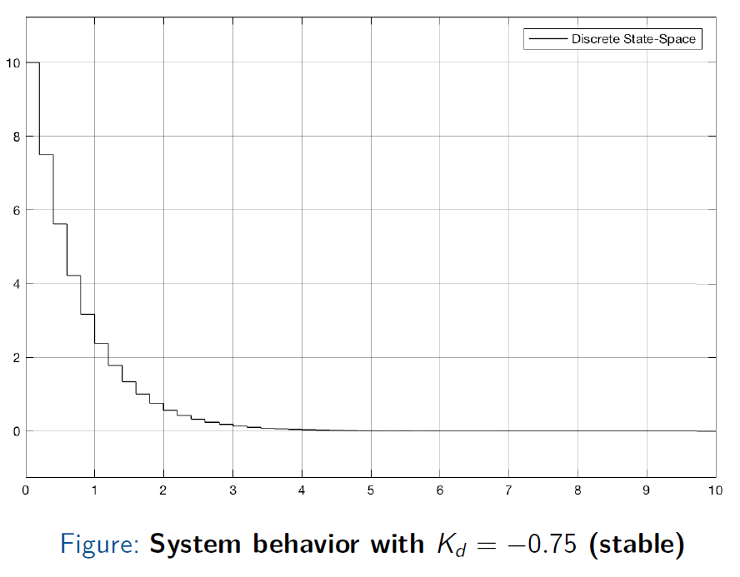

Slide 15
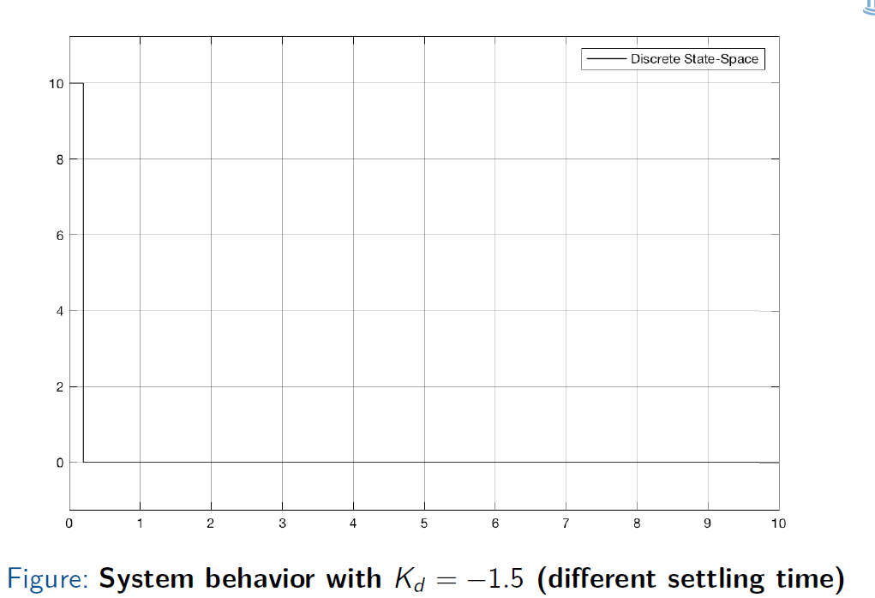
Notes:
* Is this a good controller?

Slide 16
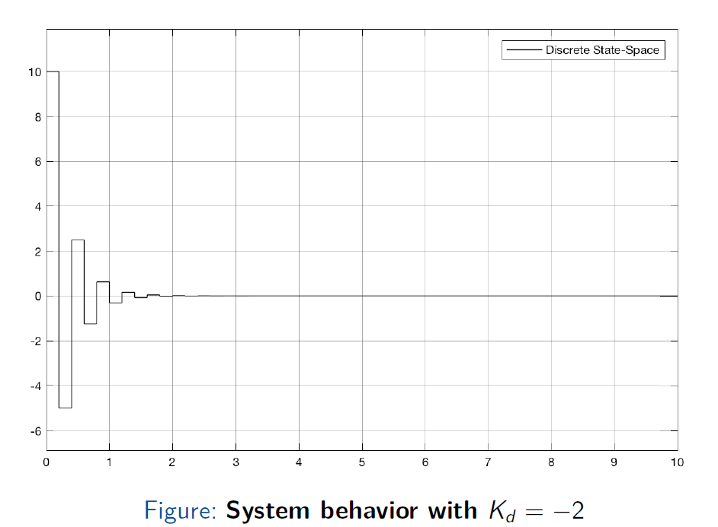

Slide 17
