Slide 1
Trustworthy Autonomy Lecture 2
Bineet Ghosh
bineet@ua.edu

Slide 2
Previous Lecture
Review of the syllabus
Brief idea about autonomous systems
Notion of safety and trust in autonomous systems
Topics to be covered in this course

Slide 3
Today’s Lecture
Review autonomous systems
Toy examples of autonomous systems
Design and verification of autonomous systems

Slide 4
Grading
Homework: 30%
Paper presentation, and leading class discussion (1-3 papers): 30%
Final project: 30%
Class participation & student’s growth: 10%
Notes:
Grading slide had a typo
Focus on learning, grades will take care of itself
Workload – wouldn’t be a lot + will be flexible (small class)

Slide 5
Student’s Growth
Identifies the effort being made by a student to understand the concepts being taught, despite their prior backgrounds.
In other words, this can be used identify the efforts being put in by a student even if it is not being reflected in their scores.
Discussing with instructor (especially during office hours) is a good way to demonstrate that.
Notes:
* You need not worry – because you have this

Slide 6
Late Work Policy
One late assignment will have $0$ (zero) penalty, if submitted within a week of the posted deadline.
Any further late assignments will result in the following deduction scheme: $min⁡( 15×(no−of−days−late),100)$% will be deducted.
In case of emergency (or unforeseen cases), please speak to instructor. The instructor will try his best to accommodate for the situation (subject to proof) in accordance with the university policy.

Slide 7
Final Project: Types
Survey. Extensive survey about the research on a topic of your interest. Not a reading and copy-paste of existing papers. Expected to identify the core of the problem and provide deep insights.
Applications. Pick an application of your interest and verifying it. Might require deploying several techniques and tools. Might lead to interesting theoretical results. The application should be nontrivial and “interesting” enough.
Theory. Identify a theoretical problem (algorithm/property of models) and develop new fundamental solutions. Fairly challenging task. Identifying a “good” candidate solution or proving an “interesting” property suffices.
Notes:
Ongoing?
We can all together do one project, or individually
Since this a small class, our works can also result in publication.
I also have some active projects, you can also become a part of it.

Slide 8
Final Project: Logistics
Reports: 1-3 reports maybe due before the final report and presentation to share progress with the class.
Presentation: Discussion, debate, comparative analysis.

Slide 9
Presentation Topics
Problem statement
Related work
Methodology
Main novelty
Results. Identify the interesting parts (your opinion)
Have at least two questions for the class.
Notes:
Guideline to help you prepare the presentation
Of course, you are strongly encouraged to come and discuss the paper with me

Slide 10
Presentation Report
8-page document in IEEE conference format (similar to conference paper).
Guaranteed way to score A+: Project report of conference paper quality.

Slide 11
Typical Class Activity
The class activities are designed to promote active learning, critical thinking, and a deeper appreciation of the challenges and opportunities in the design and verification of autonomous systems.
Fundamental Topic Lectures. The initial portion of the course focuses on building a foundation by covering fundamental concepts and principles related to the design and verification of autonomous systems. These lectures provide students with essential theoretical knowledge and practical insights, ensuring they have the necessary background to engage effectively with advanced topics and projects later in the course.
Student Paper Presentations. Each student selects and presents one or more research papers relevant to the course. Following the presentation, there will be discussion, debate, comparative analysis (Note: this is the best way to demonstrate class participation and student's growth).
Notes:
Interactive, promote active learning
Most of the learning would be done in the class

Slide 12
Research
Design and Verification of Autonomous Systems
Applications
Robotics, Automotives, Industrial and Home Automation Systems

Slide 13
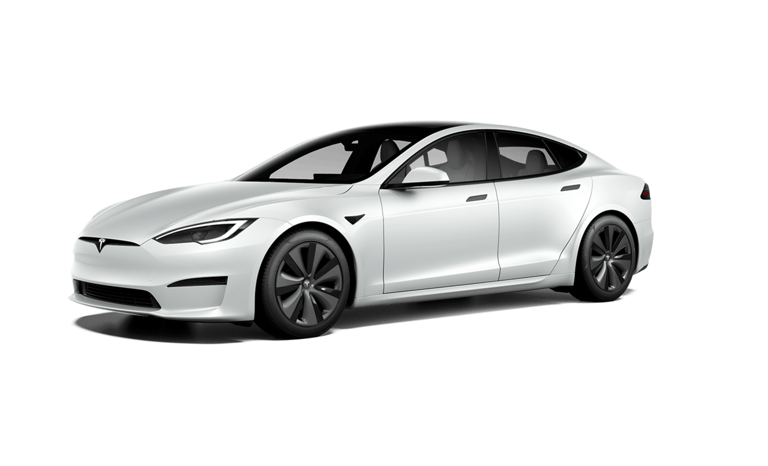
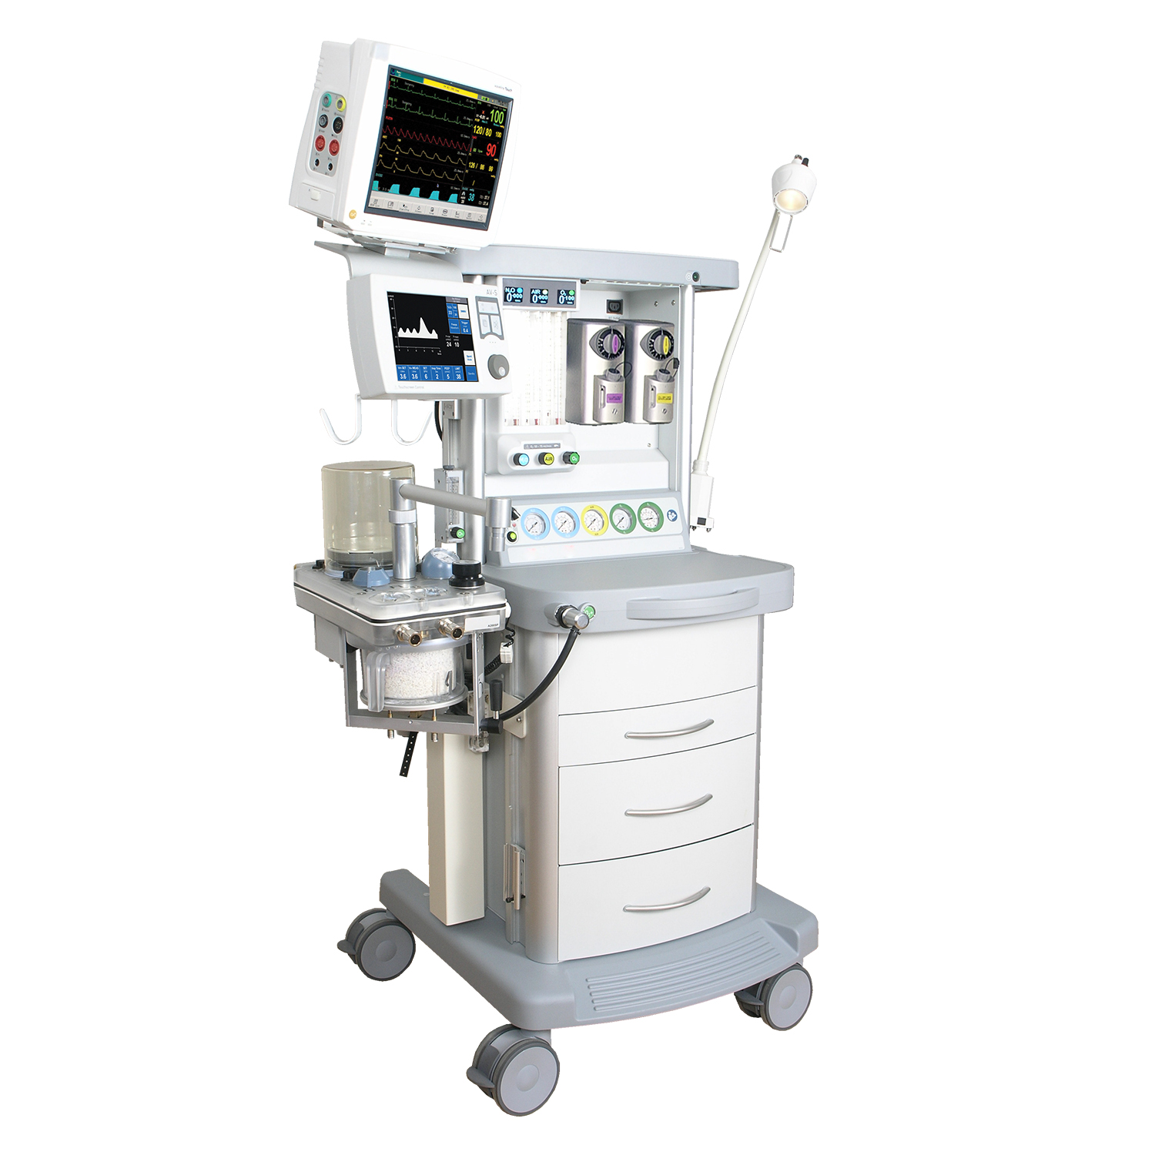
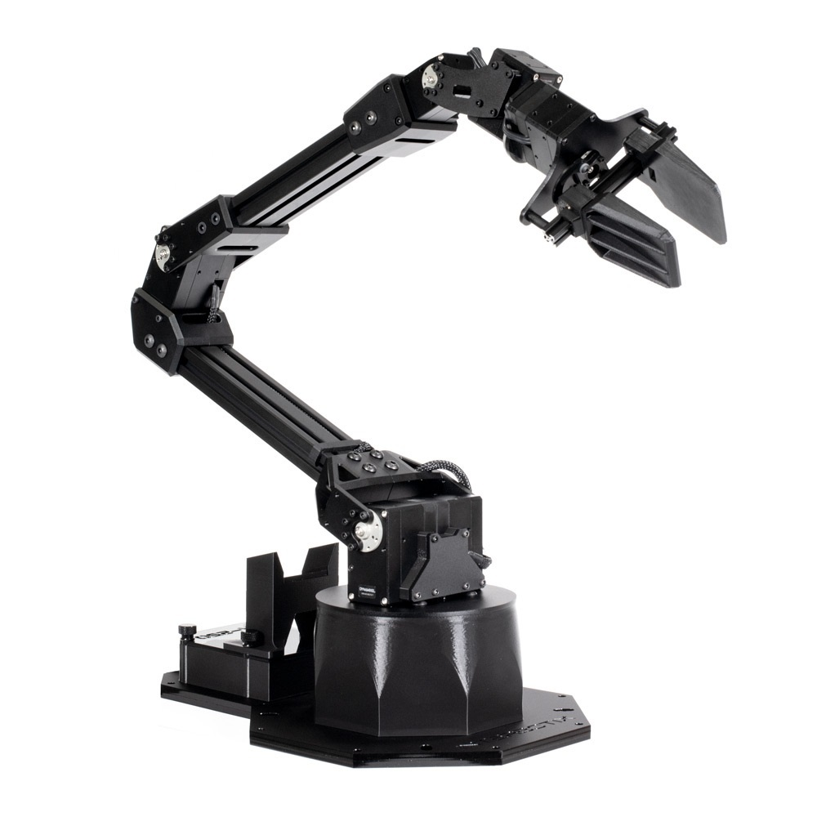
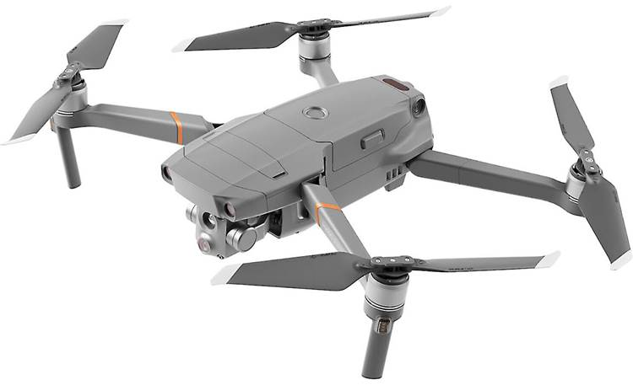
Autonomous Systems
Gathers information from its sensors
Analyzes
Plan & execute an action to achieve its goal
Safe

Slide 14
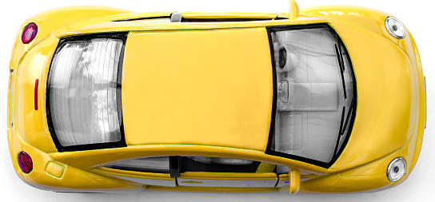
Toy Car Example: Modeling Autonomous Systems
Moves in a 2-D space
Model the movement of the toy car in $x,y$ direction
$$y$$
What are the states of this car?
$$x$$
Notes:
* States – variables that we care about. Want to control/understand in a case study.

Slide 15
Toy Example: Modeling Autonomous Systems
$x\left[t\right]:$ The position of the car in $x$ axis, at time $t$
$y\left[t\right]:$ The position of the car in $y$ axis, at time $t$
$t:$ Time is discrete, $0, 1, 2, ⋯, T$
$$y$$
Position of the vehicle: $\left(x\left[0\right],y\left[0\right]\right),\left(x\left[1\right],y\left[1\right]\right), ⋯,\left(x\left[T\right],y\left[T\right]\right)$
$$x$$

Slide 16
Toy Example: Modeling Autonomous Systems
Position of the car in $x$ axis, at time $1$ $(x\left[1\right])$, is dependent on?
Pos $x\left[1\right]:$Pos at $x\left[0\right]$ & Pos at $y[0]$
Position of the car in $y$ axis, at time $1$ $(y\left[1\right])$, is dependent on?
Pos $y\left[1\right]:$Pos at $x\left[0\right]$ & Pos at $y[0]$
$$y$$
$$x$$

Slide 17
$$x\left[0\right], y\left[0\right]= ?$$
$$x\left[1\right]=0 \\ y\left[1\right]=0.1$$
$$x\left[t\right]=0$$ $y\left[t\right]=y[t−1]$ + $0.1$
$$x\left[2\right]=0 \\ y\left[2\right]=0.2$$
$$y$$
$$x\left[3\right]=0 \\ y\left[3\right]=0.3$$
$$x\left[3\right]=0 \\ y\left[3\right]=y\left[2\right]+0.1$$
$$x\left[t\right]= ? \\ y\left[t\right]= ?$$
$$(0,0)$$
$$x$$
Notes:
Dynamics/Model of the system

Slide 18
$$x\left[0\right], y\left[0\right]=(0,0)$$
$$x\left[1\right]=0.1 \\ y\left[1\right]=0.1$$
$$x\left[t\right]=x\left[t−1\right]+0.1$$ $y\left[t\right]=y[t−1]$ + $0.1$
$$x\left[2\right]=0.2 \\ y\left[2\right]=0.2$$
$$y$$
$$x\left[3\right]=0.3 \\ y\left[3\right]=0.3$$
$$x\left[3\right]=x\left[2\right]+0.1 \\ y\left[3\right]=y\left[2\right]+0.1$$
$$x\left[t\right]= ? \\ y\left[t\right]= ?$$
$$(0,0)$$
$$x$$

Slide 19
$x\left[t\right]=$ Dependent on both $x\left[t−1\right]$ & $y\left[t−1\right]$
$$y\left[t\right]=\text{Dependent} \text{on} \text{both} x\left[t−1\right] \text{\&} y\left[t−1\right]$$
?
$$y$$
$$(0.1,0.1)$$
$$x$$

Slide 20
$x\left[t\right]=$ $x\left[t−1\right]$ + $y\left[t−1\right]$
$$y\left[t\right]=x\left[t−1\right] \text{+} y\left[t−1\right]$$
$$x\left[0\right], y\left[0\right]=(0.1,0.1)$$
$$x\left[1\right]=0.2 \\ y\left[1\right]=0.2$$
$$(0.8,0.8)$$
$$x\left[2\right]=0.4 \\ y\left[2\right]=0.4$$
$$y$$
$$x\left[3\right]=0.8 \\ y\left[3\right]=0.8$$
$$(0.4,0.4)$$
$$(0.2,0.2)$$
$$(0.1,0.1)$$
$$x$$

Slide 21
$x\left[t\right]=$ $x\left[t−1\right]$ + $y\left[t−1\right]$
$$y\left[t\right]=x\left[t−1\right] \text{+} y\left[t−1\right]$$
$$(0.8,0.8)$$
What if there is an obstacle at $\left(3.2, 3.2\right)$?
$$y$$
Will it be safe?
NO!
$$(0.4,0.4)$$
At what time step does it become unsafe?
$$(0.2,0.2)$$
$$t=5$$
$$(0.1,0.1)$$
$$x$$

Slide 22
$x\left[t\right]=$ $x\left[t−1\right]$ + $y\left[t−1\right]$
$$y\left[t\right]=x\left[t−1\right] \text{+} y\left[t−1\right]$$
$$(0.8,0.8)$$
What if there is an obstacle at $(0.16,0.17)$?
$$y$$
Will it be safe?
Yes!
$$(0.4,0.4)$$
$$(0.2,0.2)$$
$$(0.1,0.1)$$
$$x$$

Slide 23
$x\left[t\right]=$ $x\left[t−1\right]$ + $y\left[t−1\right]$
$$y\left[t\right]=x\left[t−1\right] \text{+} y\left[t−1\right]$$
$$x\left[0\right], y\left[0\right]=(0.1,0.1)$$
$$(0.8,0.8)$$
What if?
$$y$$
$$x\left[0\right]= [0.1,0.3]$$
$$(0.4,0.4)$$
$$y\left[0\right]= [0.4,0.5]$$
How many trajectories are possible?
$$(0.2,0.2)$$
How do you check safety?
$$(0.1,0.1)$$
$$x$$
Notes:
Next, we will move on to some real-world examples

Slide 24
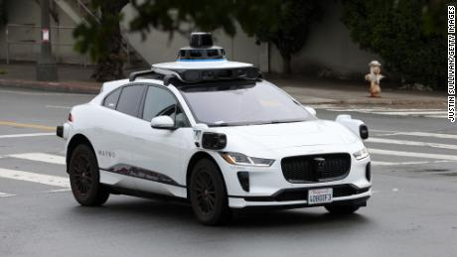
Autonomous Systems Under Uncertainties
Autonomous Systems
Uncertainties
Modeling Errors: Mass, Acceleration, etc.
Dynamic Environment: Humans and Robots Collaborating.
Perception Errors of DNNs.
Timing Uncertainties.
Operate
Notes:
It could be due to Modeling errors.
That is, Accurate measurements of mass/acceleration are required when modeling drones/vehicles, which is often not possible

Slide 25
Robotic Maneuvers
Robot operating on a busy floor
Obstacles
Notes:
Consider this example of a robot trying maneuver through this busy floor.
The obstacles to the robot, that is the wall, is marked in red. And this is what we call the unsafe region.

Slide 26
Robotic Maneuvers
Robot operating on a busy floor
Possible places that can be reached
(Clean Floor)
?
Safe
Oil spill on the floor (uncertainty)!
Still Valid?
26
Notes:
Let’s say, the possible places that can be reached by the robot is marked in blue. And this assumes a clean floor. And This set is what we call the reachable sets.
And we see that set of places that can be reached by the robot is not intersecting with the unsafe region. Therefore, this maneuver is safe.
Now, what if, there is an oil spill on the floor.
Will the reachable set be still valid?
Or, in other words, will this maneuver be still safe?

Slide 27
Robotic Maneuvers
Robot operating on a busy floor
Possible places that can be reached considering oil spill
Unsafe
Safety Analysis Must Consider Uncertainties Explicitly!
27
Notes:
Now let’s say, we compute the reachable set assuming an oil spill. This is now marked in purple.
Now we see that there is intersecting with the unsafe region. Therefore, this maneuver is unsafe.

Slide 28
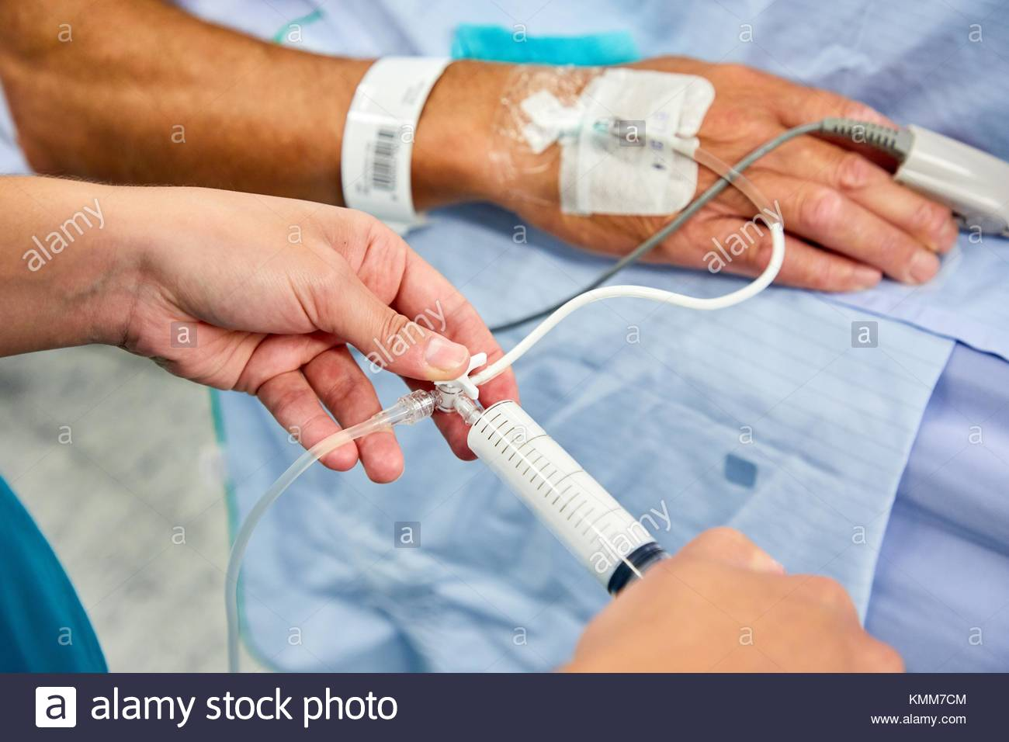
Uncertainties with an Example: Anesthesia
A safety critical event that occurs before (almost) all surgeries.
Determining its safety:
Understanding of how it is metabolized.
Its effect on the depth of hypnosis.
UNC Chapel Hill
Notes:
Next we will review some results from recent result
By the end of this course, you will gain enough understanding to actually understand the techniques involved in this research

Slide 29
Uncertainties with an Example: Anesthesia
PK
PD
Models the metabolization of the drug by the body.
Models the effect of drug on the body.
1st Peripheral Compartment: $c_{1}$.
2nd Peripheral Compartment: $c_{2}$.
Plasma Compartment: $c_{p}$.
$$c_{e}$$
State variables, modeling concentration levels.
Notes:
Components -> Compartments
High concertation level: Unconscious for longer period of time
Low concentration level: Remains conscious during the surgery – traumatic.

Slide 30
Uncertainties with an Example: Anesthesia
modeling
Obtain a dynamical model
The evolution of the state variables
$$c_{p}, c_{1},c_{2},c_{e}$$
Change of concentration levels with input ($u$); the anesthesia drug injected
Notes:
To perform safety analysis . . .

Slide 31
Uncertainties with an Example: Anesthesia
modeling
Obtain a dynamical model
The evolution of the state variables
Parameters: $θ_{1},θ_{2},θ_{3}$
$\dot{c_{1}}$ = $θ_{1}⋅c_{1}$ + $θ_{3}⋅u$
Dictated
Rate of Change ($c_{p}$/ $c_{1}$/ $c_{2}$/ $c_{e}$)
Previous Values of ($c_{p}$/ $c_{1}$/ $c_{2}$/ $c_{e}$)
Effect of Input ($u$)
Interaction
Notes:
Intuitively, the rate to change of the state variables is an interaction between its previous values and the effect of input
And this interaction is dictated by some parameters, say $θ_{1}$, $θ_{2}$, and $θ_{3}$.
One such examples is shown in this equation.
Where $\dot{c}$ denotes the rate of change of concentration level of the state variable $c_{1}$.
Which is equl to: $θ_{1}$ times $c_{1}$(the previous value of $c_{1}$) + $θ_{3}$ times the input

Slide 32
Uncertainties with an Example: Anesthesia
These parameters are determined empirically
(Weight, Alveolar Volumes, etc.)
Parameters: $θ_{1},θ_{2},θ_{3}$
$\left(θ_{1}+θ_{2}\right)⋅c_{1}$ + $θ_{3}⋅u$
Dictated
Rate of Change ($c_{p}$/ $c_{1}$/ $c_{2}$/ $c_{e}$)
Previous Values of ($c_{p}$/ $c_{1}$/ $c_{2}$/ $c_{e}$)
Effect of Input ($u$)
Interaction
Notes:
Note that these parameters are obtained empirically.
These are dependent on several factors of the patient, such as, weight, lung capacity etc.

Slide 33
Uncertainties with an Example: Anesthesia
modeling
Obtain a dynamical model
The evolution of the state variables
Dynamics
Parameters: $θ_{1},θ_{2},θ_{3}$
Dictated
Rate of Change ($c_{p}$/ $c_{1}$/ $c_{2}$/ $c_{e}$)
Previous Values of ($c_{p}$/ $c_{1}$/ $c_{2}$/ $c_{e}$)
Effect of Input ($u$)
Interaction
Notes:
And this what is the dynamics of the system

Slide 34
Uncertainties with an Example: Anesthesia
modeling
Obtain a dynamical model
The evolution of the state variables
Dynamics
Notes:
Now that we have the dynamics of the system

Slide 35
Uncertainties with an Example: Anesthesia
Given the rate of change of the concentration levels
Compute
Concentration levels after time $t$
Reachable Sets
Dynamics
Notes:
Which gives us the rate of change of concertation levels.
We can compute the possible concentration levels after time t.
And this is what we call the reachable sets.

Slide 36
Uncertainties with an Example: Anesthesia
$$C_{p}$$
Initial concentration level of $c_{p}$ ($[2.1,2.2]$)
$$C_{1}$$
Initial concentration level of $c_{1}$ ($[2.1,2.15]$)
$$C_{2}$$
Initial concentration level of $c_{2}$
$$C_{e}$$
Initial concentration level of $c_{p}$
$$u$$
Injected drug $u$
Notes:
As an illustration, let us consider the following initial concentration levels.

Slide 37
Uncertainties with an Example: Anesthesia
Using the dynamics, compute the concentration levels after time $t$
Initial Set
$$C_{p}$$
After time $t$
$$C_{p}$$
$$C_{1}$$
$$C_{1}$$
$$C_{2}$$
$$C_{2}$$
$$C_{e}$$
Reachable Set at time $t$
$$C_{e}$$
$$u$$
$$u$$

Slide 38
Uncertainties with an Example: Anesthesia
Reachable sets are a tool for safety verification
Check if concentration levels are safe
$$C_{p}$$
$$C_{1}$$
$$C_{2}$$
$$C_{e}$$
$$u$$
Notes:
Now the question is, why do we care about computing reachable sets?
We care about computing reachable sets is because, it is a handy tool to perform safety verification, among many
Now that we know possible concentration levels after time t apriori, we can check if those concentration levels are indeed withing the safe limits or not. That is, not too high, or not too low.

Slide 39
Uncertainties with an Example: Anesthesia
A safety critical event that occurs before (almost) all surgeries.
Determining its safety:
Understanding of how it is metabolized.
Its effect on the depth of hypnosis.
Safety Analysis Using Reachable Sets
UNC Chapel Hill
Notes:
Now, let’s recall the anesthesia model again.
And we would want to perform safety verification of the model using reachable sets.

