Slide 1
Trustworthy Autonomy Lecture 19
Bineet Ghosh
bineet@ua.edu

Slide 2
Closed Loop Controller
$p$: Number of states variables
Augmented
$I$: Identity matrix
Notes:
Now that we have discretized dynamics, and its controller.
We can augment the two, and obtain a single dynamics-matrix.

Slide 3
Stability
Magnitude of the eigenvalues of $A$ are strictly less than 1.
Stable
Notes:
The augmented system is said to be stable, iff, the magnitude of the eigenvalues of the dynamics matrix (A) are strictly less than 1

Slide 4
Stability: Spectral Radius
Spectral Radius $ρ(A)$:
Eigen Values of $A$:
Stable
$$ρ\left(A\right)<1$$
In absence of deadline miss

Slide 5
Stability In Presence of Deadline Misses
Aspects
Control signal to apply at deadline miss.
How the system treats the job missing the deadline.
Notes:
Now, we want to study stability in presence of deadline misses.
The aspects that we consider here, are the following.

Slide 6
Stability In Presence of Deadline Misses
Control signal to apply at deadline miss
Zero. $u\left[k+1\right]=0$.
Hold. $u\left[k+1\right]$ is unchanged (same as the previous input).
$$u\left[k+1\right]=u[k]$$

Slide 7
Stability In Presence of Deadline Misses
How the system treats the job missing the deadline.
Kill. The job is killed.
Skip-Next. The job is allowed to continue.

Slide 8
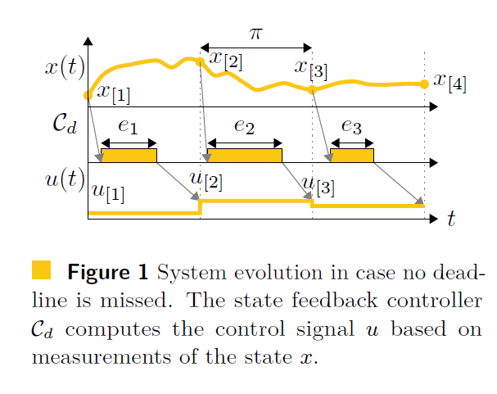
Stability In Presence of Deadline Misses
Notes:
X(t) is the state space. C_d is computing the input. And u(t) is the input.
At each period, C_d senses the state of the system x(t), computes the input, and applies at the beginning of the next period.
This assumes that no deadline is missed. That is, C_d always computes the input before the next period.
What if it doesn’t?

Slide 9
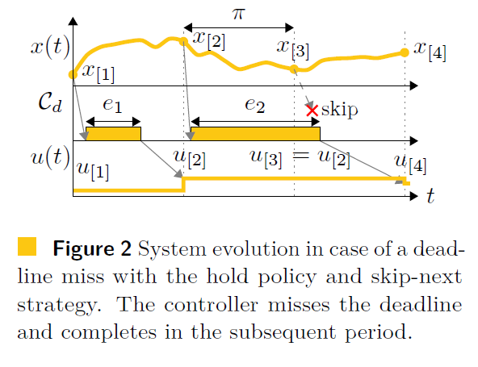
Stability In Presence of Deadline Misses
Notes:
For instance, here, at the second period, C_d was not able to compute the input on time.
So the previously know input is applied. Note we could have also applied zero input.
And the process is allowed to run. Although we could have also killed the process. In that case, it would have started with a fresh measurement of the process.

Slide 10
Stability In Presence of Deadline Misses
$Σ^{μ}$: Behavior after $μ$ evolution steps.
Where each step is a hit/set of misses followed by a hit
$ρ_{μ}(Σ)$: Spectral radius after $μ$ evolution steps.
$$ρ\left(Σ\right)=\lim_{μ→∞}\sup{ρ_{u}(Σ)}$$
Notes:
Let’s say, \Sigma_mu is the evolution after \mu steps. Where each step is a hit, or a set of misses followed by a hit.
Let \rho_mu be the spectral radius after \mu evolution steps.
Then, \rho is the supremum of all possible \mu. In the other words, \rho is the max possible spectral radius of the system, under the allowed pattern of deadline misses, upto any time horizon.
Note that this is not a bounded time behavior.

Slide 11
Stability In Presence of Deadline Misses
$$ρ\left(Σ\right)<1$$
Stable
Computing this is undecidable!
However, approximation techniques are known.
$$ρ\left(Σ\right)∈[lb,ub]$$

Slide 12
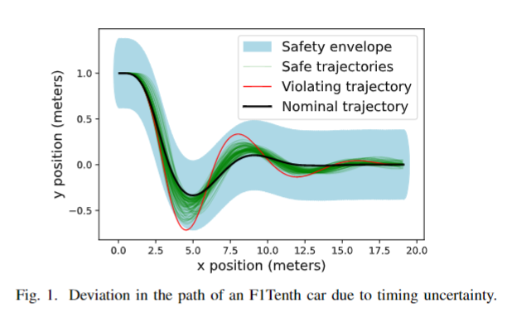
Does Stable Means Safe?
Notes:
Consider this example of F1Tenth car. Where the nominal trajectory is given in black, assuming no deadline misses.
And in cyan, the safety envelope is given.
Due to timing uncertainties, the car can miss its deadline, such trajectories are shown in black and red.
Note that, unlike the black trajectories, the red one goes out of the safety envelope for a brief time.
Though all the trajectories are stable, some might still be unsafe – as shown here.

Slide 13
Dynamics
Discretize
Notes:
Given a continuous time system, we discretize the system, and compute it’s controller.

Slide 15
Notes:
* Set C=I. D=0

Slide 16
Dynamics
Discretize
Notes:
Given a continuous time system, we discretize the system, and compute it’s controller.

Slide 17
Discretization using Python
import numpy as np
import matplotlib.pyplot as plt
from scipy.signal import cont2discrete, lti, dlti, dstep
A = np.array([[0, 1],[-10., -3]])
B = np.array([[0],[10.]])
C = np.array([[1., 0]])
D = np.array([[0.]])
dt = 0.1
d_system = cont2discrete((A, B, C, D), dt)
$$n=2,m=1$$

Slide 18
Discrete Systems
$x_{[k+1]}=Ax_{[k]}+Bx_{[k]}$
$u_{[k]}=?⋅x_{[k]}$

Slide 19
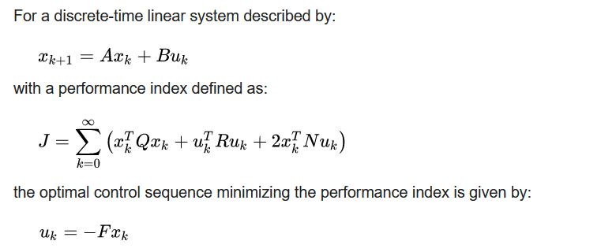
Discrete Time LQR Control (Infinite Time)

Slide 20
Discrete Time LQR Controller using Python

Slide 21
Discrete Systems
$x_{[k+1]}=Ax_{[k]}+Bu_{[k]}$
$u_{[k]}=K⋅x_{[k]}$
Augmented: $x_{[k+1]}=Ax_{[k]}+B⋅{K⋅x}_{[k]}$
$x_{[k+1]}=\left(A+BK\right){⋅x}_{[k]}$
$$K=−F$$
Notes:
* Augmentation allows us to compute reachable sets using our known methods – vertex shooting

Slide 22
Homework 3
Will be posted today (after the class)
Due: 11:59pm, April 1.

Slide 23
Discrete Systems
$x_{[k+1]}=Ax_{[k]}+Bu_{[k]}$
$u_{[k]}=K⋅x_{[k−1]}$
To account for delays

Slide 24
Dynamics
Discretize
Notes:
Given a continuous time system, we discretize the system, and compute it’s controller.

Slide 25
LET Paradigm
The controller input is computed within a control period
Applied at the beginning of the next control period
Notes:
We follow the LET paradigm.
That is, the controller input is computed within a control period.
And applied at the beginning of the next control period.

Slide 26
Discrete Systems
$x_{[k+1]}=Ax_{[k]}+Bu_{[k]}$
$u_{[k]}=K⋅x_{[k−1]}$
To account for delays

Slide 27
Augmentation for LET

Slide 28
What if there’s a deadline miss?

Slide 29
Zero&Kill

Slide 30
Hold&Kill

Slide 31
Reachable sets with hits/misses

