Slide 1
Trustworthy Autonomy Lecture 18
Bineet Ghosh
bineet@ua.edu

Slide 2
Uncertainties with an Example: Anesthesia
modeling
Obtain a dynamical model
The evolution of the state variables
Dynamics
Parameters: $θ_{1},θ_{2},θ_{3}$
Dictated
Rate of Change ($c_{p}$/ $c_{1}$/ $c_{2}$/ $c_{e}$)
Previous Values of ($c_{p}$/ $c_{1}$/ $c_{2}$/ $c_{e}$)
Effect of Input ($u$)
Interaction
Notes:
And this what is the dynamics of the system

Slide 3
Uncertainties with an Example: Anesthesia
modeling
Obtain a dynamical model
The evolution of the state variables
Dynamics
Notes:
Now that we have the dynamics of the system

Slide 4
Uncertainties with an Example: Anesthesia
Given the rate of change of the concentration levels
Compute
Concentration levels after time $t$
Reachable Sets
Dynamics
Notes:
Which gives us the rate of change of concertation levels.
We can compute the possible concentration levels after time t.
And this is what we call the reachable sets.

Slide 5
Uncertainties with an Example: Anesthesia
$$C_{p}$$
Initial concentration level of $c_{p}$ ($[2.1,2.2]$)
$$C_{1}$$
Initial concentration level of $c_{1}$ ($[2.1,2.15]$)
$$C_{2}$$
Initial concentration level of $c_{2}$
$$C_{e}$$
Initial concentration level of $c_{p}$
$$u$$
Injected drug $u$
Notes:
As an illustration, let us consider the following initial concentration levels.

Slide 6
Uncertainties with an Example: Anesthesia
Using the dynamics, compute the concentration levels after time $t$
Initial Set
$$C_{p}$$
After time $t$
$$C_{p}$$
$$C_{1}$$
$$C_{1}$$
$$C_{2}$$
$$C_{2}$$
$$C_{e}$$
Reachable Set at time $t$
$$C_{e}$$
$$u$$
$$u$$

Slide 7
Uncertainties with an Example: Anesthesia
Reachable sets are a tool for safety verification
Check if concentration levels are safe
$$C_{p}$$
$$C_{1}$$
$$C_{2}$$
$$C_{e}$$
$$u$$
Notes:
Now the question is, why do we care about computing reachable sets?
We care about computing reachable sets is because, it is a handy tool to perform safety verification, among many
Now that we know possible concentration levels after time t apriori, we can check if those concentration levels are indeed withing the safe limits or not. That is, not too high, or not too low.

Slide 8
Important Dates
Today: March 20
Last Class: April 24
Student Presentations (1-3 Papers): April 15 & April 17
Papers uploaded to Blackboard.
Submit preferences by: April 1
Final Project Report: April 24 - May 1 (Discuss)
Homework: 1-2 more
Notes:
Unless some need arises, we will stick to these dates
Papers: Help you in your project. Write these works as related work. So definitely start reading all the papers.
Presentation: 30 mins, see previous slides for details on how to prepare the slides. 10-15 Q&A. Rest of the class we will discuss updates on projects.
Final Project report: IEEE two column format, max 8 pages. Must have experiments, problem statement, related works.

Slide 9
Next: Controller Design

Slide 10
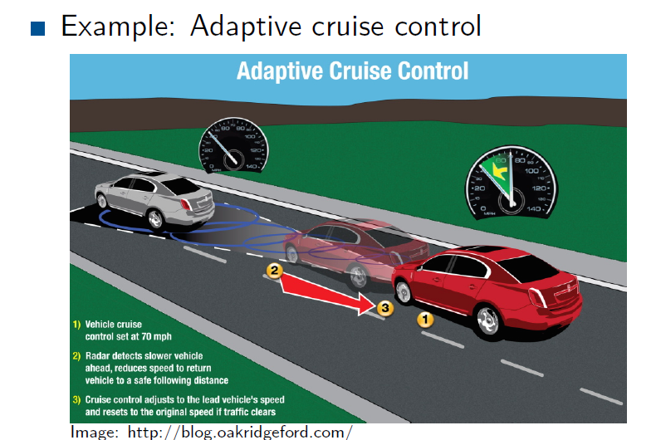

Slide 14
Notes:
* Model: room temp, airflow, (rate of drop in temp with a airflow, rate of increase )

Slide 24
Notes:
* Note: The matrix changes at every time step unlike time-invariant systems

Slide 25
Dynamics
Discretize
Notes:
Given a continuous time system, we discretize the system, and compute it’s controller.

Slide 26
LET Paradigm
The controller input is computed within a control period
Applied at the beginning of the next control period
Notes:
We follow the LET (Logical Execution Time) paradigm.
That is, the controller input is computed within a control period.
And applied at the beginning of the next control period.

Slide 27
Closed Loop Controller
$p$: Number of states variables
Augmented
$I$: Identity matrix
Notes:
Now that we have discretized dynamics, and its controller.
We can augment the two, and obtain a single dynamics-matrix.

Slide 28
Stability
Magnitude of the eigenvalues of $A$ are strictly less than 1.
Stable
Notes:
The augmented system is said to be stable, iff, the magnitude of the eigenvalues of the dynamics matrix (A) are strictly less than 1

Slide 29
Eigenvalues of A

Slide 30
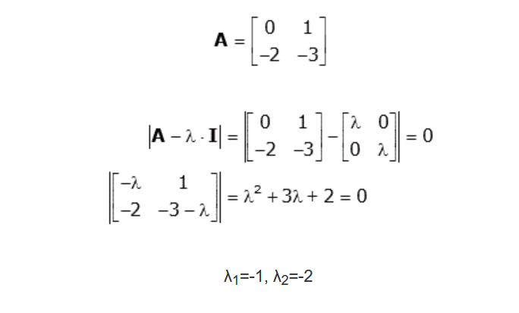

Slide 31
