Slide 1
Trustworthy Autonomy Lecture 17
Bineet Ghosh
bineet@ua.edu

Slide 2
23
Offline Monitoring of noisy-logs to detect possible safety violation.
Online Monitoring to reduce number of logs required. This targets at energy efficiency, as less logs $⇒$ less energy consumed by the logger.
Evaluated both our methods on two case studies, namely Adaptive Cruise Control (ACC), and Anesthesia Delivery.

Slide 3
Monitoring: Proposed Strategy
18
Scattered & Noisy Logs
Reconstruct missing logs using reachability of uncertain linear systems
Safe or Unsafe?
Bounding Model: Over-approximated using Uncertain Linear Systems

Slide 4
Offline Monitoring
24
Unsafe Set
$$t+5$$
$$t$$
Two consecutive logs $k$ and $k+1$ gathered at time steps $t$ and $t+5$ respectively.
$$\log_{k+1}{=( , t+5)}$$
Safe Set
$$\log_{k}{=( , t)}$$
Unsafe Set

Slide 5
Offline Monitoring
25
Unsafe Set
$$t+5$$
$$t$$
Main Idea: Check if the reachable set from $\log_{k}$ reaches $\log_{k+1}$ while intersecting the unsafe region.
$$\log_{k+1}{=( , t+5)}$$
Safe Set
$$\log_{k}{=( , t)}$$
Unsafe Set

Slide 6
Offline Monitoring
26
Reachable sets are represented in blue.
Unsafe Set
$$t+1$$
$$t+5$$
$$t$$
$$\log_{k+1}{=( , t+5)}$$
Safe Set
$$\log_{k}{=( , t)}$$
Reachable set at time step $t+1$
Unsafe Set

Slide 7
Offline Monitoring
27
Reachable sets are represented in blue.
Unsafe Region
$$t+2$$
Unsafe Set
$$t+1$$
$$t+5$$
$$t$$
Check if the next sample is reachable from the unsafe region
$$\log_{k+1}{=( , t+5)}$$
Safe Set
$$\log_{k}{=( , t)}$$
Unsafe Set

Slide 8
Offline Monitoring
28
Reachable sets are represented in blue.
Unsafe Region
$$t+2$$
Unsafe Set
$$t+1$$
$$t+5$$
$$t$$
Check if the next sample is reachable from the unsafe region
$$\log_{k+1}{=( , t+5)}$$
Safe Set
$$\log_{k}{=( , t)}$$
If Yes: Potentially Unsafe!
If No: Safe!
Unsafe Set

Slide 9
Online Monitoring
29
Compute this
Given this, when should the next log be obtained? I.e., compute $t′$
$$\log_{k}{=( , t)}$$
$$\log_{k+1}{=( , t′)}$$

Slide 10
Online Monitoring
30
A log at this step is needed!
$$t+4$$
$$t+3$$
$$t+1$$
$$t+2$$
Certainly safe until time step $t+3$. So, any logs, in between, are practically useless.
$$\log_{k}{=( , t)}$$

Slide 11
Case Study: Anesthesia
31
PK
PD
Models the metabolization of the drug by the body.
Models the effect of drug on the body.
1st Peripheral Compartment: $c_{1}$.
2nd Peripheral Compartment: $c_{2}$.
Plasma Compartment: $c_{p}$.
$$c_{e}$$
State variables, modelling concentration levels.
“Benchmark Problem: A PK/PD Model and Safety Constraints for Anesthesia Delivery” Victor Gan, Guy Albert Dumont, and Ian Mitchell. ARCH@CPSWeek 2014 and ARCH@CPSWeek 2015.

Slide 12
Case Study: Anesthesia
32
Given: Logs of a patient.
Task 1: Whether the plasma concertation ($c_{p}$) of the patient violated the safe range at any time?
Task 2: Compare offline and online monitoring.
“Benchmark Problem: A PK/PD Model and Safety Constraints for Anesthesia Delivery” Victor Gan, Guy Albert Dumont, and Ian Mitchell. ARCH@CPSWeek 2014 and ARCH@CPSWeek 2015.

Slide 13
Case Study: Anesthesia
33
Black: Scattered & noisy logs given as input.
Blue: Computed Reachable Sets
“Benchmark Problem: A PK/PD Model and Safety Constraints for Anesthesia Delivery” Victor Gan, Guy Albert Dumont, and Ian Mitchell. ARCH@CPSWeek 2014 and ARCH@CPSWeek 2015.

Slide 14
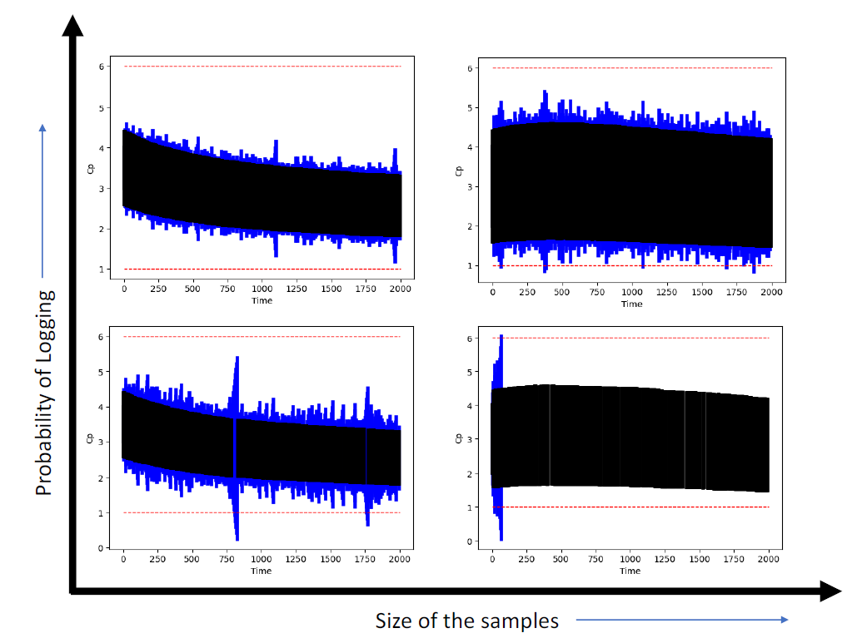
Case Study: Anesthesia (Offline Monitoring)
34
Safe!
Safe!
Increasing the probability of logging results in less false alarms.
Increasing the noise in the logs results in more false alarms.
Safe!
Unsafe?
Amount of uncertainty in the log

Slide 15
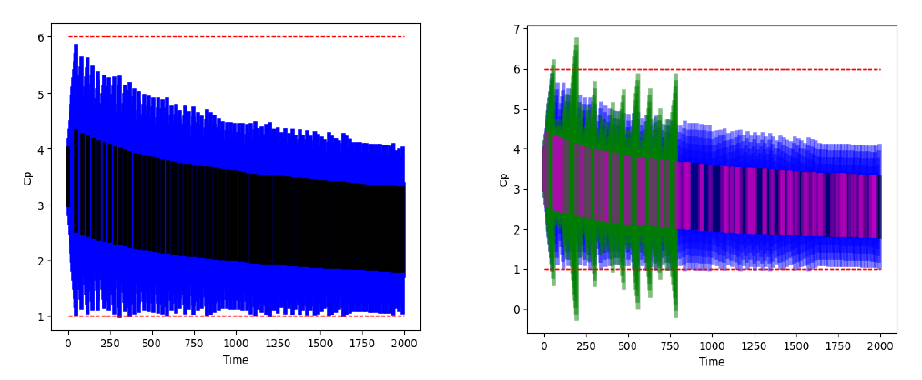
Case Study: Anesthesia (Online Monitoring)
35
Green: Reach set computed by offline monitoring.
Purple: Logs given to the offline monitoring
Proved safety using just 5% logs of the total time steps.
The offline monitoring raised false alarm at 35th log (out of 115), whereas online monitoring proved safety using just 84 logs!

Slide 16
Conclusion
36
We present online and offline monitoring approaches.
The offline approach monitors noisy and scattered logs for safety, assuming a bounding model.
The online approach aims at energy efficiency, only logging when required.
Extension: What happens when the log timestamps are uncertain too?

Slide 17
Final Project Logistics
Due today by 11:59pm.
Everyone must submit (not just one member of the team)

Slide 18
So Far . . .
Course Objectives
Introduction to Formal Methods
Autonomous Systems
Design and Verification of Safe Autonomous Systems

Slide 19
So Far . . .
Course Objectives
Introduction to Formal Methods
Autonomous Systems
Design and Verification of Safe Autonomous Systems

Slide 20
Course Objectives: Formal Methods
Understand the fundamental concepts and principles of formal methods.
Gain insights into the techniques used for verifying the safety and correctness of programs and autonomous systems.
Explore the theoretical foundations of formal methods and their practical applications.
Notes:
Learnt techniques for FM (The cyber part)
Toy example
Next, we learn about the physical part

Slide 21
So Far . . .
Course Objectives
Introduction to Formal Methods
Autonomous Systems
Design and Verification of Safe Autonomous Systems
Notes:
* We will learn it through control theory

Slide 22
Course Objectives: Autonomous Systems
Understand the concept of autonomous systems.
Learn to model autonomous systems for formal analysis.
Learn about different types of models and their inherent properties.

Slide 23
Recall why we need a model

Slide 24
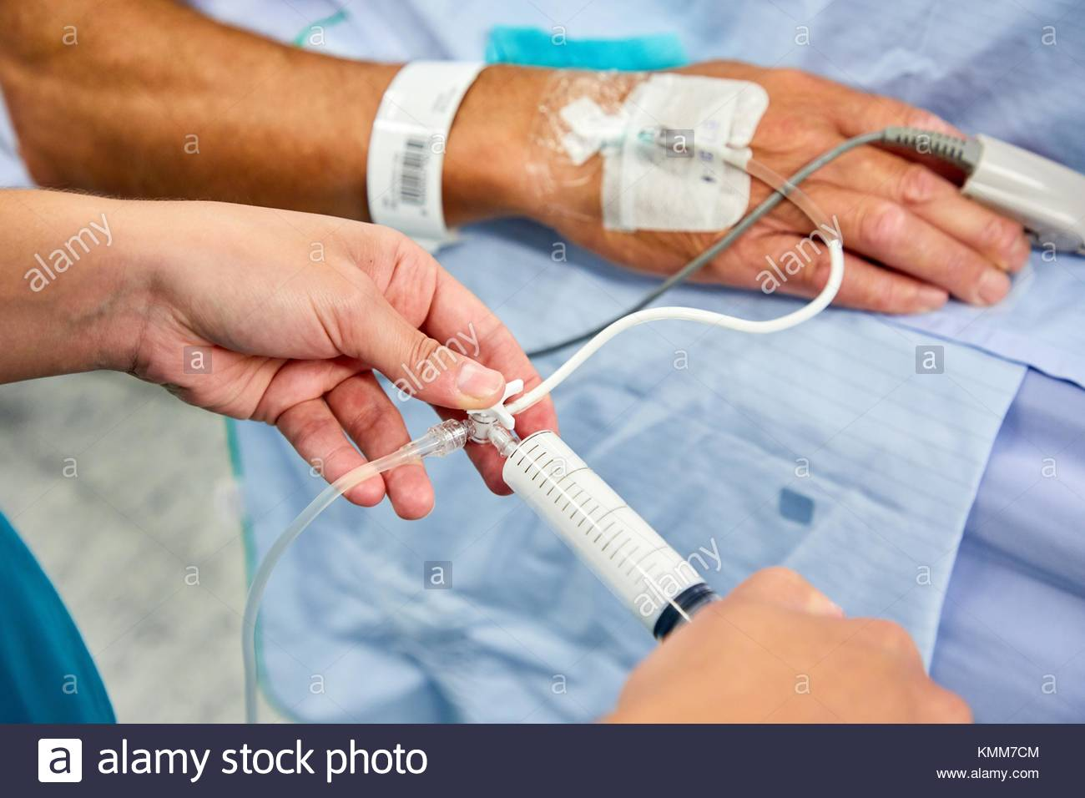
Uncertainties with an Example: Anesthesia
A safety critical event that occurs before (almost) all surgeries.
Determining its safety:
Understanding of how it is metabolized.
Its effect on the depth of hypnosis.
UNC Chapel Hill
Notes:
Next we will review some results from recent result
By the end of this course, you will gain enough understanding to actually understand the techniques involved in this research

Slide 25
Uncertainties with an Example: Anesthesia
PK
PD
Models the metabolization of the drug by the body.
Models the effect of drug on the body.
1st Peripheral Compartment: $c_{1}$.
2nd Peripheral Compartment: $c_{2}$.
Plasma Compartment: $c_{p}$.
$$c_{e}$$
State variables, modeling concentration levels.
Notes:
Components -> Compartments
High concertation level: Unconscious for longer period of time
Low concentration level: Remains conscious during the surgery – traumatic.

Slide 26
Uncertainties with an Example: Anesthesia
modeling
Obtain a dynamical model
The evolution of the state variables
$$c_{p}, c_{1},c_{2},c_{e}$$
Change of concentration levels with input ($u$); the anesthesia drug injected
Notes:
To perform safety analysis . . .

Slide 27
Uncertainties with an Example: Anesthesia
modeling
Obtain a dynamical model
The evolution of the state variables
Parameters: $θ_{1},θ_{2},θ_{3}$
$\dot{c_{1}}$ = $θ_{1}⋅c_{1}$ + $θ_{3}⋅u$
Dictated
Rate of Change ($c_{p}$/ $c_{1}$/ $c_{2}$/ $c_{e}$)
Previous Values of ($c_{p}$/ $c_{1}$/ $c_{2}$/ $c_{e}$)
Effect of Input ($u$)
Interaction
Notes:
Intuitively, the rate to change of the state variables is an interaction between its previous values and the effect of input
And this interaction is dictated by some parameters, say $θ_{1}$, $θ_{2}$, and $θ_{3}$.
One such examples is shown in this equation.
Where $\dot{c}$ denotes the rate of change of concentration level of the state variable $c_{1}$.
Which is equl to: $θ_{1}$ times $c_{1}$(the previous value of $c_{1}$) + $θ_{3}$ times the input

Slide 28
Uncertainties with an Example: Anesthesia
These parameters are determined empirically
(Weight, Alveolar Volumes, etc.)
Parameters: $θ_{1},θ_{2},θ_{3}$
$\left(θ_{1}+θ_{2}\right)⋅c_{1}$ + $θ_{3}⋅u$
Dictated
Rate of Change ($c_{p}$/ $c_{1}$/ $c_{2}$/ $c_{e}$)
Previous Values of ($c_{p}$/ $c_{1}$/ $c_{2}$/ $c_{e}$)
Effect of Input ($u$)
Interaction
Notes:
Note that these parameters are obtained empirically.
These are dependent on several factors of the patient, such as, weight, lung capacity etc.

Slide 29
Uncertainties with an Example: Anesthesia
modeling
Obtain a dynamical model
The evolution of the state variables
Dynamics
Parameters: $θ_{1},θ_{2},θ_{3}$
Dictated
Rate of Change ($c_{p}$/ $c_{1}$/ $c_{2}$/ $c_{e}$)
Previous Values of ($c_{p}$/ $c_{1}$/ $c_{2}$/ $c_{e}$)
Effect of Input ($u$)
Interaction
Notes:
And this what is the dynamics of the system

Slide 30
Uncertainties with an Example: Anesthesia
modeling
Obtain a dynamical model
The evolution of the state variables
Dynamics
Notes:
Now that we have the dynamics of the system

Slide 31
Uncertainties with an Example: Anesthesia
Given the rate of change of the concentration levels
Compute
Concentration levels after time $t$
Reachable Sets
Dynamics
Notes:
Which gives us the rate of change of concertation levels.
We can compute the possible concentration levels after time t.
And this is what we call the reachable sets.

Slide 32
Uncertainties with an Example: Anesthesia
$$C_{p}$$
Initial concentration level of $c_{p}$ ($[2.1,2.2]$)
$$C_{1}$$
Initial concentration level of $c_{1}$ ($[2.1,2.15]$)
$$C_{2}$$
Initial concentration level of $c_{2}$
$$C_{e}$$
Initial concentration level of $c_{p}$
$$u$$
Injected drug $u$
Notes:
As an illustration, let us consider the following initial concentration levels.

Slide 33
Uncertainties with an Example: Anesthesia
Using the dynamics, compute the concentration levels after time $t$
Initial Set
$$C_{p}$$
After time $t$
$$C_{p}$$
$$C_{1}$$
$$C_{1}$$
$$C_{2}$$
$$C_{2}$$
$$C_{e}$$
Reachable Set at time $t$
$$C_{e}$$
$$u$$
$$u$$

Slide 34
Uncertainties with an Example: Anesthesia
Reachable sets are a tool for safety verification
Check if concentration levels are safe
$$C_{p}$$
$$C_{1}$$
$$C_{2}$$
$$C_{e}$$
$$u$$
Notes:
Now the question is, why do we care about computing reachable sets?
We care about computing reachable sets is because, it is a handy tool to perform safety verification, among many
Now that we know possible concentration levels after time t apriori, we can check if those concentration levels are indeed withing the safe limits or not. That is, not too high, or not too low.

Slide 35
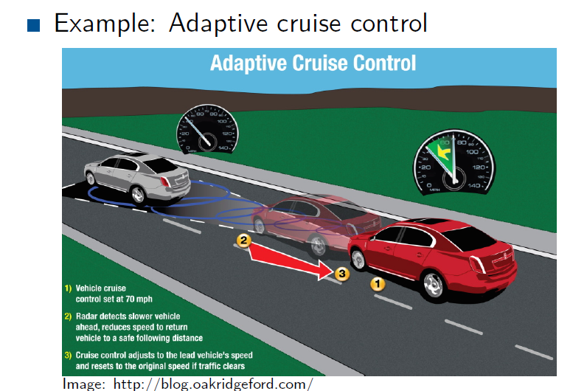

Slide 39
Notes:
* Model: room temp, airflow, (rate of drop in temp with a airflow, rate of increase )

Slide 49
Notes:
* Note: The matrix changes at every time step unlike time-invariant systems

