Slide 1
Trustworthy Autonomy Lecture 16
Bineet Ghosh
bineet@ua.edu

Slide 2
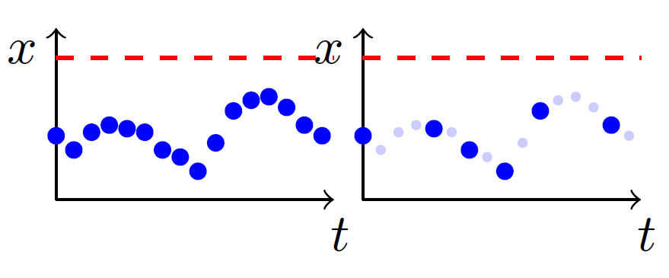
Monitoring: Logs
13
Unsafe region!
Logging at every time step.
Logging at some time steps.
Did the system reach the unsafe region at missing log steps?
Main Idea: Reconstruct the missing logs!

Slide 3
Monitoring: Naïve Approaches
14
Three possible reconstruction of the missing logs.
Green dots represent reconstructed samples.
Blue dots represent the scattered logs.

Slide 4
Monitoring: Naïve Approaches
15
Problems:
Often models the behavior inaccurately!
Can yield a “safe” answer, while the actual system might have been unsafe (unsound).
Reconstructed using piecewise-constant or linear approximation.
Green dots represent reconstructed samples.
Blue dots represent the scattered logs.

Slide 5
Monitoring: Naïve Approaches
16
Reconstructed assuming arbitrary dynamics.
Problems:
Always yields potentially “unsafe”!
Removes interest of monitoring!
Green dots represent reconstructed samples.
Blue dots represent the scattered logs.

Slide 6
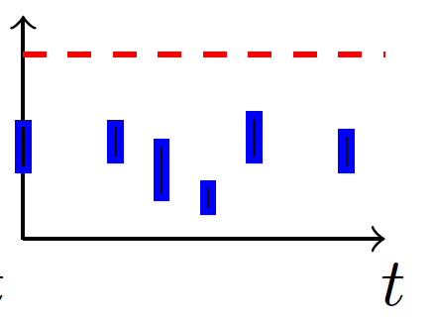
Monitoring: Logs
17
Logging at every time step.
Scattered Logging.
Scattered & Noisy Logging.
Considered in this work.

Slide 7
Monitoring: Proposed Strategy
18
Scattered & Noisy Logs
Reconstruct missing logs using reachability of uncertain linear systems
Safe or Unsafe?
Bounding Model: Over-approximated using Uncertain Linear Systems

Slide 8
Monitoring: Proposed Strategy
19
Scattered & Noisy Logs
Reconstruct missing logs using reachability of uncertain linear systems
Safe or Unsafe?
Bounding Model: Over-approximated using Uncertain Linear Systems
To be introduced next . . .

Slide 9



Bounding Model: A Toy Example
20
$$\begin{matrix}x_{1}^{+} \\ x_{2}^{+}\end{matrix}$$
$$\begin{matrix}1 & θ \\ 0 & 1\end{matrix}$$
$$\begin{matrix}x_{1} \\ x_{2}\end{matrix}$$

Slide 10

Bounding Model: A Toy Example
21
$$\begin{matrix}x_{1}^{+} \\ x_{2}^{+}\end{matrix}$$
$$\begin{matrix}1 & θ \\ 0 & 1\end{matrix}$$
$$\begin{matrix}x_{1} \\ x_{2}\end{matrix}$$
Parameter to the system
$$θ∈\left[−0.2,0.2\right]$$
Not a fixed value, but a range

Slide 11
Bounding Model: A Toy Example
22
$$θ∈\left[−0.2,0.2\right]$$
$$\begin{matrix}x_{1}^{+} \\ x_{2}^{+}\end{matrix}$$
$$\begin{matrix}1 & θ \\ 0 & 1\end{matrix}$$
$$\begin{matrix}x_{1} \\ x_{2}\end{matrix}$$
A subclass of non-linear systems, known as Uncertain Linear Systems.
Represents an over-approximation of the model, when the perfect model is unknown.

Slide 12
23
Offline Monitoring of noisy-logs to detect possible safety violation.
Online Monitoring to reduce number of logs required. This targets at energy efficiency, as less logs $⇒$ less energy consumed by the logger.
Evaluated both our methods on two case studies, namely Adaptive Cruise Control (ACC), and Anesthesia Delivery.

