Slide 1
Trustworthy Autonomy Lecture 15
Bineet Ghosh
bineet@ua.edu

Slide 2
Where are we now? Topics
Introduction
Formal Methods
Cyber-Physical and Autonomous Systems
Verification of Autonomous Systems

Slide 3
Where are we now? Topics
Introduction
Formal Methods
Cyber-Physical and Autonomous Systems
Verification of Autonomous Systems

Slide 4
Topics: Introduction
Autonomous systems
Notion of trust in deployment of autonomous systems

Slide 5
Topics
Introduction
Formal Methods
Cyber-Physical and Autonomous Systems
Verification of Autonomous Systems

Slide 6
Topics: Formal Methods
Mathematical logic
Verifying correctness of programs
Software testing

Slide 7
Topics
Introduction
Formal Methods
Cyber-Physical and Autonomous Systems
Verification of Autonomous Systems
After Spring break

Slide 8
Topics: Cyber-Physical and Autonomous Systems
Introduction to control theory
Linear systems
Hybrid automata

Slide 9
Topics
Introduction
Formal Methods
Cyber-Physical and Autonomous Systems
Verification of Autonomous Systems
After Spring break

Slide 10
Topics: Verification of Autonomous Systems
Understanding uncertainties
Provable safety verification of autonomous systems
Designing provably safe and performance optimal systems

Slide 11
Topics
Introduction
Formal Methods
Cyber-Physical and Autonomous Systems
Verification of Autonomous Systems
Already Covered!
After Spring break!

Slide 12
Final Project Logistics
Need to finalize: 11:59pm, Mar. 18, 2024.
Submit through blackboard
Think it during the Spring break!
Discuss

Slide 13
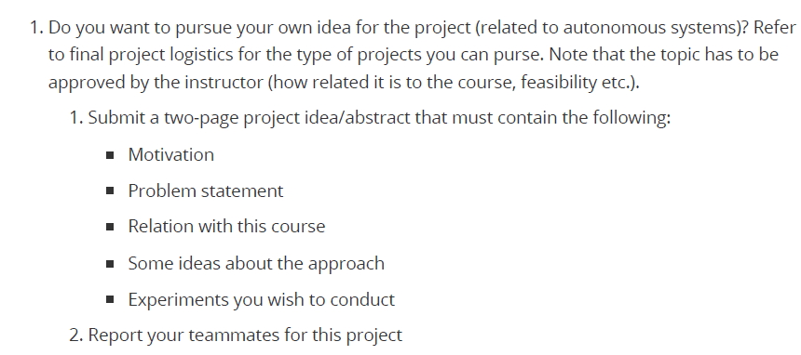
Final Project: Your Own Idea
Notes:
Consent of your teammate – don’t write Donal Knuth!

Slide 14
Final Project: Types
Survey. Extensive survey about the research on a topic of your interest. Not a reading and copy-paste of existing papers. Expected to identify the core of the problem and provide deep insights.
Applications. Pick an application of your interest and verifying it. Might require deploying several techniques and tools. Might lead to interesting theoretical results. The application should be nontrivial and “interesting” enough.
Theory. Identify a theoretical problem (algorithm/property of models) and develop new fundamental solutions. Fairly challenging task. Identifying a “good” candidate solution or proving an “interesting” property suffices.

Slide 15
Final Project: Ongoing Work

Slide 16
Topics
Introduction
Formal Methods
Cyber-Physical and Autonomous Systems
Verification of Autonomous Systems
Already Covered!
After Spring break!

Slide 17
Before we move on to our new topics
Monitoring
Ideas for project
Topics you don’t understand will motivate the next part

Slide 18
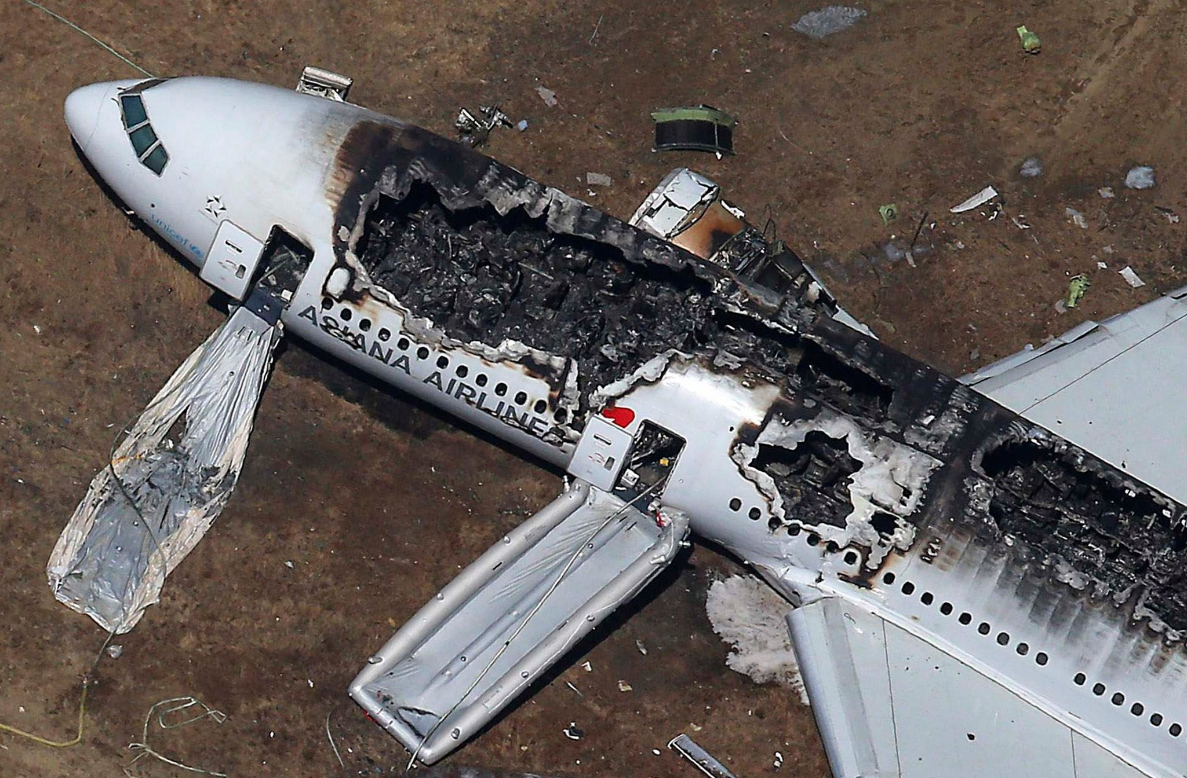
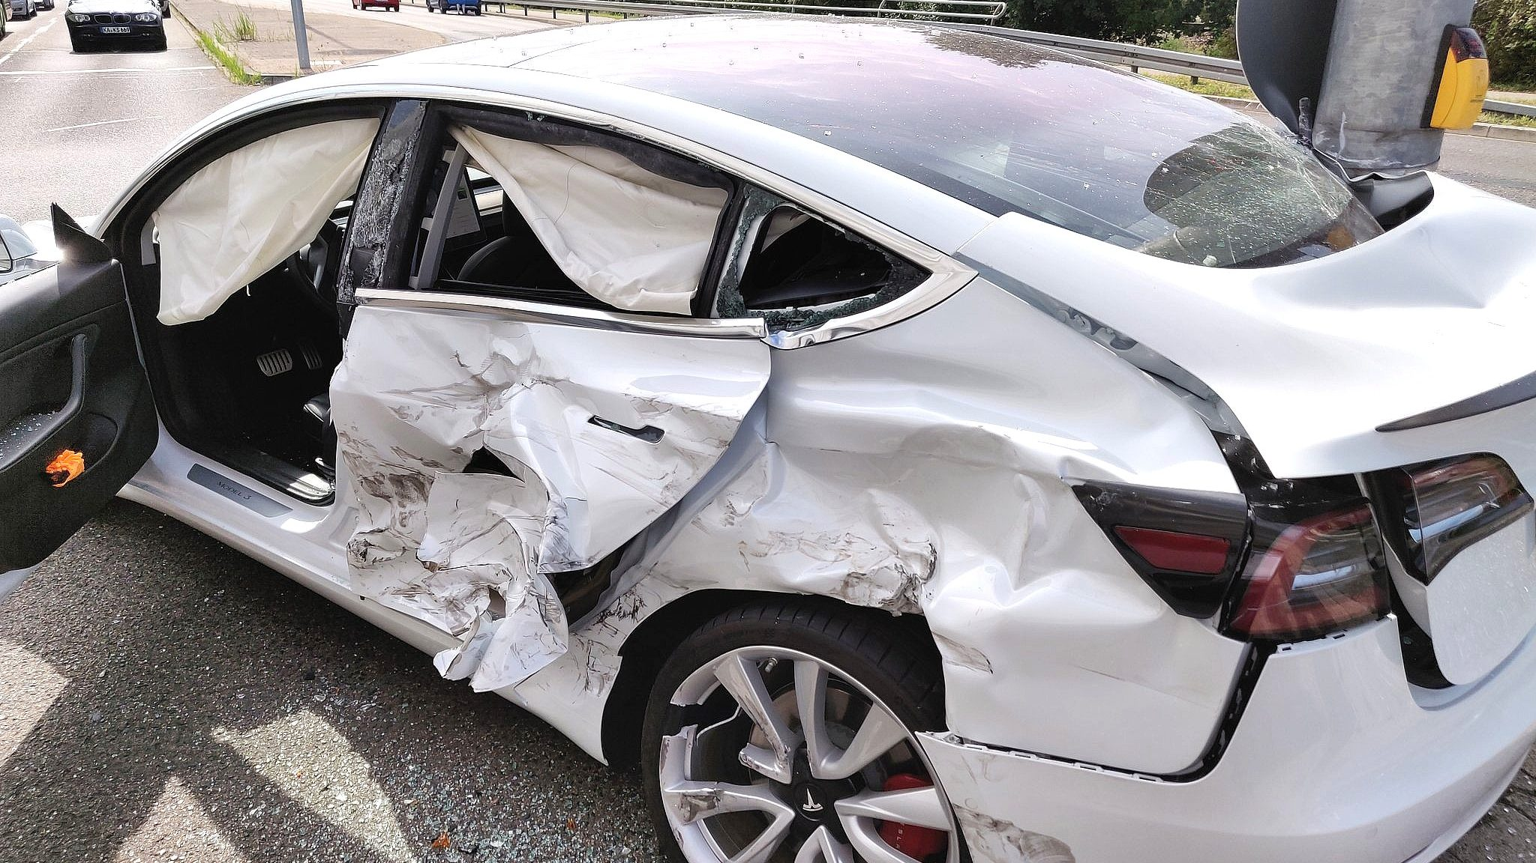
In the Event of a Crash!
2
Cause of the crash?
Who was at fault?

Slide 19
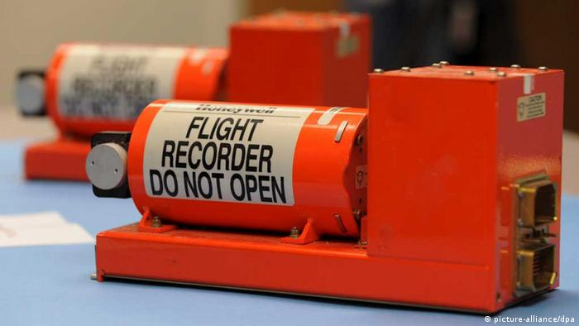
Investigating the Crash
3
Stores information of the vehicle/plane until the time of crash.
Flight Black Box
Detecting safety violation from the stored information.

Slide 20
Investigating the Crash: Logging is Expensive!
3
Logging accurately at all time steps is hard!
Sensors are uncertain, on budget systems
Logs sent over unreliable networks
Energy consumption – a concern on intermittently powered devices
Flight Black Box
Notes:
Uncertain, or not-so-accurate sensors, are used in systems that are designed on a tight budget
It could also be due to the logs being sent over an unreliable network. So some logs might become noisy or lost.
Further, in intermittently powered devices, spending energy on logging is not always feasible.

Slide 21
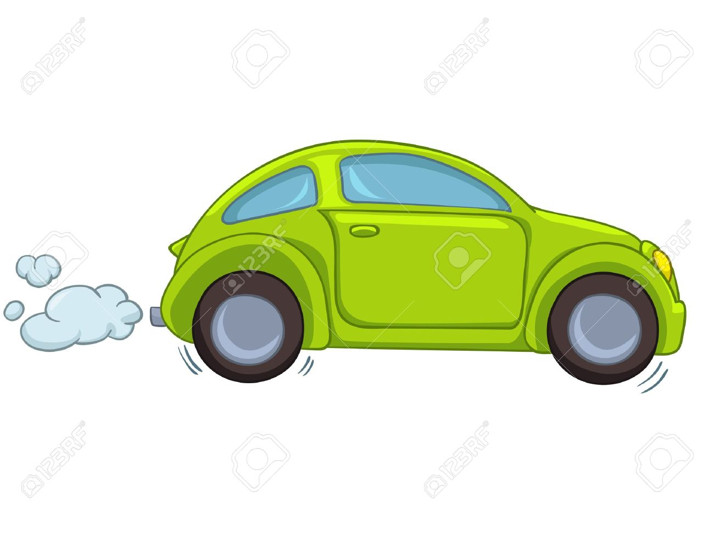
The Stored Information (Logs)
4
Zonotopes: A polytope, that is an affine transformation of the unit box.
Stores the information of the current state of the car
State variable values, represented as Zonotopes.
Logs
$t$=0
Notes:
Stretching/Squeezing, Rotation, Shearing, Reflection

Slide 22
The Stored Information (Logs)
5
Represented as Zonotopes
Acceleration with an error range.
$${[a}_{min},a_{max}]$$
$${[v}_{min},v_{max}]$$
Velocity with an error range.
Stored Information
$${[h}_{min},v_{max}]$$
Distance to the lead vehicle.
Stores the information of the current state of the car
State variable values, represented as Zonotopes.
Logs
$t$=0

Slide 23
The Stored Information (Logs)
6
Represented as Zonotopes
Acceleration with an error range.
$${[a}_{min},a_{max}]$$
$${[v}_{min},v_{max}]$$
Velocity with an error range.
$${[h}_{min},v_{max}]$$
Distance to the lead vehicle.
Note: the gathered logs can have added noise—due to sensor errors.
The gathered logs are an over-approximation of the actual states.
Logs
$t$=0

Slide 24
The Stored Information (Logs)
7
$t$=0
$t$=1

Slide 25
The Stored Information (Logs)
8
Not Logged at $t=2$
$t$=0
$t$=1

Slide 26
The Stored Information (Logs)
9
$t$=0
$t$=1
$t$=3

Slide 27
The Stored Information (Logs)
10
Not Logged at $t=4$
$t$=0
$t$=1
$t$=3

Slide 28
The Stored Information (Logs)
11
Engine breakdown!
$t$=0
$t$=1
$t$=3
$t$=5

Slide 29
The Stored Information (Logs)
12
Engine breakdown!
What caused the engine breakdown?
Need to answer this question from the (noisy) logs.
Was an unsafe maneuver made by the vehicle at time steps with no logs?
$t$=0
$t$=1
$t$=2
$t$=3
$t$=4
$t$=5

Slide 30
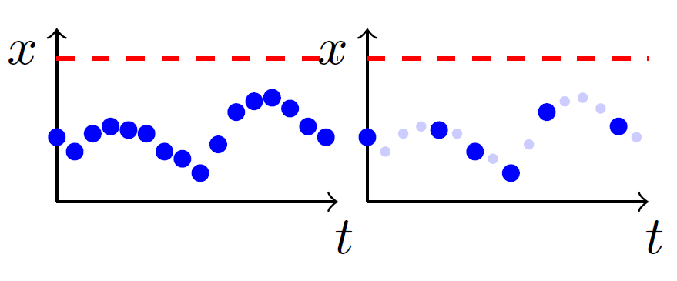
Monitoring: Logs
13
Unsafe region!
Logging at every time step.
Logging at some time steps.
Did the system reach the unsafe region at missing log steps?
Main Idea: Reconstruct the missing logs!

Slide 31
Monitoring: Naïve Approaches
14
Three possible reconstruction of the missing logs.
Green dots represent reconstructed samples.
Blue dots represent the scattered logs.

Slide 32
Monitoring: Naïve Approaches
15
Problems:
Often models the behavior inaccurately!
Can yield a “safe” answer, while the actual system might have been unsafe (unsound).
Reconstructed using piecewise-constant or linear approximation.
Green dots represent reconstructed samples.
Blue dots represent the scattered logs.

Slide 33
Monitoring: Naïve Approaches
16
Reconstructed assuming arbitrary dynamics.
Problems:
Always yields potentially “unsafe”!
Removes interest of monitoring!
Green dots represent reconstructed samples.
Blue dots represent the scattered logs.

Slide 34
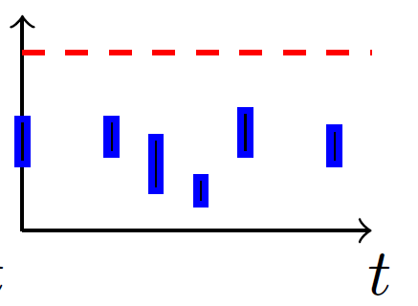
Monitoring: Logs
17
Logging at every time step.
Scattered Logging.
Scattered & Noisy Logging.
Considered in this work.

Slide 35
Monitoring: Proposed Strategy
18
Scattered & Noisy Logs
Reconstruct missing logs using reachability of uncertain linear systems
Safe or Unsafe?
Bounding Model: Over-approximated using Uncertain Linear Systems

Slide 36
Monitoring: Proposed Strategy
19
Scattered & Noisy Logs
Reconstruct missing logs using reachability of uncertain linear systems
Safe or Unsafe?
Bounding Model: Over-approximated using Uncertain Linear Systems
To be introduced next . . .

