Slide 1
Trustworthy Autonomy Lecture 14
Bineet Ghosh
bineet@ua.edu

Slide 2
Handouts
Reading
Synopsis (strongly encouraged)
Submit in-class
Two pages
Parts you don’t understand – next portion of the course
Also, an idea for a course project
Learning dynamics

Slide 3
Abstract Interpretation!

Slide 4
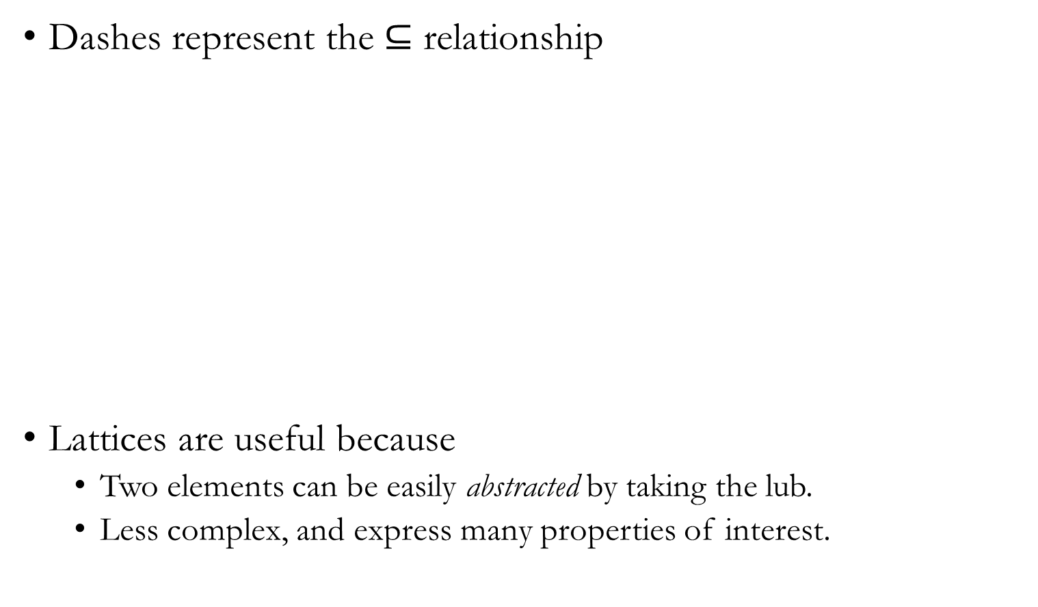
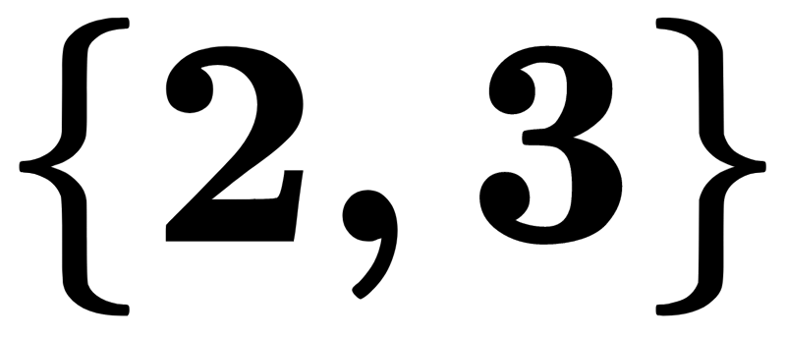
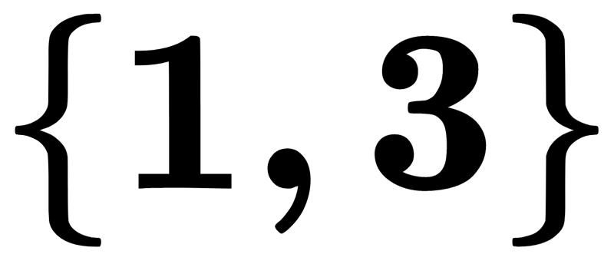
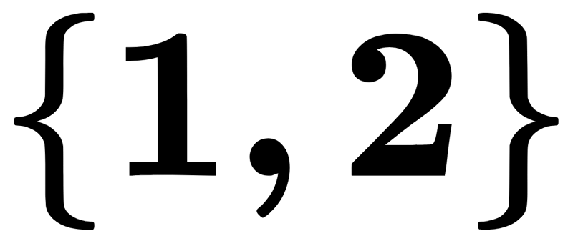
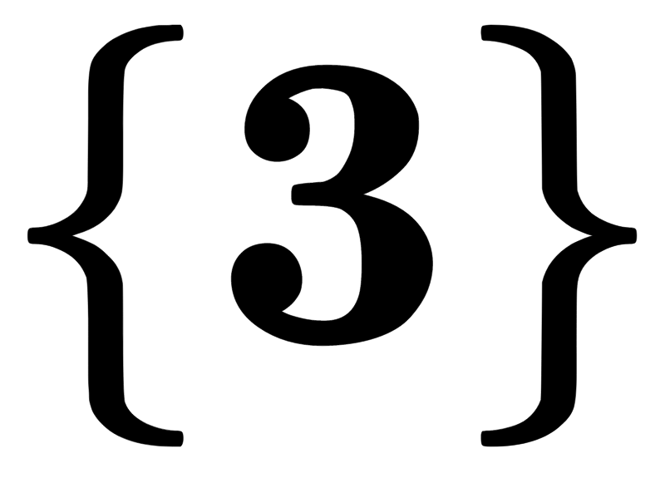
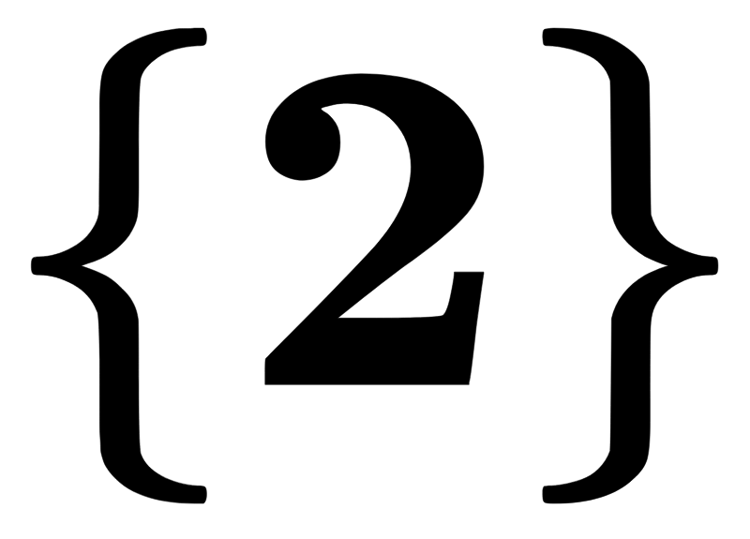
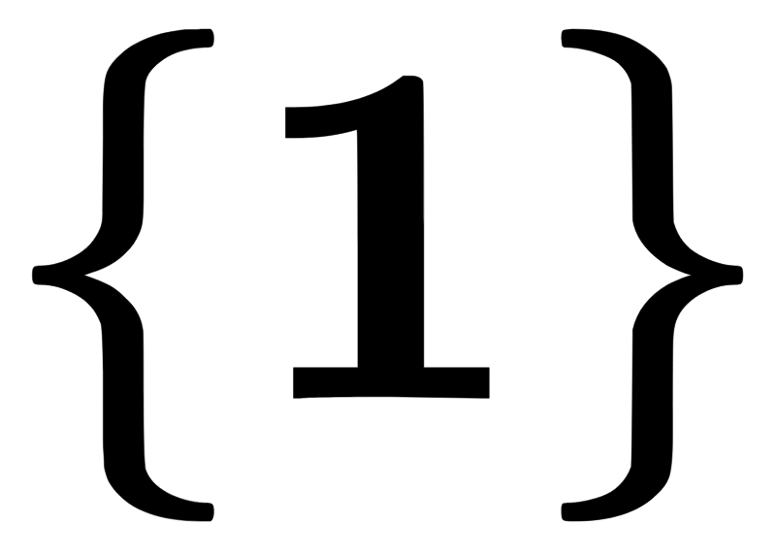
Pictorial Representation

Slide 5
What Is Abstract Interpretation?
Instead of performing concrete computations, select an abstract domain, perform computations in the abstract domain to obtain the relevant answer.

Slide 6
What Is Abstract Interpretation?

Slide 7
What Is Abstract Interpretation?

Slide 8
What Is Abstract Interpretation?
You have two spaces
Concrete Space
Abstract Space

Slide 9
What Is Abstract Interpretation?
You have two spaces
Concrete Space
Abstract Space
Then you do two things
Map the elements in concrete domain to elements in abstract domain
Map the operations in concrete domain to operations in abstract domain

Slide 10
What Is Abstract Interpretation?

Slide 11
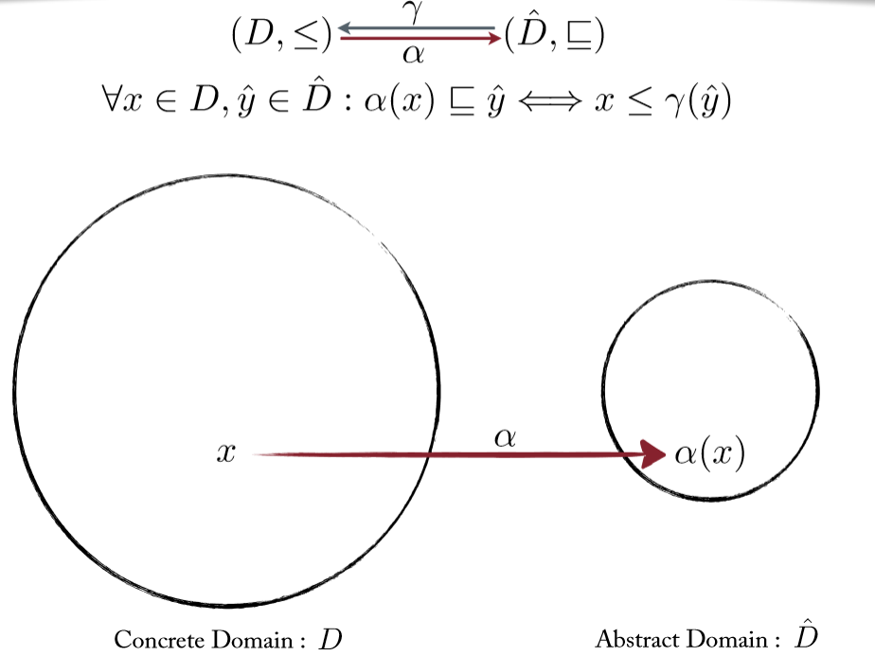
Technical Term: Galois Connection.

Slide 12
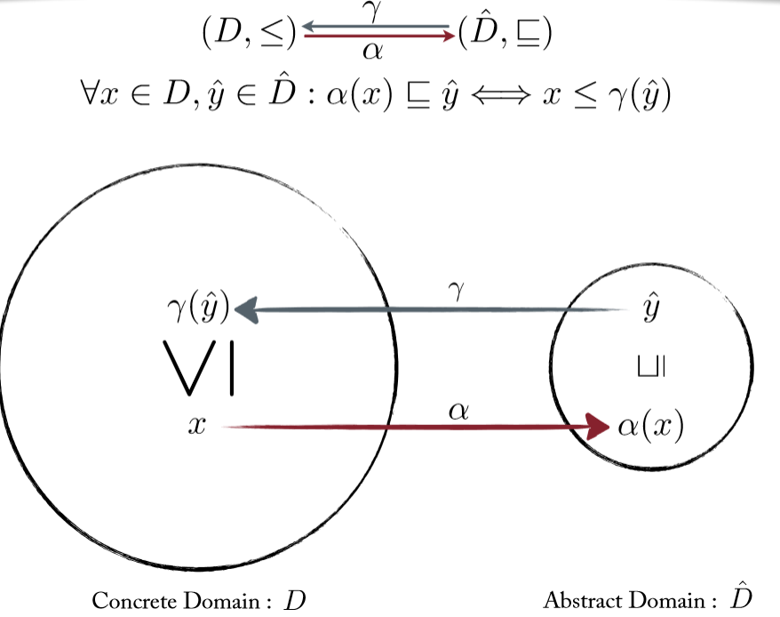
Technical Term: Galois Connection.

Slide 13
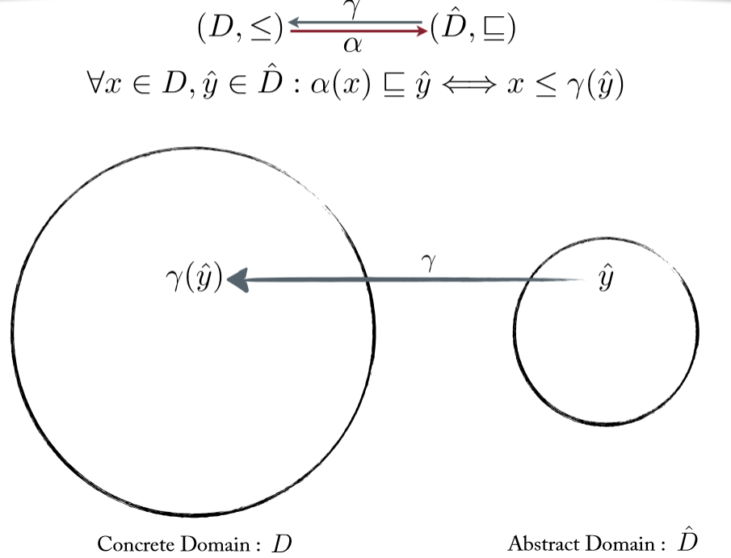
Technical Term: Galois Connection.

Slide 14
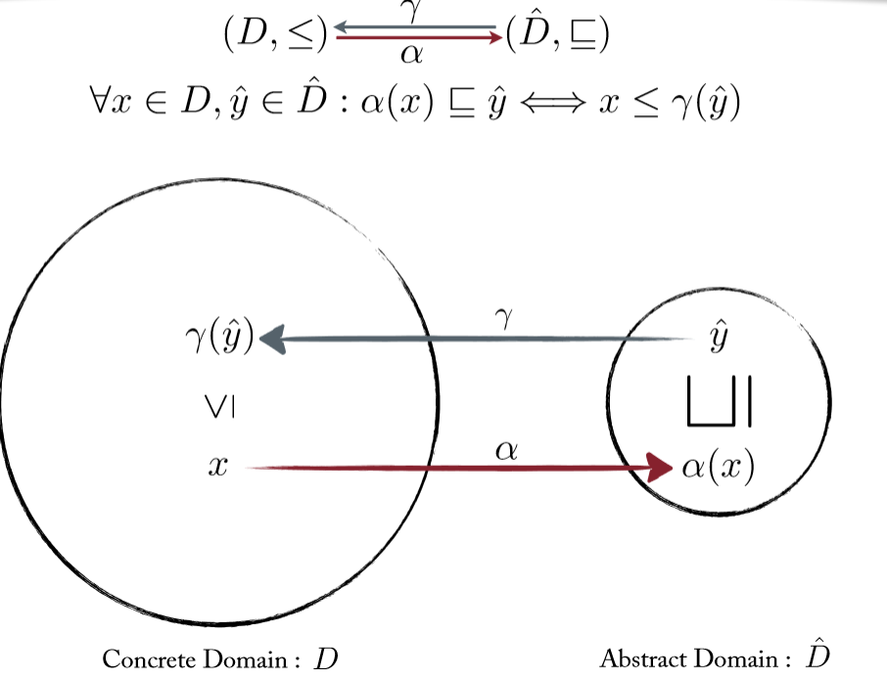
Technical Term: Galois Connection.

Slide 15
Galois Connections: Example
What is the abstraction function?
What is the concretization function?
Is this a Galois Connection?
Notes:
When solving a problem.
Identify the concrete domain
Identify the abstract domain
Then:
<qs>

Slide 16
Properties Of Abstract Interpretation
If the abstract system satisfies the property, then the concrete system satisfies the property.
That is, if the abstract execution says that there are no division by zero errors in the code, then there are indeed no division by zero.

Slide 17
Properties Of Abstract Interpretation
If the abstract system satisfies the property, then the concrete system satisfies the property.
That is, if the abstract execution says that there are no division by zero errors in the code, then there are indeed no division by zero.
Same goes for buffer overflows.
Q) What if the abstract execution does not satisfy the property?

Slide 18
Drawbacks Of Abstract Interpretation
Can give false positives.
What if your abstract domain is too coarse?
Solution: CEGAR (Counter Example Guided Abstraction Refinement)

Slide 19
Counter–Example Guided Abstraction Refinement (CEGAR)
Steps in CEGAR
Pick an abstract domain for the concrete system.
Track the abstract executions of the system in the abstract domain and prove the required property.
If the specification can be proved by abstract domain, Great!
If the abstract domain cannot prove the required specification, then take the counterexample of the abstract execution and find the corresponding execution of the concrete system.
Else, refine the abstract domain and go to step 2.

Slide 20
CEGAR – Overview
Concrete System
New
Abstraction
Refine
Abstract
Spurious
Counterexample
Abstract
System
Abstract
Counterexample
Concrete Counterexample
Validate
Verify
Certificate

Slide 21
CEGAR – Overview
Concrete System
Refine
Abstract
CEGAR loop
Concrete Counterexample
Validate
Verify
Certificate

