Slide 1
Trustworthy Autonomy Lecture 12
Bineet Ghosh
bineet@ua.edu

Slide 2
Review.
Propositional logic,
Predicate logic.
Hoare logic for program correctness.
Weakest pre-condition, Strongest post-condition
SAT Solvers – Z3 (Extra in Homework).

Slide 3
Abstract Interpretation!

Slide 4
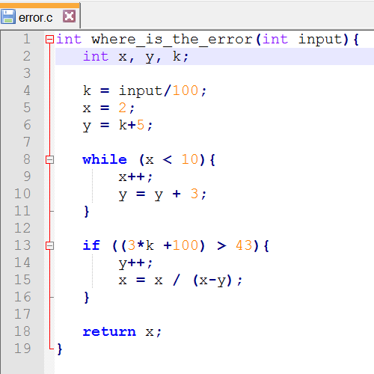
Motivation: A Simple Example
Catch division by zero error
Notes:
Quite tedious, right?
Any approach?

Slide 5
BTW . . .
Handouts!

Slide 6
Motivation: A Simple Example
Catch division by zero error
Notes:
Quite tedious, right?
Any approach?

Slide 7
Scalability – Lines Of Code
Is it possible to analyze simple properties like division by zero?
Can be manually checked for simple programs.

Slide 8
Scalability – Lines Of Code
Is it possible to analyze simple properties like division by zero?
Can be manually checked for simple programs.
What about programs with 100K LOC?
What about 1M LOC?

Slide 9
Scalability – Lines Of Code
Is it possible to analyze simple properties like division by zero?
Can be manually checked for simple programs.
What about programs with 100K LOC?
What about 1M LOC?
Typical car software – 100 M LOC.
Try checking division by zero in all the code manually!

Slide 10
Another Example
Addition yielding to a number greater than zero or less than zero

Slide 11
Another Example
Addition yielding to a number greater than zero or less than zero
Notes:
What made you say so?

Slide 12
Another Example
Addition yielding to a number greater than zero or less than zero
Apply the same logic; since all the numbers are +ve, result is +ve.
What about?
Notes:
So you see, that you are (in your mind) performing computations in abstract domain

Slide 13
This Is All So Confusing!
Sometimes abstraction is good, sometimes it is bad.
When should we use abstraction?

Slide 14
This Is All So Confusing!
Sometimes abstraction is good, sometimes it is bad.
When should we use abstraction?
If your problem is “nice”, then you can use the correct abstraction to solve your problem.
Some “nice” problems are:
Buffer overflows
Division by zero
Fast Termination of Control Programs (Worst Case Timing Analysis)
“The purpose of abstraction is not to be vague, but to create
a new semantic level in which one can be absolutely precise”
- Edsger W. Dijkstra

Slide 15
Isn’t It Over Simplification? Does This Work?
It works! (In some cases)
Some successful tools that use abstraction.
Astree – used by Airbus in validating its flight control software.
Poly Space – provided by MATHWORKS.
SLAM – verifier for device drivers for windows.
BLAST – popular academic tool.
FSOFT – verifier from NEC Labs that uses ideas from abstraction
Scalability? – 1M to 10M LOC (No Kidding!)
But it is not a silver bullet!

Slide 16
OK, Lets Go Into The Details
Outline of the details
Mathematical Foundations: Sets, Lattices, Functions, Fixed Points
Abstract Interpretation – Basics
Galois Connections
Verification using abstract interpretation

Slide 17
Fundamentals: Set Theory & Partial Orders

Slide 18
Fundamentals: Set Theory & Partial Orders

Slide 19
Fundamentals: Set Theory & Partial Orders
Notes:
Any quick example of partial orders?

Slide 20
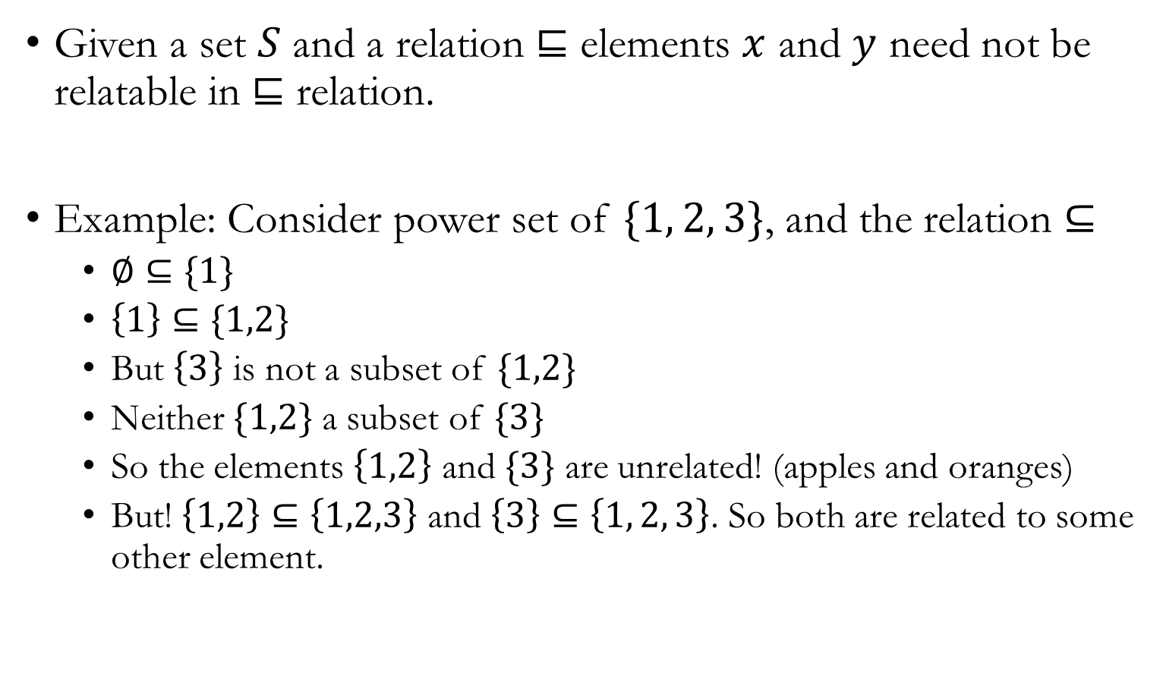
Partial Orders and Lattices

Slide 21
Partial Orders and Lattices
Notes:
What’s a power set?

Slide 22
Partial Orders and Lattices
Notes:
What’s a power set?

Slide 23
Partial Orders And Lattices
Notes:
Draw the lattice diagram.
Examples of lub, glb

Slide 25
Partial Orders And Lattices
A lattice is said to be complete if and only if any two elements have a lub and glb.

Slide 26
Partial Orders And Lattices
Notes:
* Give an example function for fixed point

Slide 27
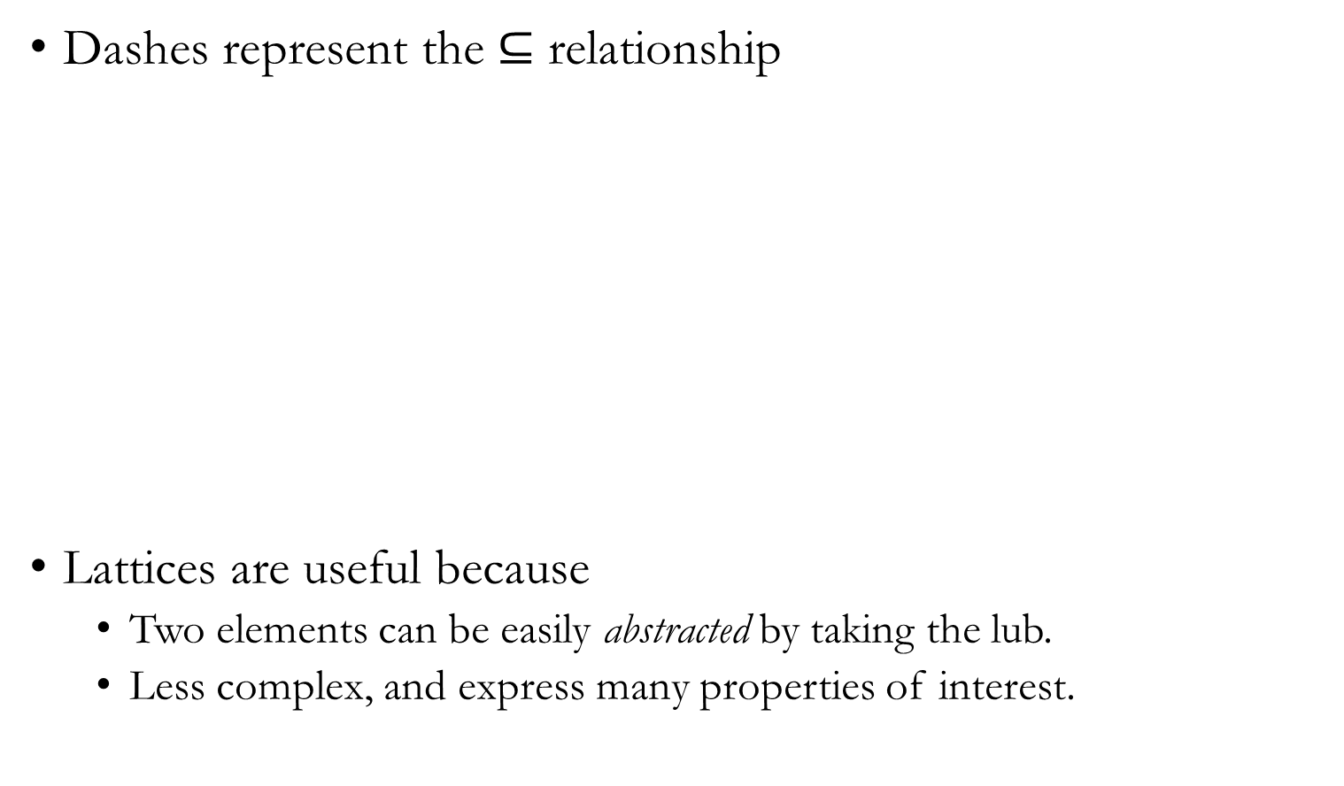
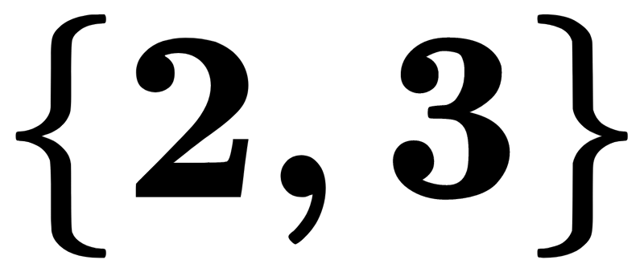
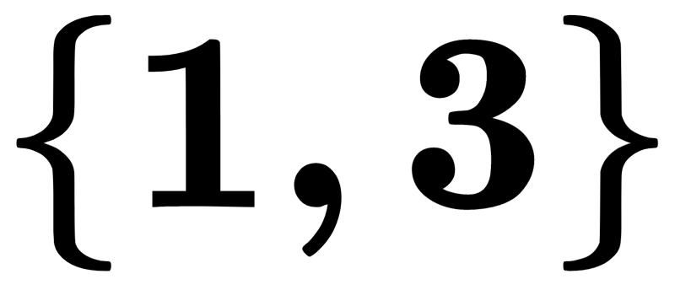
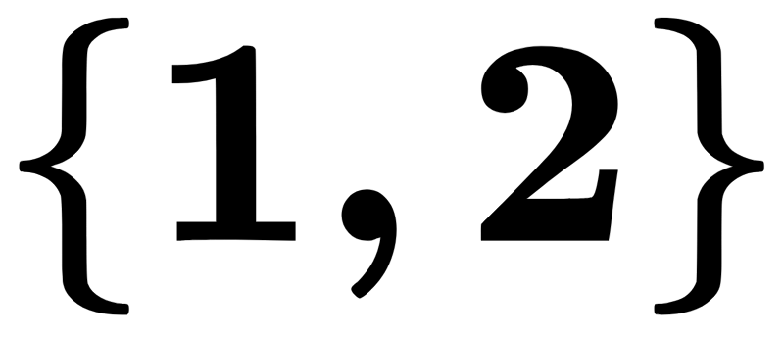
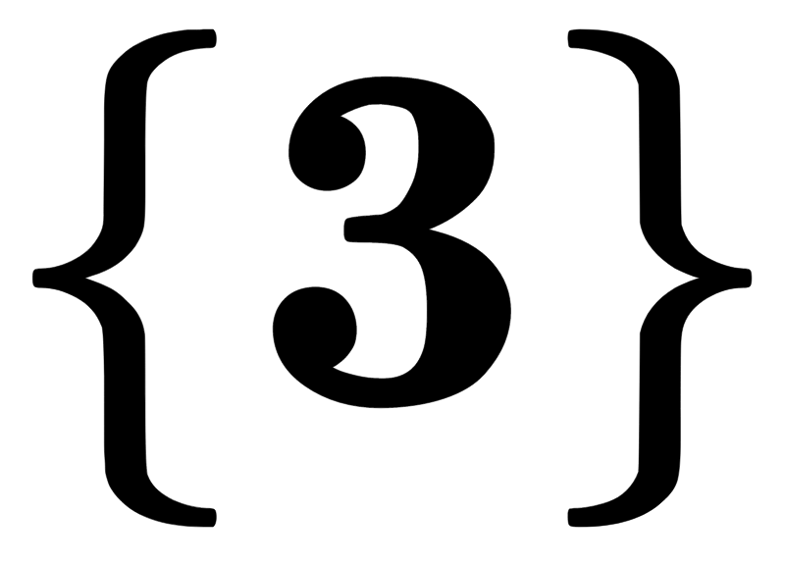
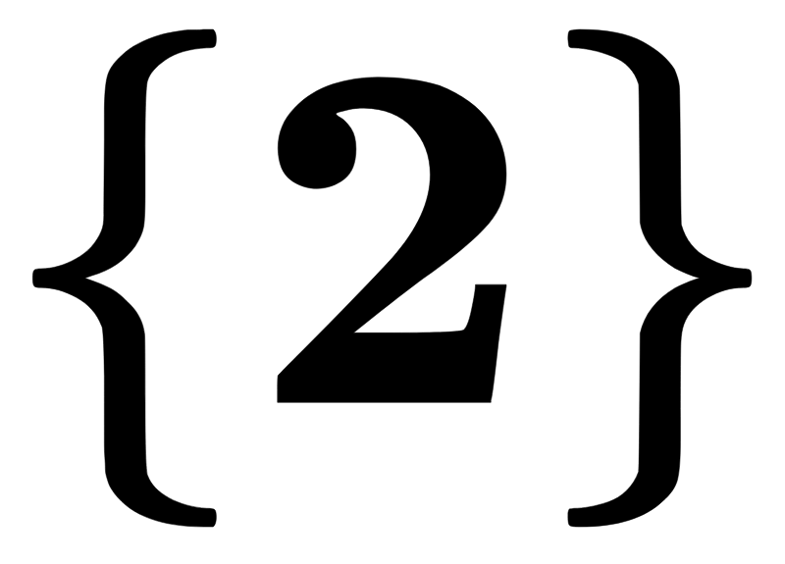
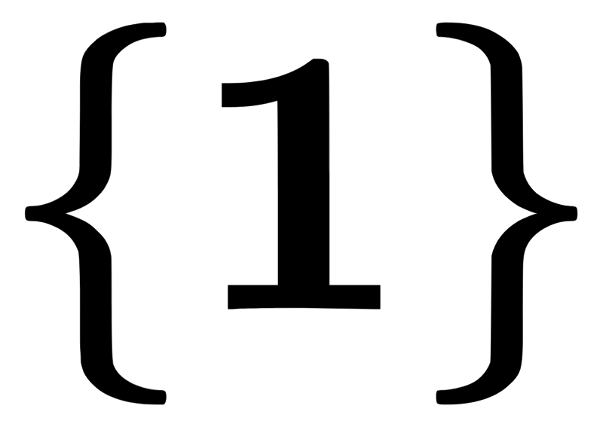
Pictorial Representation

Slide 28
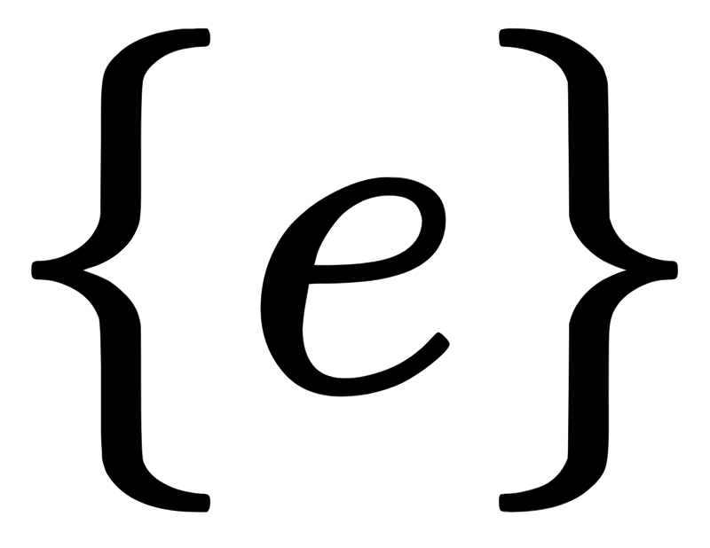
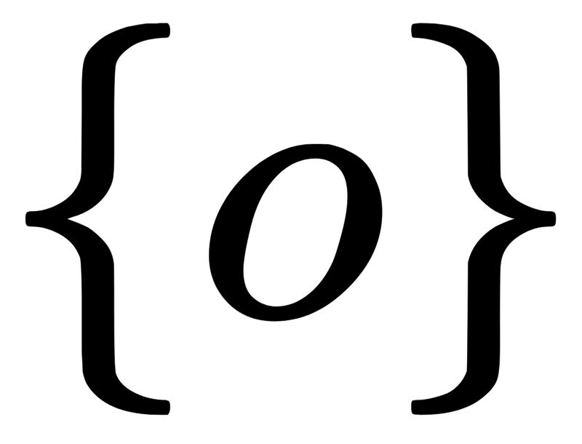
Too Much Theory, Application Please!
Lattice for determining Odd/Even
Notes:
So any property true for an element in the bottom, is also true for the element at the top
So we can change the domains for simplicity, yeah?

Slide 29
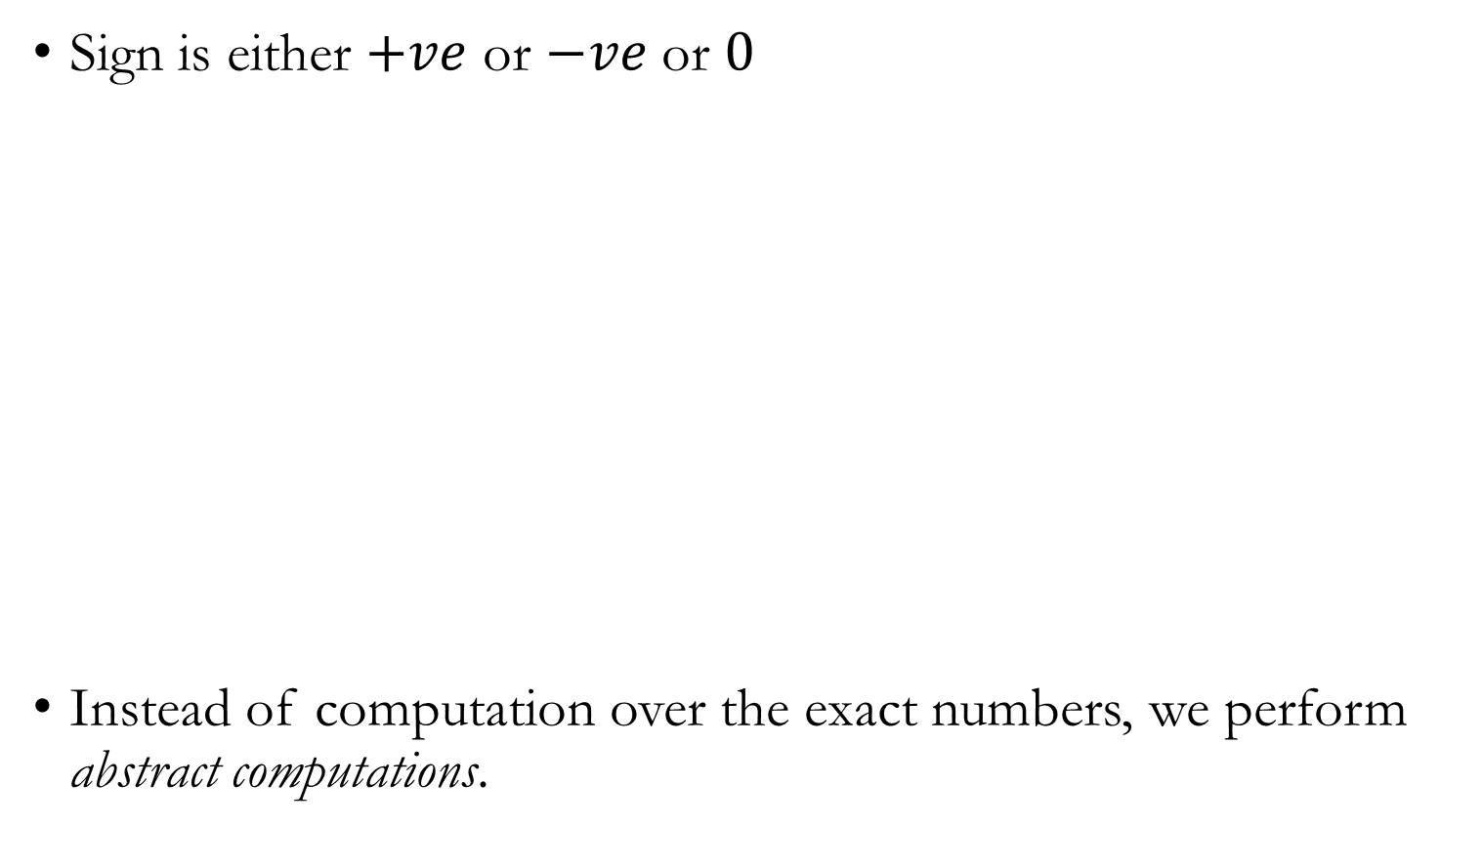
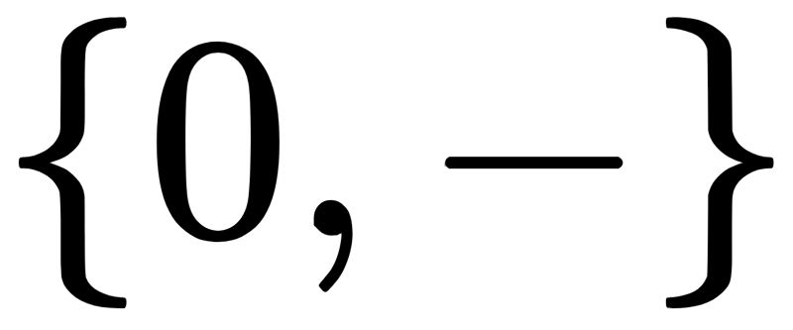
Lattice For Determining The Sign

Slide 30
What Is Abstract Interpretation?
Instead of performing concrete computations, select an abstract domain, perform computations in the abstract domain to obtain the relevant answer.

Slide 31
What Is Abstract Interpretation?

Slide 32
What Is Abstract Interpretation?

