Slide 1
Trustworthy Autonomy Lecture 11
Bineet Ghosh
bineet@ua.edu

Slide 2
Higher Order Logics
Propositional logic – finite sets.
Predicate logic – extension of propositional logic to infinite sets.
Forall and Exists are extensions of conjunction and disjunction.

Slide 3
Why? Just Curious
Graph coloring
Sudoku
Type theory

Slide 4
From elements to Sets: HOL
Elements of higher cardinality are the set of all sets.
Write formulas with existential quantifiers on sets.
General forumation: Quantifiers on elements and predicates.
Example: \exists S, \forall x, (x < S(x))

Slide 5
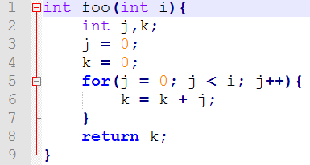
Predicate Logic and Program Verification
What does it mean for a program to be correct?
What is a program?
Sequence of computations
Updates the variables as per the instructions
Is this program correct?
What does it mean to be correct?
Notes:
What is this program doing?
k = sum upto i, starting from 0
What’s the condition on i, before it enters the function
What’s the condition on k, after it exits the function
Any predicate on i & k

Slide 6
Homework 2
Due today by 11:59pm

Slide 7
Homework 2: Problem 2
Due today by 11:59pm

Slide 8
Homework 2: Problem 3
Due today by 11:59pm

Slide 9
Predicate Logic and Program Verification
What does it mean for a program to be correct?
What is a program?
Sequence of computations
Updates the variables as per the instructions
Is this program correct?
What does it mean to be correct?
Notes:
What is this program doing?
k = sum upto i, starting from 0
What’s the condition on i, before it enters the function
What’s the condition on k, after it exits the function
Any predicate on i & k

Slide 10
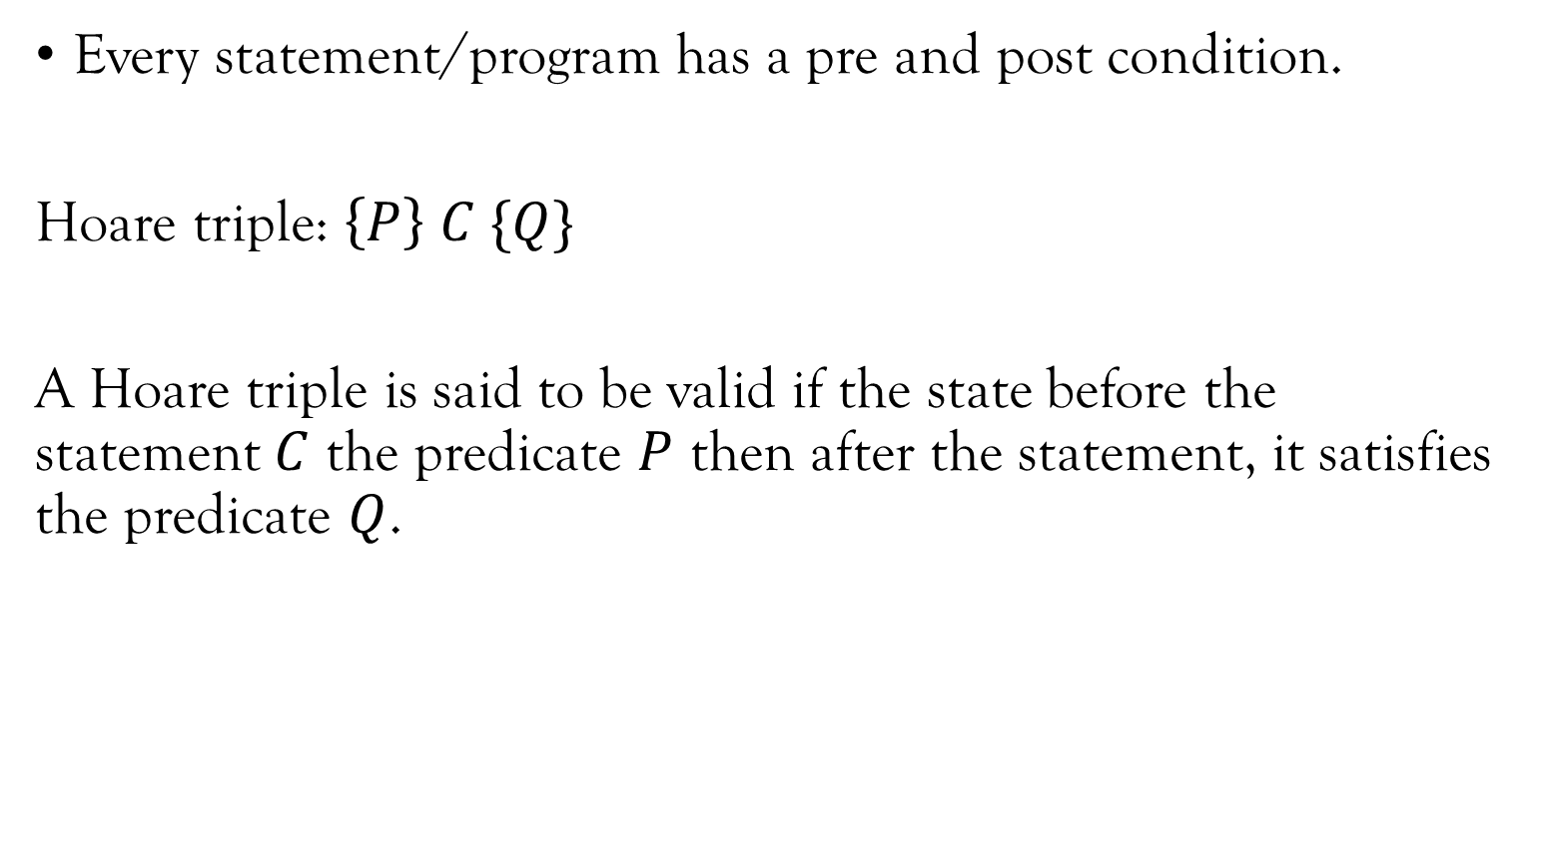
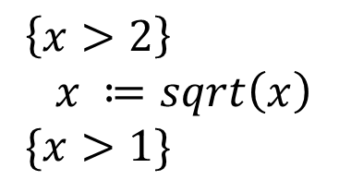
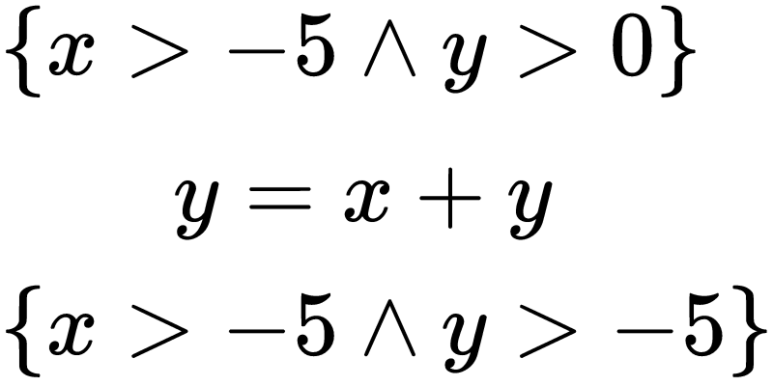
Hoare Triples
Notes:
* Is the second one correct?

Slide 11
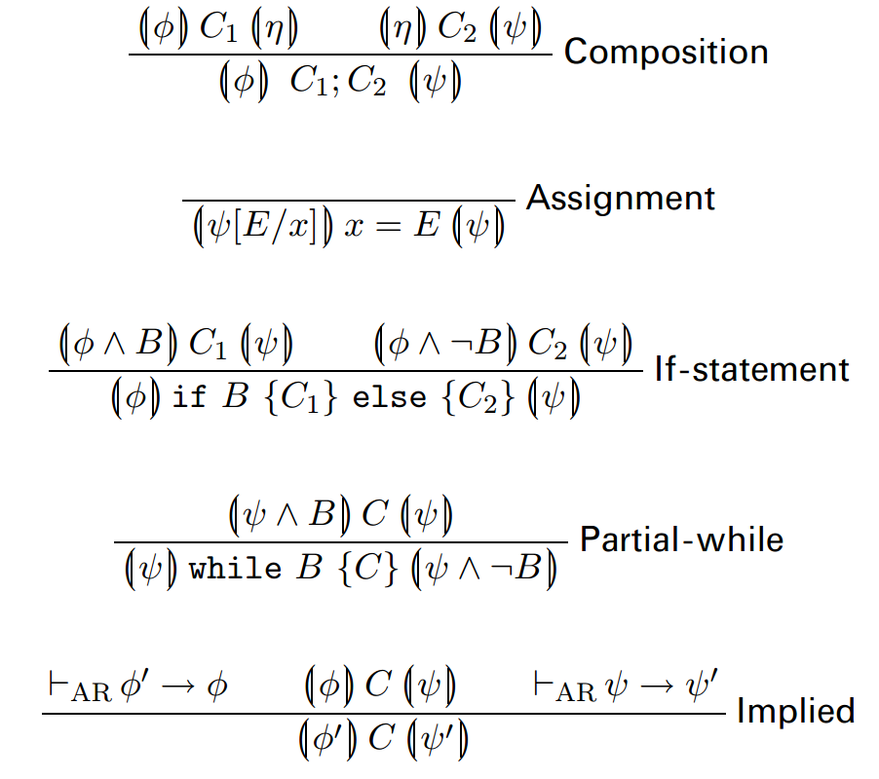
Hoare Logic – A Proof System For Proving Hoare Triples on Statements
Notes:
x>4 -> x>2
Subset -> SuperSet
Under-appx -> Over-appx
Pre-condition: can be replaced by under-appx
Post-condition: can be replaced by over-appx

Slide 12
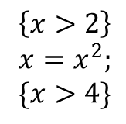
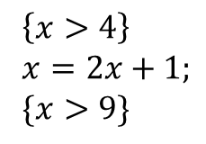
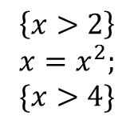
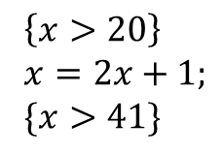
One At A Time

Slide 13
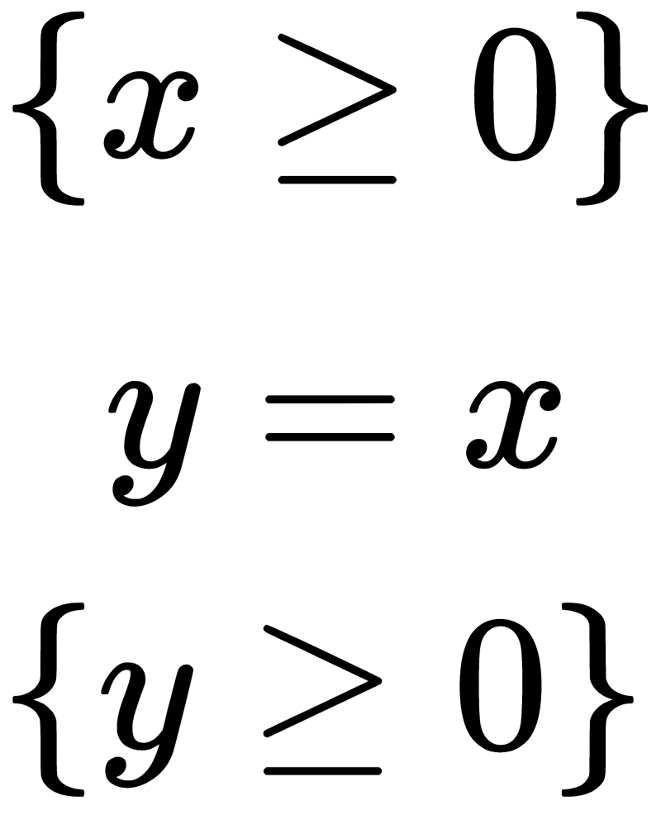
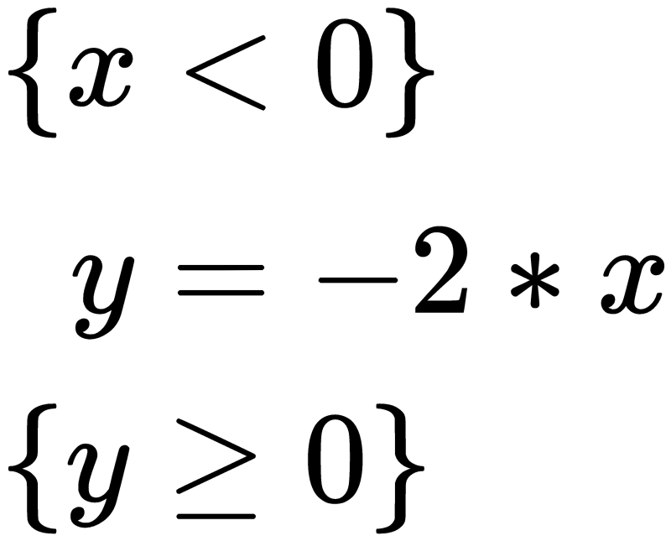
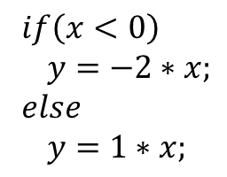
One At A Time
if (x>=0)
y=x;
else
y=-2*x
Notes:
\phi=True
B=x \ge 0
\psi = y \ge 0

Slide 14
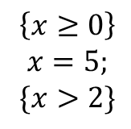
One At A Time

Slide 15
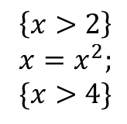
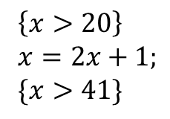
Sequential Composition?

Slide 16
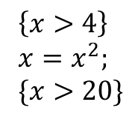
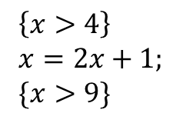
Now?

Slide 17
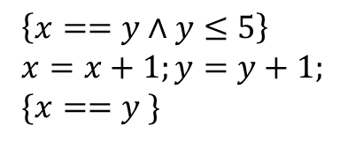
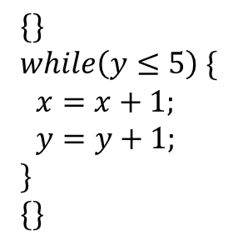
Partial-While
Loop Invariant
?
?

Slide 18
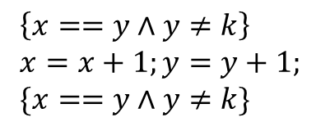
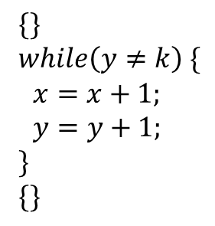
Why Partial?
What if the loop does not terminate?

Slide 19
Properties Of Hoare Logic
[Soundness]: Whatever properties you prove using the proof rules in Hoare logic is correct.
Proof: beyond scope of this course. Involves giving semantics of programs and proving equivalence of semantics.
[Relative Completeness]: Given an oracle that can reason about all the assignments, all valid assertions in Hoare Logic can be proved.
Proof: Time taking.

Slide 20
Hoare Logic Is Undecidable
Why? Undecidability of theory of natural numbers.
In simple terms, given a formula with quantifiers over natural numbers, there is no general algorithm which is guaranteed to prove/disprove it.
Earth shattering result by Kurt Godel.
Well, program variables are not integers, only a subset, of them, right!
Int = 32 bit, say a program has 5 variables.

Slide 21
Is Hoare Logic Practical?
Yes and No.
Yes: for proving functional correctness of critical software, reasoning is done manually using proofs.
Z3: An Oracle for proving assertions – later in this course.
No: for proving buffer overflow errors, reasoning through Hoare Logic gets really complicated. Need other techniques.

Slide 22
Review.
Propositional logic,
Predicate logic.
Hoare logic for program correctness.
Weakest pre-condition, Strongest post-condition
SAT Solvers – Z3 (Extra in Homework).

