Slide 1
Trustworthy Autonomy Lecture 10
Bineet Ghosh
bineet@ua.edu

Slide 2
Connection between inference and semantic entailment.
What happened to all the truth tables. Tautologies, contradictions, semantic entailment.
The proof system is equivalent to all the truth tables.
Difference between
$φ_{1}, φ_{2}, …, φ_{n}⊨ψ$ and $φ_{1}, φ_{2}, …, φ_{n}⊢ψ$
Natural deduction is sound, i.e., whatever you infer from natural deduction can be proved using truth tables.
Natural deduction is complete, i.e., whatever can be proved using truth tables, can be proved using proof rules.

Slide 3
Soundness and completeness
Natural deduction is sound, i.e., whatever you infer from natural deduction can be proved using truth tables.
Natural deduction is complete, i.e., whatever can be proved using truth tables, can be proved using proof rules.
Notes:
Soundness: A⊢B⇒A⊨B
Completeness: A⊨B⇒A⊢B

Slide 4
Proof of Soundness
Every proof is valid.

Slide 5
Proof of Completeness
Every valid statement has a proof.
Notes:
Why are we learning natural deductions?

Slide 6
Soundness and completeness
Natural deduction is sound, i.e., whatever you infer from natural deduction can be proved using truth tables.
Natural deduction is complete, i.e., whatever can be proved using truth tables, can be proved using proof rules.
All true statements in propositional logic are provable and those statements provable are true.

Slide 7
Predicate Logic
Propositional logic has a disadvantage.
“Every child has a mother”
“Not all birds can fly”
“Every student is younger than some instructor”
Propositional logic is insufficient for reasoning about such statements.

Slide 8
Predicate Logic
Variables and constants – $x$ can take values over a domain. (Students, people, birds, etc.) and constant is in the domain.
Terms – variables, or functions of them, $f(x_{1},x_{2},…,x_{n})$
Predicates – given a valuation of each of the variables, an $n$–ary predicate returns either $⊤$ or $⊥$
Formulas
Boolean combinations of formulas: $¬, ∧, ∨, →,…$
Quantification of variables: $∃$ and $∀$

Slide 9
Predicate Logic: Formally
Term: $t∷=x \left| c \right| f(t, …, t)$
Predicate: $P(t_{1}, t_{2},…, t_{n})$
Formula: $φ∷=P\left(t_{1}, t_{2},…, t_{n}\right)\left| φ∧φ \right|…\left| (∀x φ)\right| (∃x φ)$
Examples:
Pythagorean triplets: $¬∃x,y,z, (x^{2}+y^{2}=z^{2})$
Fermat’s Last Thm: $¬∃x,y,z,n (\left(x^{n}+y^{n}=z^{n}\right)∧n>2)$
Notes:
The proposition was first stated as a theorem by Pierre de Fermat around 1637 in the margin of a copy of Arithmetica.
Fermat added that he had a proof that was too large to fit in the margin.
After 358 years of effort by mathematicians, the first successful proof was released in 1994 by Andrew Wiles and formally published in 1995.

Slide 10
Formally:
“Every child has a mother”
“Not all birds can fly”
“Every student is younger than some instructor”

Slide 11
Formally:
“Every child has a mother”
“Not all birds can fly”
“Every student is younger than some instructor”

Slide 12
When Is A Statement In Predicate Logic True?
A formula in predicate logic has terms, predicates, and quantifiers. Say $φ_{1}⊨φ_{2}$ ($φ_{2}$ is true whenever $φ_{1}$ is true)
Model: All possible domains, all possible functions, all possible interpretation of constants. (very general)
A statement in predicate logic is true if and only if it is true in ALL models.
ALL of them? Yes, all of them.

Slide 13
Proof Rules And Interpretation
Example
Is this statement true in ALL models? Discuss.
Notes:
* What’s the diff between \forall P(x) -> \forall Q(x) & \forall P(x) -> Q(x)

Slide 14
Proof Rules And Interpretation
Example
Is this statement true in ALL models? Discuss.
Notes:
What’s the difference b/t the LHS and RHS?

Slide 15
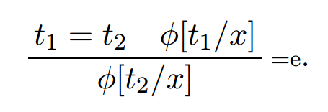
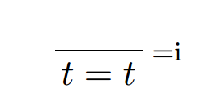
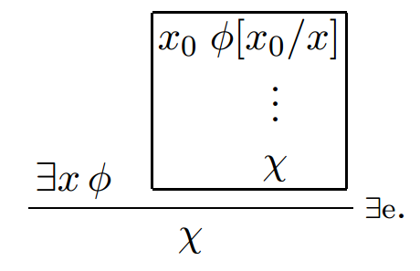
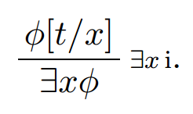
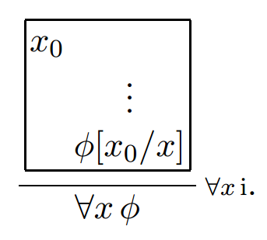
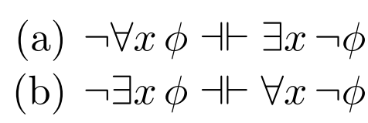
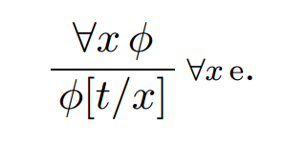
Proof Rules In Predicate Logic
Equality
Existential Quantification
Universal Quantification

Slide 16
Undecidability Of Predicate Logic
There is no general algorithm which can solve the following decision problem.
Decision problem: Given a formula $φ$ in predicate logic, is $⊨φ$ valid?
Reduced to Post–Correspondence–Problem.

Slide 17
Higher Order Logics
Propositional logic – finite sets.
Predicate logic – extension of propositional logic to infinite sets.
Forall and Exists are extensions of conjunction and disjunction.

Slide 18
Why? Just Curious
Graph coloring
Sudoku
Type theory

Slide 19
From elements to Sets: HOL
Elements of higher cardinality are the set of all sets.
Write formulas with existential quantifiers on sets.
General forumation: Quantifiers on elements and predicates.
Example: \exists S, \forall x, (x < S(x))

Slide 20
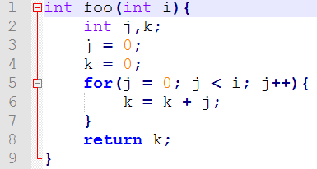
Predicate Logic and Program Verification
What does it mean for a program to be correct?
What is a program?
Sequence of computations
Updates the variables as per the instructions
Is this program correct?
What does it mean to be correct?

