Slide 1
Trustworthy Autonomy Lecture 1
Bineet Ghosh
bineet@ua.edu

Slide 2
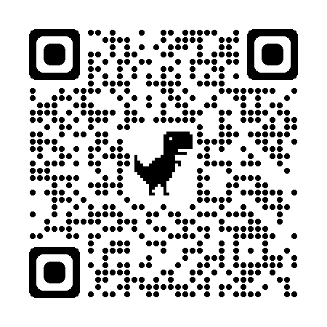
General Course Information
Term: Spring 2024
Department: COMP
Course Number: 691-002
Time: Mon & Wed, 3:30 pm - 4:45 pm
Location: Hardaway Hall 251
Course Webpage: bineet.cs.ua.edu/teaching/S2024/CS691/TrustworthyAutonomy.html
Notes:
Make sure you are in the right class

Slide 3
Introduction
Dr. Bineet Ghosh
Email: bineet@ua.edu
Please add the following in subject line if you are emailing regarding the course: [S24-CS691] <your-subject>
Office: CYB (Cyber Hall) 3053
Office Hours: Mon & Wed, 1:30 pm - 2:30 pm, or by appointment (bineet@ua.edu).
Notes:
Student Introduction: Name, level, why interested in this course?, future plans?
Slack channel

Slide 4
What is Trustworthy Autonomy
What are Autonomous Systems?
What is the notion of Trust in Autonomous Systems?
Notes:
* Take 2 – examples, trust

Slide 5
Trustworthy Autonomy
Design and Verification of Autonomous Systems
Applications
Robotics, Automotives, Industrial and Home Automation Systems

Slide 6
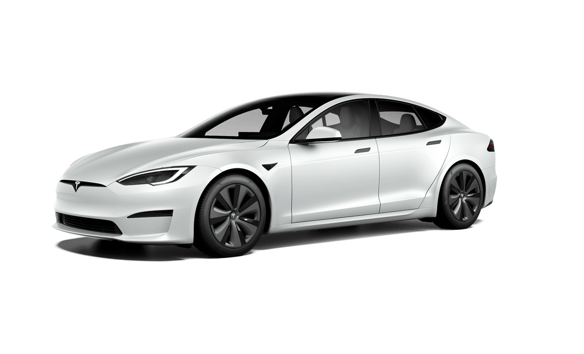
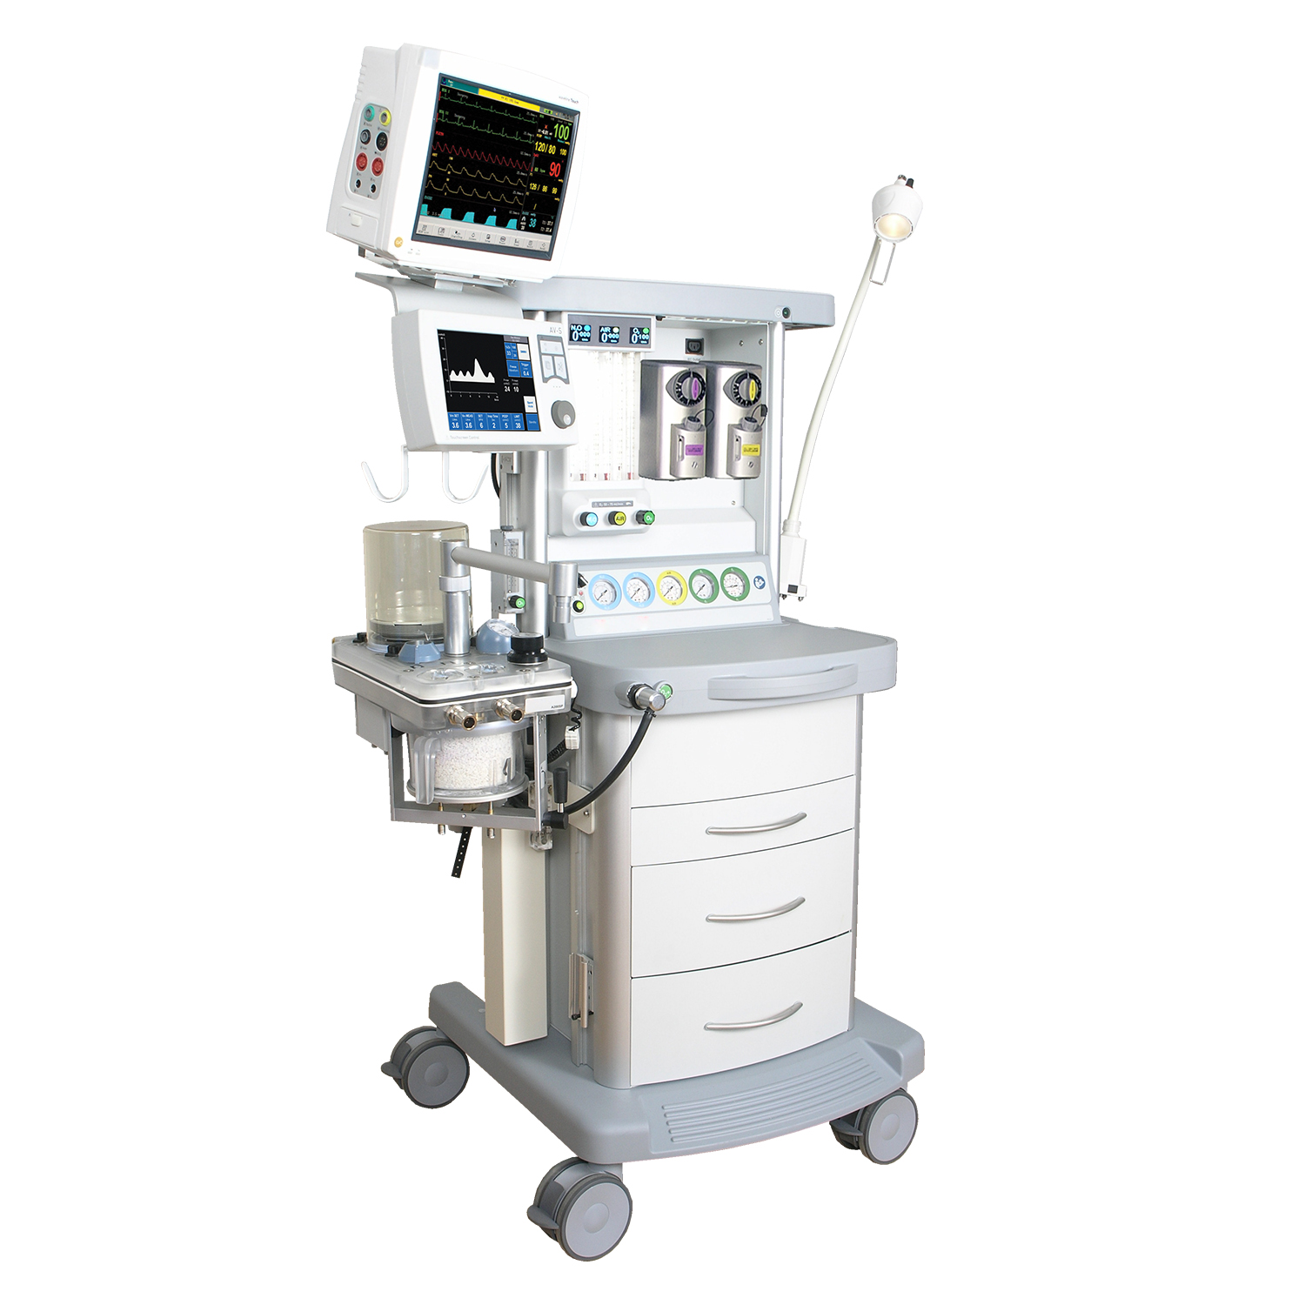
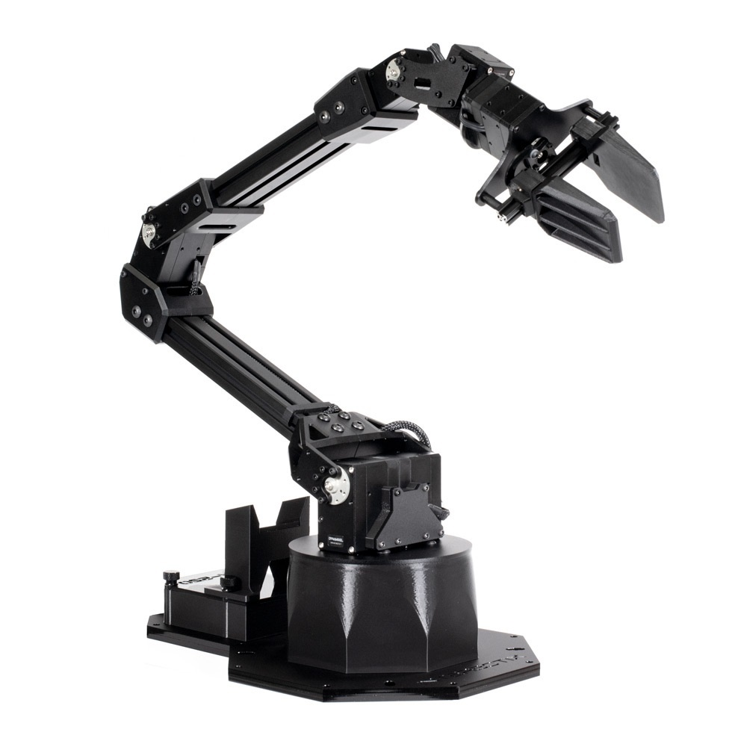
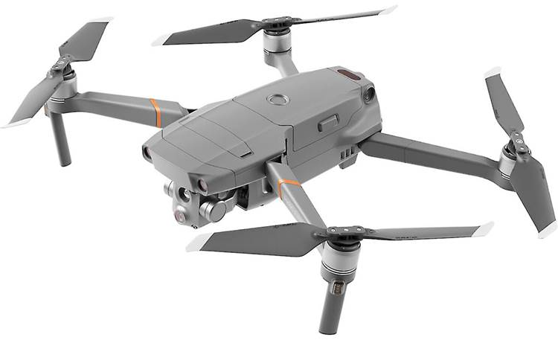
Autonomous Systems
Gathers information from its sensors
Analyzes
Plan & execute an action to achieve its goal
Safe

Slide 7
Background
Let’s Discuss!
Notes:
Intersection: Formal Methods, Real-Time Systems, Control Theory
Experience: Algorithms, Theory of Computation, Python (Laptop)?

Slide 8
Textbooks: Formal Methods
Principles of Model Checking, by Baier & Katoen
Decision Procedures, by Kroening & Strichman

Slide 9
Textbooks: Control Systems
Linear Systems Theory, by Hespanha
Principles of Cyber-physical Systems, by Alur

Slide 10
Course Objectives
Introduction to Formal Methods
Autonomous Systems
Design and Verification of Safe Autonomous Systems

Slide 11
Course Objectives
Introduction to Formal Methods
Autonomous Systems
Design and Verification of Safe Autonomous Systems
Notes:
Any experience?

Slide 12
Course Objectives: Formal Methods
Formal techniques to ensure safety in systems
Notes:
Formal techniques? Is C/Python Code?
Systems?

Slide 13
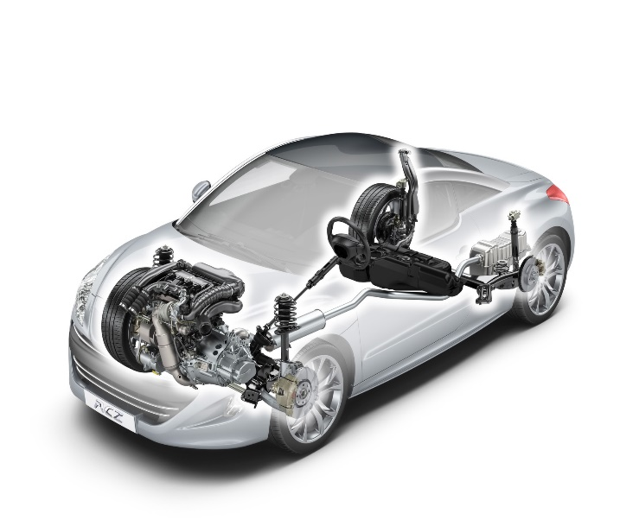
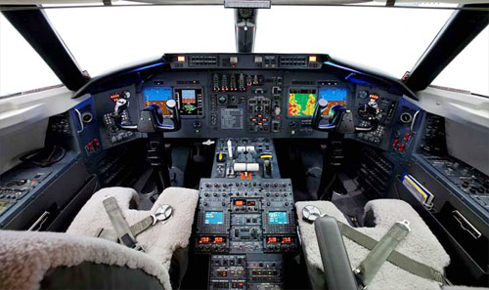
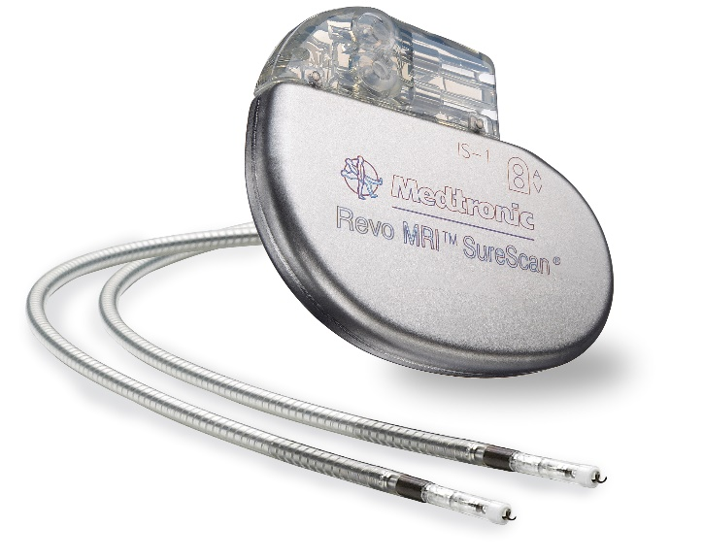
Course Objectives: Formal Methods
Autonomous Systems (Cyber-physical Systems): Physical part + Software
Problems in CPS
Toyota recalled 1.9 Million Prius cars (total cars recalled in 2013 – 20M)
FDA report: Software failure is responsible for 24% of recalls in medical devices (of 2M)
Northeast blackout of 2003 caused due to a race condition
Software testing did not reveal all “bugs” in the system.
Need for verification: consider all possible behaviors of the system.
Notes:
How do you solve these problems? Any ideas?
How do you test your code?

Slide 14
Course Objectives: Formal Methods
Understand the fundamental concepts and principles of formal methods.
Gain insights into the techniques used for verifying the safety and correctness of programs and autonomous systems.
Explore the theoretical foundations of formal methods and their practical applications.
Notes:
Tools
Use those tools to verify
Some theoretical concepts and applications

Slide 15
Course Objectives
Introduction to Formal Methods
Autonomous Systems
Design and Verification of Safe Autonomous Systems
Notes:
Any experience?

Slide 16
Course Objectives: Autonomous Systems
Understand the concept of autonomous systems.
Learn to model autonomous systems for formal analysis.
Learn about different types of models and their inherent properties.
Notes:
Types of models: C code, Math Eq., Automaton

Slide 17
Course Objectives
Introduction to Formal Methods
Autonomous Systems
Design and Verification of Safe Autonomous Systems
Notes:
Any experience?

Slide 18
Course Objectives: Design and Verification of Safe Autonomous Systems
Apply the formal methods introduced in the first part of the course to design and verify autonomous systems.
Explore real-world applications of safe autonomous systems, with a focus on automotive and robotics.
Review research papers related to formal methods in autonomous systems.
Engage in a course project that involves the design, verification, and practical implementation of safe autonomous systems, using knowledge from the course.

Slide 19
Student Learning Outcomes
Being able to understand and use different types of formal modeling of autonomous systems.
Being able to understand and formalize safety and performance for given system in a given application scenario.
Being able to understand and apply formal techniques to prove correctness, and design safe systems.

Slide 20
Topics
Introduction
Formal Methods
Cyber-Physical and Autonomous Systems
Verification of Autonomous Systems

Slide 21
Topics
Introduction
Formal Methods
Cyber-Physical and Autonomous Systems
Verification of Autonomous Systems

Slide 22
Topics: Introduction
Autonomous systems
Notion of trust in deployment of autonomous systems

Slide 23
Topics
Introduction
Formal Methods
Cyber-Physical and Autonomous Systems
Verification of Autonomous Systems

Slide 24
Topics: Formal Methods
Mathematical logic
Verifying correctness of programs
Software testing

Slide 25
Topics
Introduction
Formal Methods
Cyber-Physical and Autonomous Systems
Verification of Autonomous Systems

Slide 26
Topics: Cyber-Physical and Autonomous Systems
Introduction to control theory
Linear systems
Hybrid automata

Slide 27
Topics
Introduction
Formal Methods
Cyber-Physical and Autonomous Systems
Verification of Autonomous Systems

Slide 28
Topics: Verification of Autonomous Systems
Understanding uncertainties
Provable safety verification of autonomous systems
Designing provably safe and performance optimal systems

Slide 29
Grading
Homework: 30%
Paper presentation, and leading class discussion (1-3 papers): 30%
Final project: 30%
Class participation & student’s growth: 10%

Slide 30
Student’s Growth
Identifies the effort being made by a student to understand the concepts being taught, despite their prior backgrounds.
In other words, this can be used identify the efforts being put in by a student even if it is not being reflected in their scores.
Discussing with instructor (especially during office hours) is a good way to demonstrate that.

Slide 31
Late Work Policy
One late assignment will have $0$ (zero) penalty, if submitted within a week of the posted deadline.
Any further late assignments will result in the following deduction scheme: $min⁡( 15×(no−of−days−late),100)$% will be deducted.
In case of emergency (or unforeseen cases), please speak to instructor. The instructor will try his best to accommodate for the situation (subject to proof) in accordance with the university policy.

Slide 32
Final Project: Types
Survey. Extensive survey about the research on a topic of your interest. Not a reading and copy-paste of existing papers. Expected to identify the core of the problem and provide deep insights.
Applications. Pick an application of your interest and verifying it. Might require deploying several techniques and tools. Might lead to interesting theoretical results. The application should be nontrivial and “interesting” enough.
Theory. Identify a theoretical problem (algorithm/property of models) and develop new fundamental solutions. Fairly challenging task. Identifying a “good” candidate solution or proving an “interesting” property suffices.

Slide 33
Final Project: Logistics
Reports: 1-3 reports maybe due before the final report and presentation to share progress with the class.
Presentation: Discussion, debate, comparative analysis.

