Slide 1
Offline and online monitoring of scattered uncertain logs using uncertain linear dynamical systems
1
Authors: Bineet Ghosh¹, Étienne André² FORTE 2022
¹Bineet Ghosh is with the Department of Computer Science, The University of North Carolina at Chapel Hill, USA.
bineet@cs.unc.edu
²Étienne André is with the Université de Lorraine, CNRS, Inria, LORIA, Nancy, France. Etienne.Andre@loria.fr

Slide 2
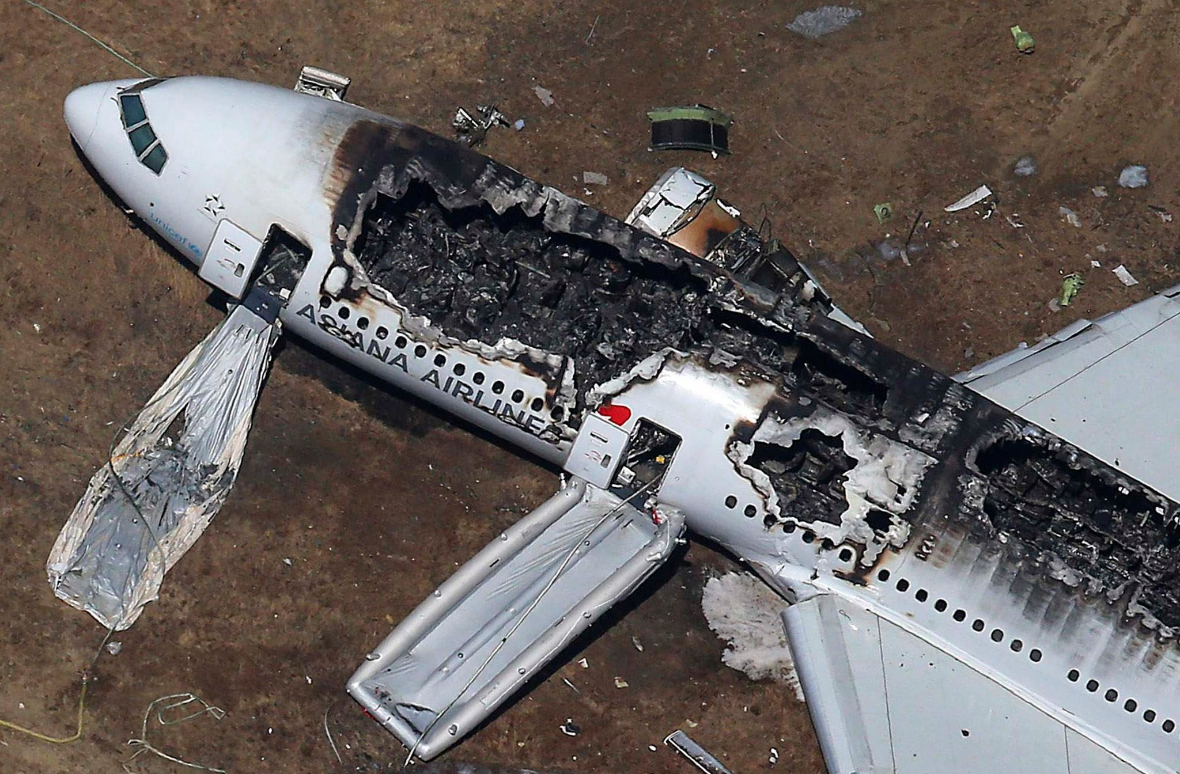
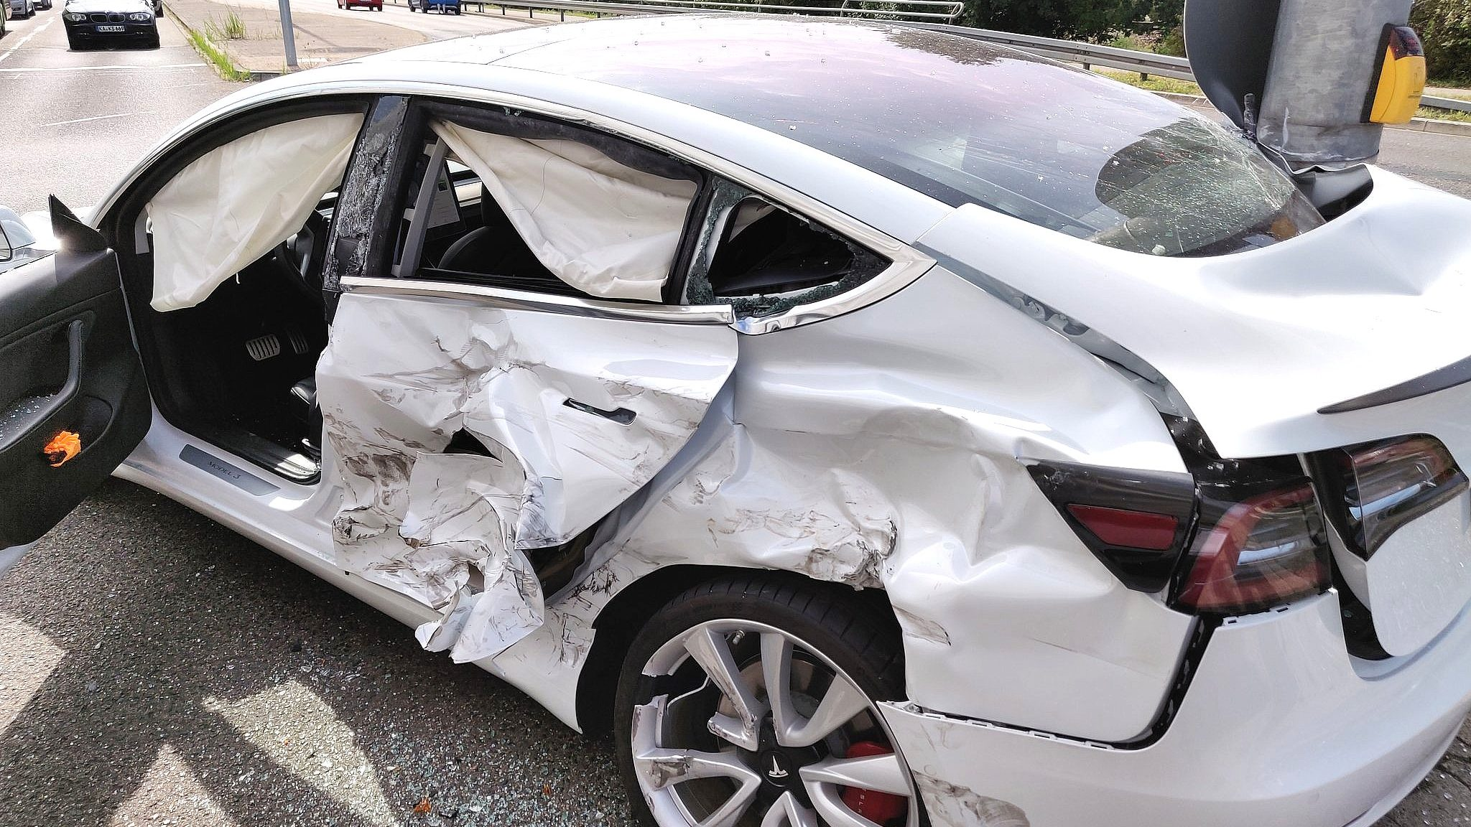
In the Event of a Crash!
2
Cause of the crash?
Who was at fault?

Slide 3
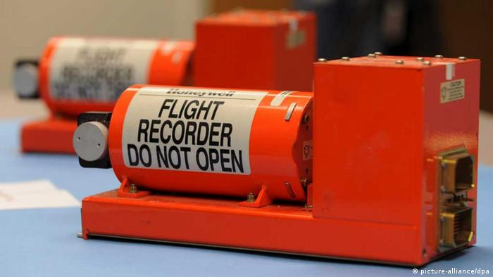
Investigating the Crash
3
Stores information of the vehicle/plane until the time of crash.
Flight Black Box
Detecting safety violation from the stored information.

Slide 4
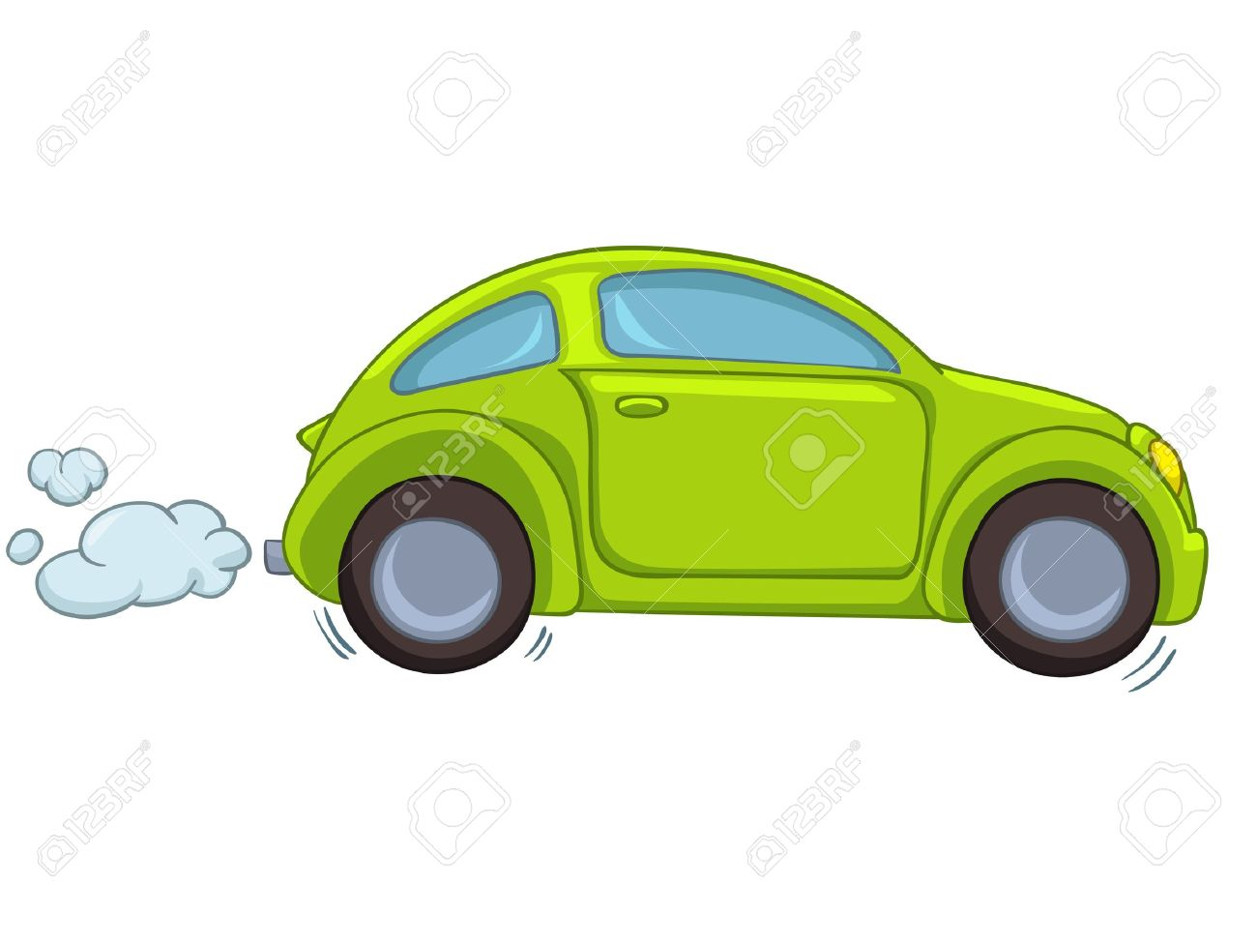
The Stored Information (Logs)
4
Stores the information of the current state of the car
State variable values, represented as Zonotopes.
Logs
$t$=0

Slide 5
The Stored Information (Logs)
5
Represented as Zonotopes
Acceleration with an error range.
$${[a}_{min},a_{max}]$$
$${[v}_{min},v_{max}]$$
Velocity with an error range.
Stored Information
$${[h}_{min},v_{max}]$$
Distance to the lead vehicle.
Stores the information of the current state of the car
State variable values, represented as Zonotopes.
Logs
$t$=0

Slide 6
The Stored Information (Logs)
6
Represented as Zonotopes
Acceleration with an error range.
$${[a}_{min},a_{max}]$$
$${[v}_{min},v_{max}]$$
Velocity with an error range.
$${[h}_{min},v_{max}]$$
Distance to the lead vehicle.
Note: the gathered logs can have added noise—due to sensor errors.
The gathered logs are an over-approximation of the actual states.
Logs
$t$=0

Slide 7
The Stored Information (Logs)
7
$t$=0
$t$=1

Slide 8
The Stored Information (Logs)
8
Not Logged at $t=2$!
$t$=0
$t$=1

Slide 9
The Stored Information (Logs)
9
$t$=0
$t$=1
$t$=3

Slide 10
The Stored Information (Logs)
10
Not Logged at $t=4$!
$t$=0
$t$=1
$t$=3

Slide 11
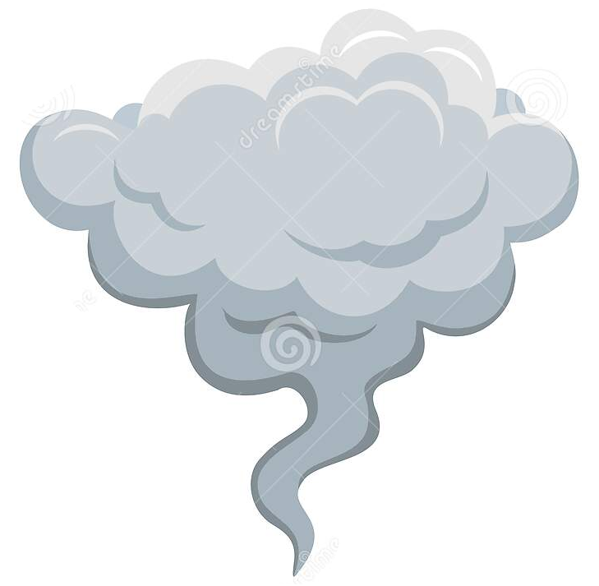
The Stored Information (Logs)
11
Engine breakdown!
$t$=0
$t$=1
$t$=3
$t$=5

Slide 12
The Stored Information (Logs)
12
Engine breakdown!
What caused the engine breakdown?
Need to answer this question from the (noisy) logs.
Was an unsafe maneuver made by the vehicle at time steps with no logs?
$t$=0
$t$=1
$t$=2
$t$=3
$t$=4
$t$=5

Slide 13
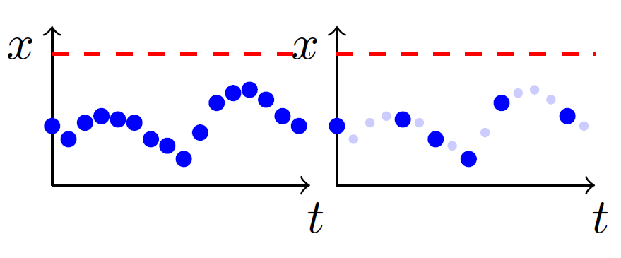
Monitoring: Logs
13
Unsafe region!
Logging at every time step.
Logging at some time steps.
Did the system reach the unsafe region at missing log steps?
Main Idea: Reconstruct the missing logs!

Slide 14
Monitoring: Naïve Approaches
14
Three possible reconstruction of the missing logs.
Green dots represent reconstructed samples.
Blue dots represent the scattered logs.

Slide 15
Monitoring: Naïve Approaches
15
Problems:
Often models the behavior inaccurately!
Can yield a “safe” answer, while the actual system might have been unsafe (unsound).
Reconstructed using piecewise-constant or linear approximation.
Green dots represent reconstructed samples.
Blue dots represent the scattered logs.

Slide 16
Monitoring: Naïve Approaches
16
Reconstructed assuming arbitrary dynamics.
Problems:
Always yields potentially “unsafe”!
Removes interest of monitoring!
Green dots represent reconstructed samples.
Blue dots represent the scattered logs.

Slide 17
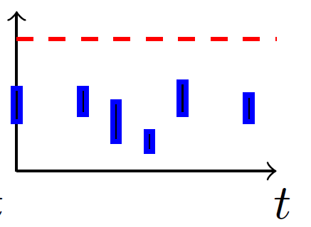
Monitoring: Logs
17
Logging at every time step.
Scattered Logging.
Scattered & Noisy Logging.
Considered in this work.

Slide 18
Monitoring: Proposed Strategy
18
Scattered & Noisy Logs
Reconstruct missing logs using reachability of uncertain linear systems
Safe or Unsafe?
Bounding Model: Over-approximated using Uncertain Linear Systems

Slide 19
Monitoring: Proposed Strategy
19
Scattered & Noisy Logs
Reconstruct missing logs using reachability of uncertain linear systems
Safe or Unsafe?
Bounding Model: Over-approximated using Uncertain Linear Systems
To be introduced next . . .

Slide 20
Bounding Model: A Toy Example
20
$$\begin{matrix}x_{1}^{+} \\ x_{2}^{+}\end{matrix}$$
$$\begin{matrix}1 & θ \\ 0 & 1\end{matrix}$$
$$\begin{matrix}x_{1} \\ x_{2}\end{matrix}$$
“Robust Reachable Set: Accounting for Uncertainties in Linear Dynamical Systems”. Bineet Ghosh and Parasara Sridhar Duggirala. ACM Transactions on Embedded Computing Systems 18.5s (2019).

Slide 21
Bounding Model: A Toy Example
21
$$\begin{matrix}x_{1}^{+} \\ x_{2}^{+}\end{matrix}$$
$$\begin{matrix}1 & θ \\ 0 & 1\end{matrix}$$
$$\begin{matrix}x_{1} \\ x_{2}\end{matrix}$$
Parameter to the system
$$θ∈\left[−0.2,0.2\right]$$
Not a fixed value, but a range
“Robust Reachable Set: Accounting for Uncertainties in Linear Dynamical Systems”. Bineet Ghosh and Parasara Sridhar Duggirala. ACM Transactions on Embedded Computing Systems 18.5s (2019).

Slide 22
Bounding Model: A Toy Example
22
$$θ∈\left[−0.2,0.2\right]$$
$$\begin{matrix}x_{1}^{+} \\ x_{2}^{+}\end{matrix}$$
$$\begin{matrix}1 & θ \\ 0 & 1\end{matrix}$$
$$\begin{matrix}x_{1} \\ x_{2}\end{matrix}$$
A subclass of non-linear systems, known as Uncertain Linear Systems.
Represents an over-approximation of the model, when the perfect model is unknown.
“Robust Reachable Set: Accounting for Uncertainties in Linear Dynamical Systems”. Bineet Ghosh and Parasara Sridhar Duggirala. ACM Transactions on Embedded Computing Systems 18.5s (2019).

Slide 23
In this Work
23
Offline Monitoring of noisy-logs to detect possible safety violation.
Online Monitoring to reduce number of logs required (Sound and Complete). This targets at energy efficiency, as less logs $⇒$ less energy consumed by the logger.
Evaluated both our methods on two case studies, namely Adaptive Cruise Control (ACC), and Anesthesia Delivery.

Slide 24
Offline Monitoring
24
Unsafe Set
$$t+5$$
$$t$$
Two consecutive logs $k$ and $k+1$ gathered at time steps $t$ and $t+5$ respectively.
$$\log_{k+1}{=( , t+5)}$$
Safe Set
$$\log_{k}{=( , t)}$$
Unsafe Set

Slide 25
Offline Monitoring
25
Unsafe Set
$$t+5$$
$$t$$
Main Idea: Check if the reachable set from $\log_{k}$ reaches $\log_{k+1}$ while intersecting the unsafe region.
$$\log_{k+1}{=( , t+5)}$$
Safe Set
$$\log_{k}{=( , t)}$$
Unsafe Set

Slide 26
Offline Monitoring
26
Reachable sets are represented in blue.
Unsafe Set
$$t+1$$
$$t+5$$
$$t$$
$$\log_{k+1}{=( , t+5)}$$
Safe Set
$$\log_{k}{=( , t)}$$
Reachable set at time step $t+1$
Unsafe Set

Slide 27
Offline Monitoring
27
Reachable sets are represented in blue.
Unsafe Region
$$t+2$$
Unsafe Set
$$t+1$$
$$t+5$$
$$t$$
Check if the next sample is reachable from the unsafe region
$$\log_{k+1}{=( , t+5)}$$
Safe Set
$$\log_{k}{=( , t)}$$
Unsafe Set

Slide 28
Offline Monitoring
28
Reachable sets are represented in blue.
Unsafe Region
$$t+2$$
Unsafe Set
$$t+1$$
$$t+5$$
$$t$$
Check if the next sample is reachable from the unsafe region
$$\log_{k+1}{=( , t+5)}$$
Safe Set
$$\log_{k}{=( , t)}$$
If Yes: Potentially Unsafe!
If No: Safe!
Unsafe Set

Slide 29
Online Monitoring
29
Compute this
Given this, when should the next log be obtained? I.e., compute $t′$
$$\log_{k}{=( , t)}$$
$$\log_{k+1}{=( , t′)}$$

Slide 30
Online Monitoring
30
A log at this step is needed!
$$t+4$$
$$t+3$$
$$t+1$$
$$t+2$$
Certainly safe until time step $t+3$. So, any logs, in between, are practically useless.
$$\log_{k}{=( , t)}$$

Slide 31
Case Study: Anesthesia
31
PK
PD
Models the metabolization of the drug by the body.
Models the effect of drug on the body.
1st Peripheral Compartment: $c_{1}$.
2nd Peripheral Compartment: $c_{2}$.
Plasma Compartment: $c_{e}$.
$$c_{e}$$
State variables, modelling concentration levels.
“Benchmark Problem: A PK/PD Model and Safety Constraints for Anesthesia Delivery” Victor Gan, Guy Albert Dumont, and Ian Mitchell. ARCH@CPSWeek 2014 and ARCH@CPSWeek 2015.

Slide 32
Case Study: Anesthesia
32
Given: Logs of a patient.
Task 1: Whether the plasma concertation ($c_{e}$) of the patient violated the safe range at any time?
Task 2: Compare offline and online monitoring.
“Benchmark Problem: A PK/PD Model and Safety Constraints for Anesthesia Delivery” Victor Gan, Guy Albert Dumont, and Ian Mitchell. ARCH@CPSWeek 2014 and ARCH@CPSWeek 2015.

Slide 33
Case Study: Anesthesia
33
Black: Scattered & noisy logs given as input.
Blue: Computed Reachable Sets
“Benchmark Problem: A PK/PD Model and Safety Constraints for Anesthesia Delivery” Victor Gan, Guy Albert Dumont, and Ian Mitchell. ARCH@CPSWeek 2014 and ARCH@CPSWeek 2015.

Slide 34
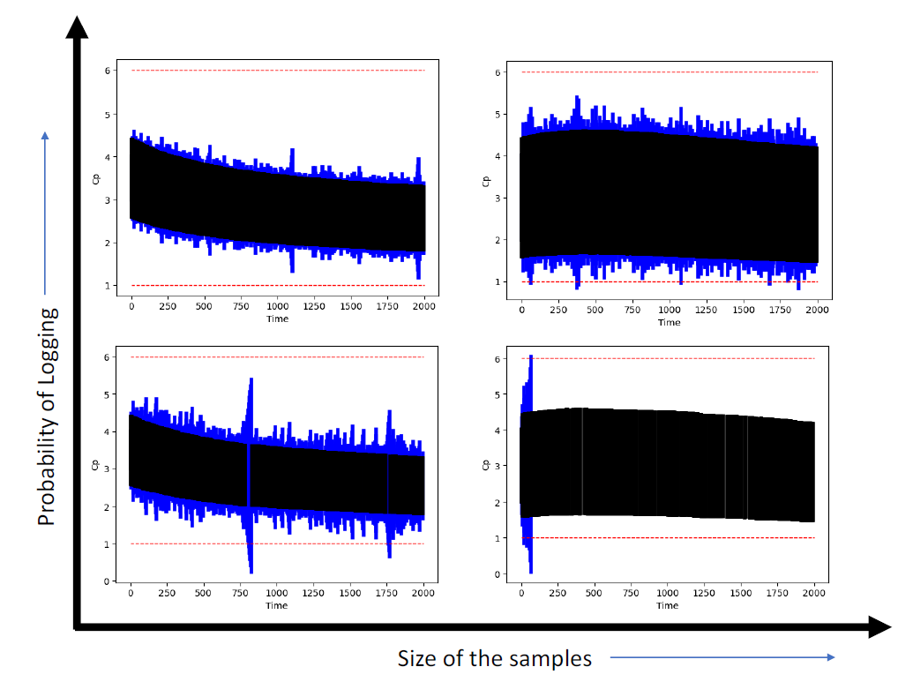
Case Study: Anesthesia (Offline Monitoring)
34
Safe!
Safe!
Increasing the probability of logging results in less false alarms.
Increasing the noise in the logs results in more false alarms.
Safe!
Unsafe!

Slide 35
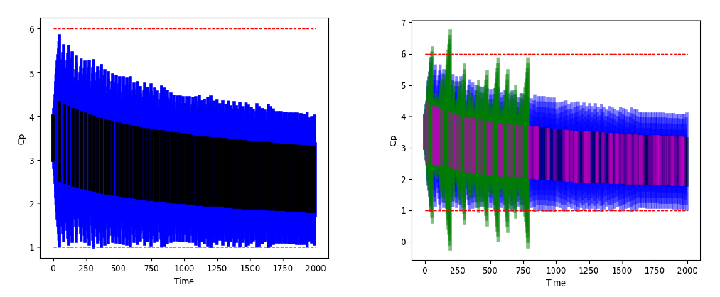
Case Study: Anesthesia (Online Monitoring)
35
Green: Reach set computed by offline monitoring.
Purple: Logs given to the offline monitoring
Proved safety using just 5% logs of the total time steps.
The offline monitoring raised false alarm at 35th log (out of 115), whereas online monitoring proved safety using just 84 logs!

Slide 36
Conclusion
36
We present online and offline monitoring approaches.
The offline approach monitors noisy and scattered logs for safety, assuming a bounding model.
The online approach aims at energy efficiency, only logging when required.
Future work: What happens when the log timestamps are uncertain too?

Slide 37
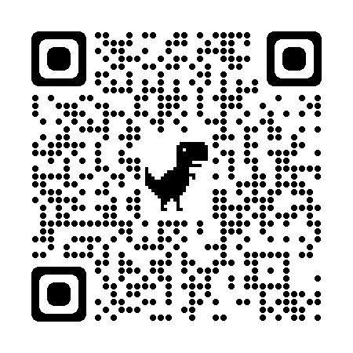
37
Scan this QR code on your phone
The open-source tool is available at: github.com/bineet-coderep/MoULDyS
Thank You!

