Slide 1


Probabilistic Safety Verification of Autonomous Systems: A Statistical Approach for Monitoring
Bineet Ghosh¹ Étienne André²
FORTE 2025
¹Bineet Ghosh is with the Department of Computer Science, The University of Alabama, USA.
bineet@ua.edu
²Étienne André is with the Université Sorbonne Paris Nord, LIPN, CNRS UMR 7030, Villetaneuse, France and a member of Institut universitaire de France.
etienne.andre@lipn.univ-paris13.fr

Slide 2


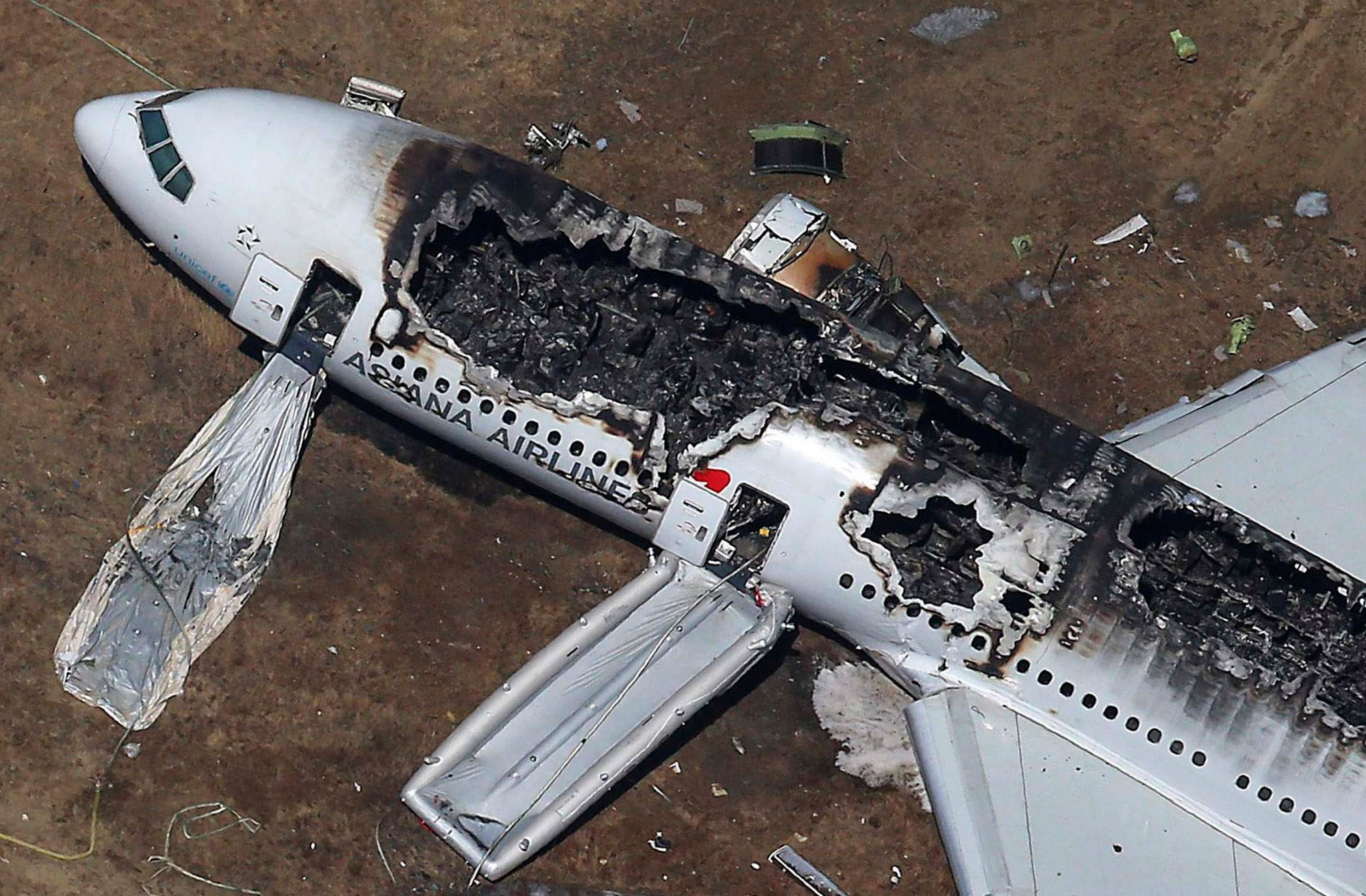
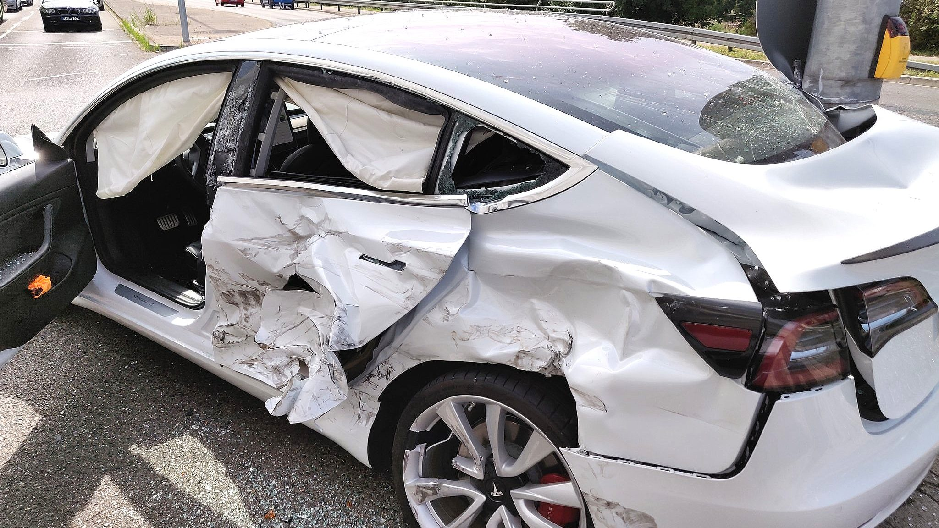
In the Event of a Crash!
Cause of the crash?
Who was at fault?

Slide 3
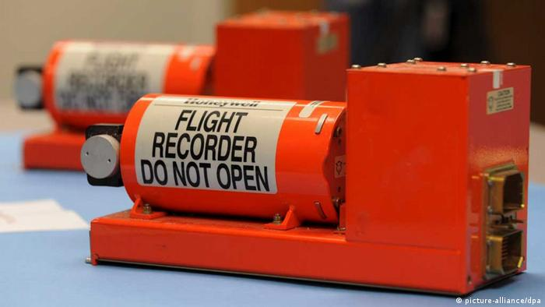
Investigating the Crash
Stores information of the vehicle/plane until the time of crash.
Flight Black Box
Detecting safety violation from the stored information.
Notes:
* Typically stores: states of the system, the control inputs, sensor data etc.

Slide 4
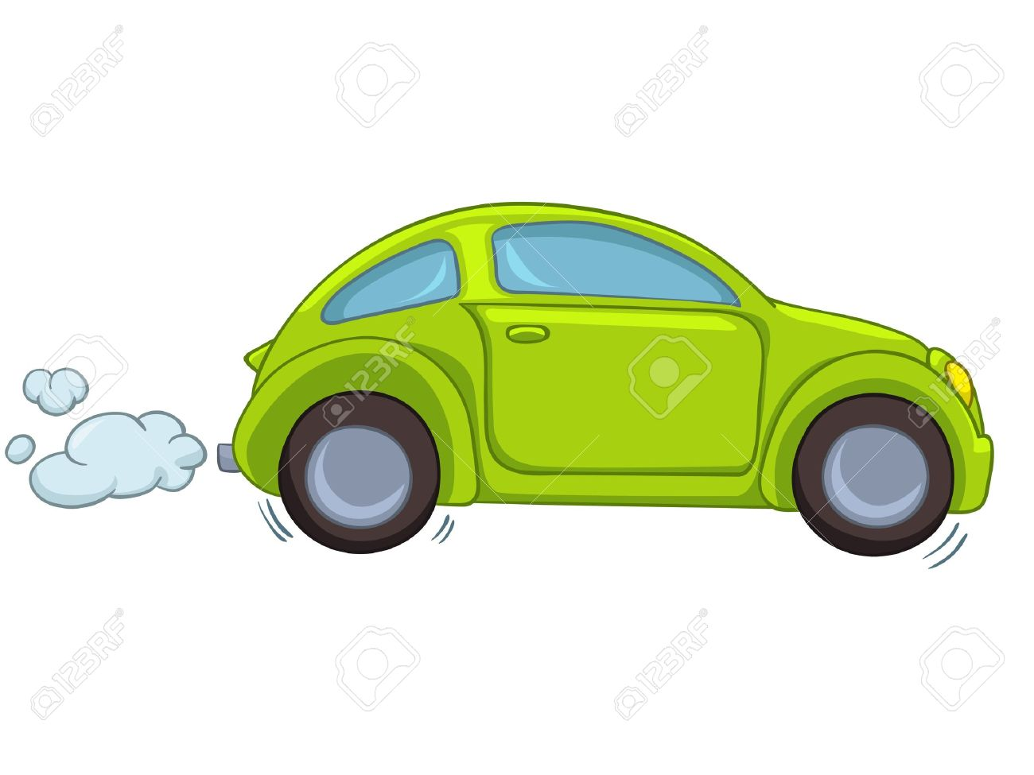

The Stored Information (Logs)
Stores the information of the current state of the car
Logs
$t$=0
Notes:
* Consider this toy example of a vehicle that is about to experience an engine breakdown

Slide 5



The Stored Information (Logs)
Acceleration with an error range.
$${[a}_{min},a_{max}]$$
$${[v}_{min},v_{max}]$$
Velocity with an error range.
Stored Information
$${[h}_{min},v_{max}]$$
Distance to the lead vehicle.
Stores the information of the current state of the car
Logs
$t$=0
Notes:
* Real world sensors are not perfect - they typically have errors associated with them

Slide 6
The Stored Information (Logs)
Acceleration with an error range.
$${[a}_{min},a_{max}]$$
$${[v}_{min},v_{max}]$$
Velocity with an error range.
$${[h}_{min},v_{max}]$$
Distance to the lead vehicle.
Note: the gathered logs can have added noise—due to sensor errors.
The gathered logs are an over-approximation of the actual states.
Logs
$t$=0
Notes:
So it certainly contains the actual state – with some extra added noise around it

Slide 7

The Stored Information (Logs)
$t$=0
$t$=1

Slide 8
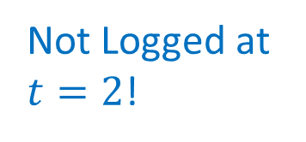
The Stored Information (Logs)
Not Logged at $t=2$!
$t$=0
$t$=1
Notes:
* This could be due to energy saving policies, sensor failure, etc.

Slide 9

The Stored Information (Logs)
$t$=0
$t$=1
$t$=3

Slide 10
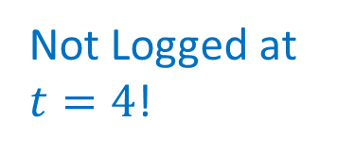
The Stored Information (Logs)
Not Logged at $t=4$!
$t$=0
$t$=1
$t$=3

Slide 11
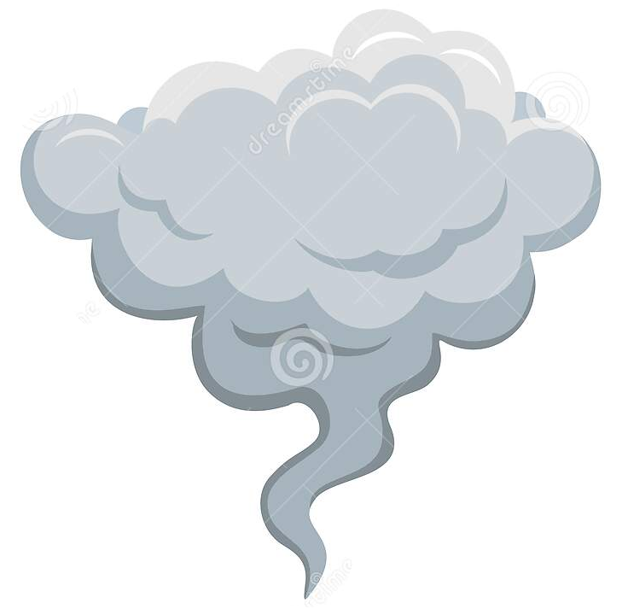

The Stored Information (Logs)
Engine breakdown!
$t$=0
$t$=1
$t$=3
$t$=5

Slide 12


The Stored Information (Logs)
Engine breakdown!
What caused the engine breakdown?
Need to answer this question from the (noisy) logs.
Was an unsafe maneuver made by the vehicle at time steps with no logs?
$t$=0
$t$=1
$t$=2
$t$=3
$t$=4
$t$=5

Slide 13
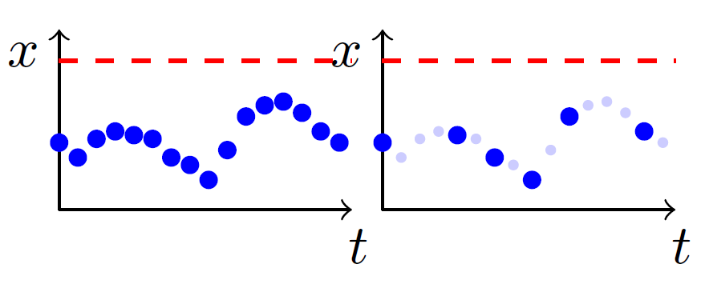
Monitoring: Logs
Unsafe region!
Logging at every time step.
Logging at some time steps.
Did the system reach the unsafe region at missing log steps?
Main Idea: Reconstruct the missing logs!
Notes:
* Consider this example of logging, where x axis is time, and y axis is the value of a state variable x. The dark blue dots are the gathered logs, and the light blue dots are missing logs.

Slide 14
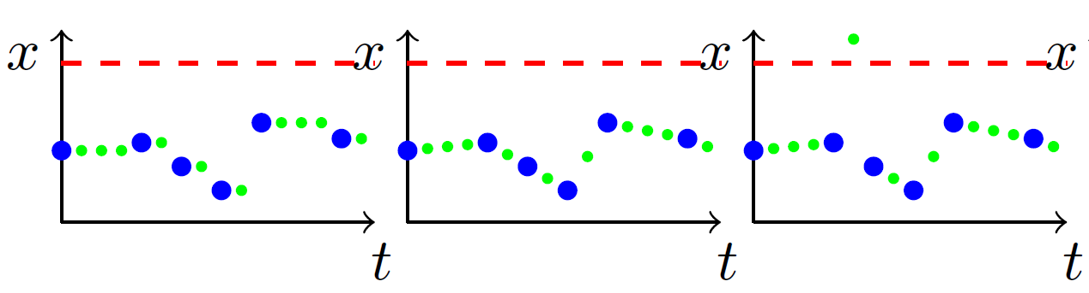
Monitoring: Naïve Approaches
Three possible reconstruction of the missing logs.
Green dots represent reconstructed samples.
Blue dots represent the scattered logs.

Slide 15
Monitoring: Naïve Approaches
Problems:
Often models the behavior inaccurately!
Can yield a “safe” answer, while the actual system might have been unsafe (unsound).
Reconstructed using piecewise-constant or linear approximation.
Green dots represent reconstructed samples.
Blue dots represent the scattered logs.

Slide 16
Monitoring: Naïve Approaches
Reconstructed assuming arbitrary dynamics.
Problems:
Always yields potentially “unsafe”!
Removes interest of monitoring!
Green dots represent reconstructed samples.
Blue dots represent the scattered logs.

Slide 17
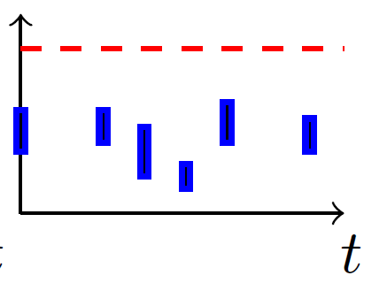
Monitoring: Logs
Logging at every time step.
Scattered Logging.
Scattered & Noisy Logging.
Considered in this work.
Notes:
Note: in both these examples, the gathered logs are exact. I.e., at every time step, the exact values of the state variable is gathered.
But it in reality, this can seldom be the case, as the sensors used for gathering data are noisy. So as a result, what we have is a range of values instead of an exact value.

Slide 18
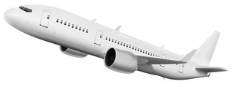
Monitoring: Main Challenge
Main Idea: Reconstruct the missing logs!
“Formal” Model of the System’s Behavior?
Operation
Complex – thus making formal techniques unscalable.
Unavailable – for complex components such DNNs and Simulink models.
Unsafe region
Logging at some time steps.
Notes:
Once the AS is in operation, it will gather some scattered and noisy logs
Now recall, the main idea is to reconstruct the missing logs. That is the behaviors, between the blue bars here.
Now to reconstruct the behavior between to blue bars, one needs to consider all possible behaviors, that typically represented as reachable sets. Represnted by the blue pipes
Now to compute such reachable sets, one needs to have a formal model of the system behavior.
For real world systems, these formal models are extremely complex……

Slide 19
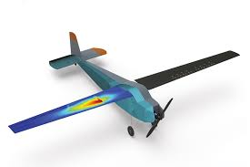
Monitoring: Main Challenge
Main Idea: Reconstruct the missing logs!
In this Work!
Operation
Unsafe region
I/O Execution Model
Digital replica of the actual system.
Generates random trajectories/behaviors from an initial state
Logging at some time steps.
No Formal Model Needed!
Notes:
In contrast, in this work, we consider…..

Slide 20
Monitoring: Main Idea
I/O Execution Model
Operation
Using
Step 1: Create random trajectories from the log
Unsafe region
These trajectories recreate potential behaviors of the system from the log
Log
Notes:
Let us go through the main idea of the monitoring approach proposed in our work
It is worth noting, that between every possible logs, we are generating random trajectories, and not pipes of reachable unlike what we saw in our last slide.

Slide 21
Monitoring: Main Idea
I/O Execution Model
Operation
Step 2: Check safety
Unsafe region
System Safe: If all the random trajectories are safe
System Unsafe: If an unsafe trajectory is found
Log
Concrete counterexample/behavior violating safety property

Slide 22


Monitoring: Main Idea
I/O Execution Model
Operation
But!
How many such random trajectories do we need to check?
Unsafe region
Clearly, there are infinitely many such trajectories
Ans: Only $K$ trajectories!
$K$ computed using statistical hypothesis testing
Still Sound?
Yes, with high probabilistic guarantees!
Safe for practical purposes, suitable for complex systems
Log
Notes:
* As we saw, we simply generating trajectories between the logs, and not pipes. That is, these trajectories represent only one possible behavior, and not all possible behaviors.

Slide 23
Monitoring: Main Idea
I/O Execution Model
Operation
Driving Philosophy!
Unsafe region
Make Autonomous Systems Trustworthy!
Safe for practical purposes with a high level of confidence
Trades of Formal Guarantees, with Statistical Guarantees.
Log

Slide 24
Monitoring: Main Idea
I/O Execution Model
Operation
Driving Philosophy!
Unsafe region
Make Autonomous Systems Trustworthy!
Safe for practical purposes with a high level of confidence
Trades of Formal Guarantees, with Statistical Guarantees.
Unscalable or unavailable for complex systems with DNN, Simulink or black box based components
Log

Slide 25
Monitoring: Main Idea
I/O Execution Model
Operation
Driving Philosophy!
Unsafe region
Make Autonomous Systems Trustworthy!
Safe for practical purposes with a high level of confidence
Trades of Formal Guarantees, with Statistical Guarantees.
Efficient for complex systems, and provides high confidence safety guarantees for practical purposes
Log

Slide 26
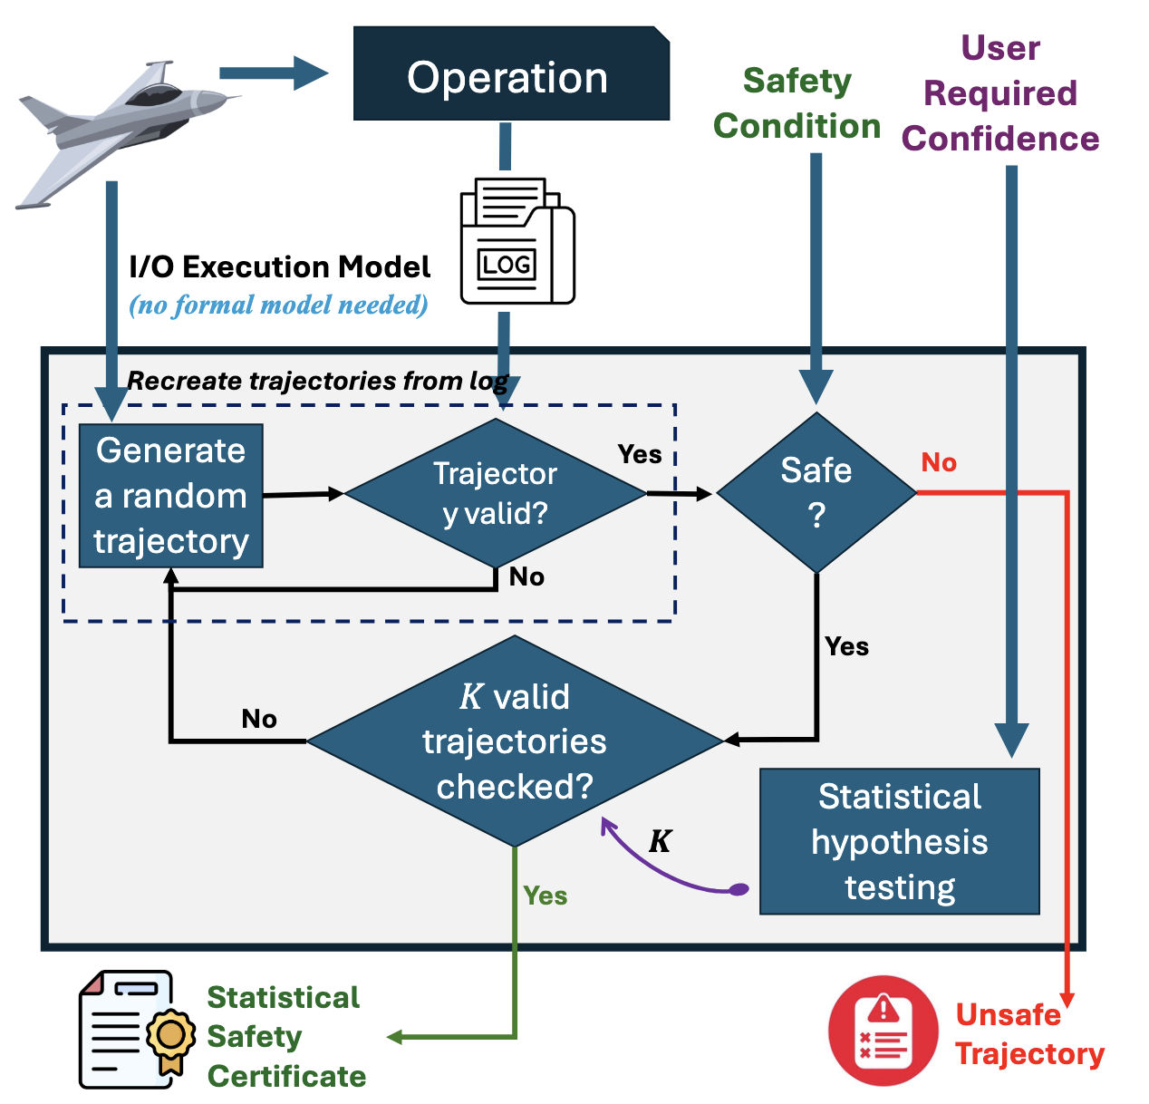
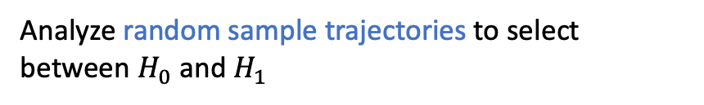
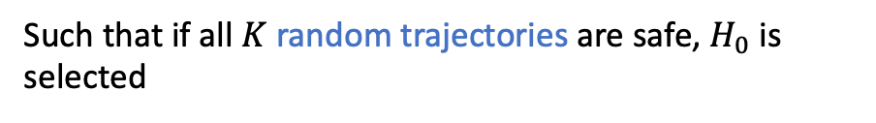


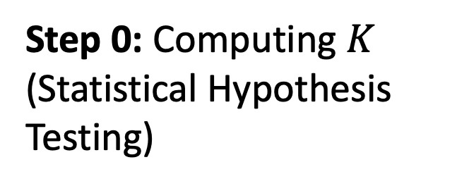

Monitoring: Overview
Step 0: Computing $K$ (Statistical Hypothesis Testing)
Formulate hypothesis
$$c∈\left(0,1\right)$$
$$H_{0}:Prob\left[random trajectory is safe\right]≥c$$
$$H_{1}:Prob\left[random trajectory is safe\right]<c$$
Hypothesis Selection
Analyze random sample trajectories to select between $H_{0}$ and $H_{1}$
Note: $H_{0}$ denotes the system is safe
Compute $K$
Such that if all $K$ random trajectories are safe, $H_{0}$ is selected
Such a closed form can be obtained based on $c$
Notes:
* Now let us go through the overview of the approach.

Slide 27
Monitoring: Overview
Step 1: Create random trajectories from the log
Valid Trajectory?
I/O Execution Model
Not intersecting all logs
Such a behavior was never witnessed during its execution
Unsafe region
Log

Slide 28
Monitoring: Overview
Step 1: Create random trajectories from the log
Valid Trajectory?
I/O Execution Model
Intersecting all logs
Such a behavior was witnessed during its execution
Unsafe region
Log

Slide 29
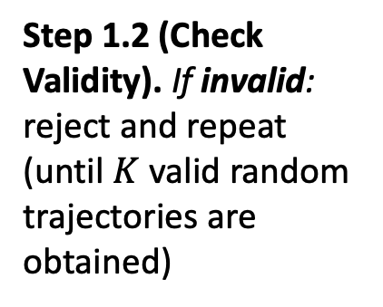

Monitoring: Overview
Step 1: Create random trajectories from the log
Generate $K$ valid random trajectories?
I/O Execution Model
Step 1.1. Generate a random trajectory with the first log-sample as initial set
Unsafe region
Step 1.2 (Check Validity). If invalid: reject and repeat (until $K$ valid random trajectories are obtained)
Log

Slide 30
Monitoring: Overview
Step 1: Create random trajectories from the log
Generate $K$ valid random trajectories?
I/O Execution Model
Step 1.1. Generate a random trajectory with the first log-sample as initial set
Unsafe region
Step 1.2 (Check Validity). If valid: proceed to next step
Log

Slide 31
Monitoring: Overview
Step 2: Check safety
If unsafe. Return as a concrete counterexample
I/O Execution Model
Process ends. System unsafe, with concrete counterexample.
Unsafe region
Log

Slide 32
Monitoring: Overview
Step 2: Check safety
If safe. Proceed to next step.
I/O Execution Model
Unsafe region
Log

Slide 33
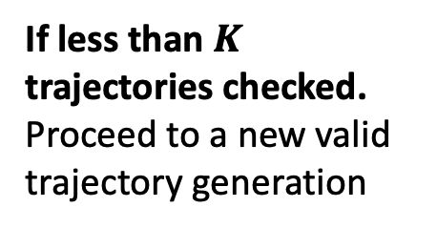
Monitoring: Overview
Step 3: How many trajectories checked?
If less than $K$ trajectories checked. Proceed to a new valid trajectory generation
I/O Execution Model
Unsafe region
Log

Slide 34
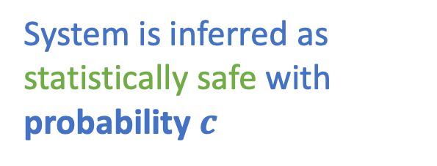
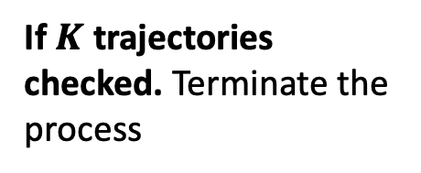
Monitoring: Overview
Step 3: How many trajectories checked?
If $K$ trajectories checked. Terminate the process
I/O Execution Model
System is inferred as statistically safe with probability $c$
Unsafe region
Log

Slide 35
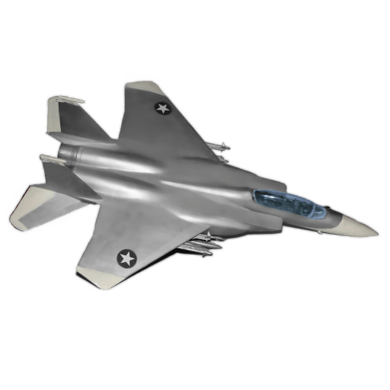


Case Study: Jet Model
To evaluate our approach under realistic jet engine dynamics in no-stall mode.
Dynamics
State Variables
$$x=X−1$$
Mass flow
$$y=Y−Y_{co}−2$$
Jet engine dynamics based on the Moore-Greitzer model
Operates in no-stall mode with stabilizing feedback control
Constant
Pressure rise

Slide 36


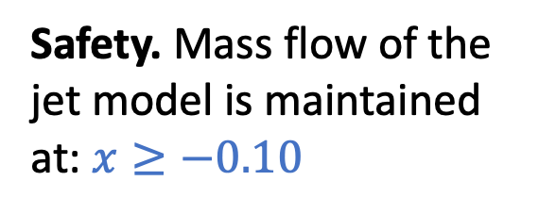

Case Study: Jet Model
To evaluate a safety monitoring approach under realistic jet engine dynamics in no-stall mode.
Dynamics
Safety. Mass flow of the jet model is maintained at: $x≥−0.10$
State Variables
Operation
$$x=X−1+ε_{x}$$
$$y=Y−Y_{co}−2+ε_{y}$$
Safe?
Imagine a crash scenario where the only available data for analysis is the log recorded by the jet prior to the crash

Slide 37
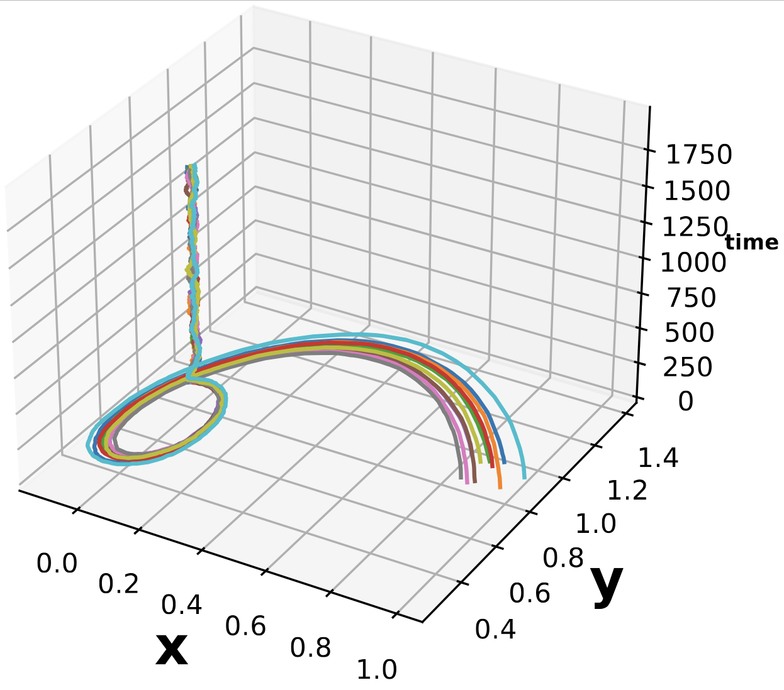
Jet Model: Random Behaviors

Slide 38
Jet Model: Monitoring Tasks
Given: Log of the jet
Task 1: Impact of logging frequency (number of records in the log) on safety inference.
Task 2: Impact of uncertainty (in log records) on safety inference.
Number of records
Amount of uncertainty

Slide 39
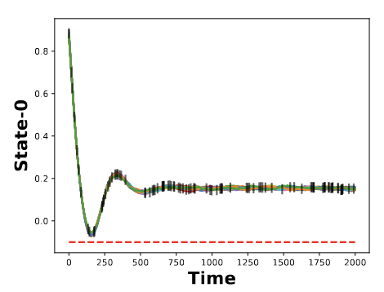
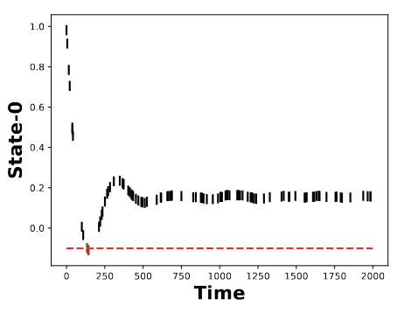
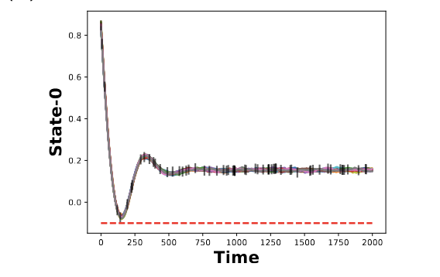
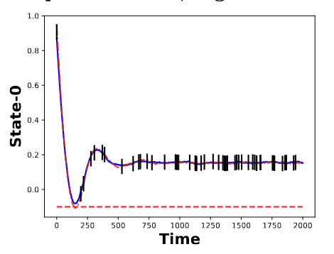

Jet Model: Results
Black: Log records
Red dotted: Safety constraint
Colored Lines: Random trajectories
$$c=0.99$$
Unsafe!
Safe!
Increasing Uncertainty. Increased chances of finding a counterexample.
Increasing Logging Frequency. No significant impact.
Logging frequency
Safe!
Unsafe!
Uncertainty

Slide 40
Conclusion
Trades-off formal safety guarantees with high-confidence probabilistic assurances
Trustworthy monitoring suitable for most practical applications
SHT-based framework to detect safety violations from a log with noisy and missing records
Successfully monitored non-linear and DNN benchmarks in under 250 seconds

Slide 41


Artifact Evaluated Tool: Posto
Scan this QR code on your phone
Thank You!
github.com/bineet-coderep/posto

